Slide 1

First Nations Leadership in Impact Assessment and Climate Action
2024 Special Chiefs Assembly
Dialogue Session
December 2, 2024

Slide 2

Overview
Current AFN Impact Assessment Mandate
Impact Assessment Act and key First Nation Provisions
Supreme Court of Canada Opinion and Amendments
Project List Review and AFN Recommendations
Co-administration of Federal Impact Assessment and AFN Recommendations
First Nation-led Assessments
Regional Assessments
Draft Resolution 04/2024: First Nations Leadership in Impact Assessment
Climate Action Update
Draft Resolution 39/2024: Reaffirming Support for the Joint Committee on Climate Action

Slide 3
AFN Mandate – Impact Assessment
Call on Canada to ensure that regulatory and policy development fully respects the constitutional and other legal obligations of the Crown to First Nations and standards set by the United Nations Declaration on the Rights of Indigenous Peoples (Resolution 69/2018).
Call on Canada to engage in focused dialogue with First Nations to substantively identify, recognize, and engage the protocols, elements, and processes to conduct joint regulatory and policy drafting (Resolutions 69/2018, 06/2019).
Advocate for adequate funding directly to First Nations for their full and effective participation (Resolutions 73/2017, 07/2018, 69/2018, 06/2019).

Slide 4
Key First Nation Provisions in the Impact Assessment Act
Mandatory consideration of the impacts of a project on Indigenous rights both as part of the assessment and at the decision-making stage;
Mandatory consideration and protection of Indigenous knowledge;
Recognition of Indigenous governing bodies as “jurisdictions”;
New opportunities for Indigenous led assessments;
Prohibition on designated projects proceeding without approval under the Impact Assessment Act if they will have effects on Indigenous rights or interests; and
Mandatory establishment of an Indigenous Advisory Committee.
Notes:
The Impact Assessment Act entered into force in August 2019. It repealed and replaced the Canadian Environmental Assessment Act, 2012.
The Impact Assessment Act outlines a process for assessing the impacts of major projects.
First Nations participated actively in the law and policy development processes for the Impact Assessment Act.

Slide 5
AFN Recommendations on IAA Amendments
Seek opportunities to operationalize the UN Declaration;
Uphold Inherent Title, Aboriginal and Treaty rights;
Strengthen reference to First Nations’ ‘decision-making’ in the context of Indigenous Co-Administration;
Avoid a restrictive understanding of “effects within federal jurisdiction”;
Strengthen references to Indigenous knowledge;
Protect Indigenous knowledge systems and confidentiality (non-public disclosure);
Defer to First Nations’ designation requests and ensure First Nations participation in designation decisions; and
Do not substitute for assessments with lesser standards.
Notes:
On October 13, 2023, the Supreme Court of Canada issued a split opinion finding that the majority of the Impact Assessment Act is unconstitutional.
The Supreme Court of Canada found the Impact Assessment Act to be unconstitutional for two overarching reasons:
The “pith and substance” (i.e., the main purpose of the legislation) is not directed at regulating effects within federal jurisdiction; and
The scope of the defined term “effects within federal jurisdiction” does not align with federal legislative jurisdiction.
Government of Canada developed a package of amendments proposed in the Budget Implementation Act, 2024. AFN appeared at Senate Environment Committee.
The Government made amendments that can be categorized into two types: amendments to “fix” the issues identified by the SCC and amendments to make IAA more “efficient.”
Amendments were made to the following content in the IAA:
Project Designation;
Screening Decision;
Public Interest Decision;
Definition of Federal Effects;
Cooperative Federalism.
These amendments received Royal Assent on June 20, 2024.

Slide 6
5 Year Review of the Project List
Existing Project List has 61 entries across 10 sectors.
Project List uses a criteria-based approach that only captures projects with the “greatest potential for adverse effects in areas of federal jurisdiction related to the environment.”
Production capacity and other thresholds encourage “project splitting” to avoid federal IA and may not capture the unique impacts of projects on First Nations.
Reduced scope of projects subject to federal assessment compared to Canadian Environmental Assessment Act, 2012.
IAAC’s lens for review is “regulatory efficiency” but does not include an analysis of impact to First Nations Inherent and/or constitutionally protected rights or title.
Notes:
61 entries across 10 different sectors:
National parks and protected areas;
Defense;
Mines and mills;
Nuclear facilities;
Oil and gas;
Transmission lines and pipelines;
Renewable energy;
Transportation;
Hazardous waste;
Water projects.
Thresholds for each project category identify “production capacity” or other size metric. A project must be above threshold to be designated for a federal impact assessment.

Slide 7
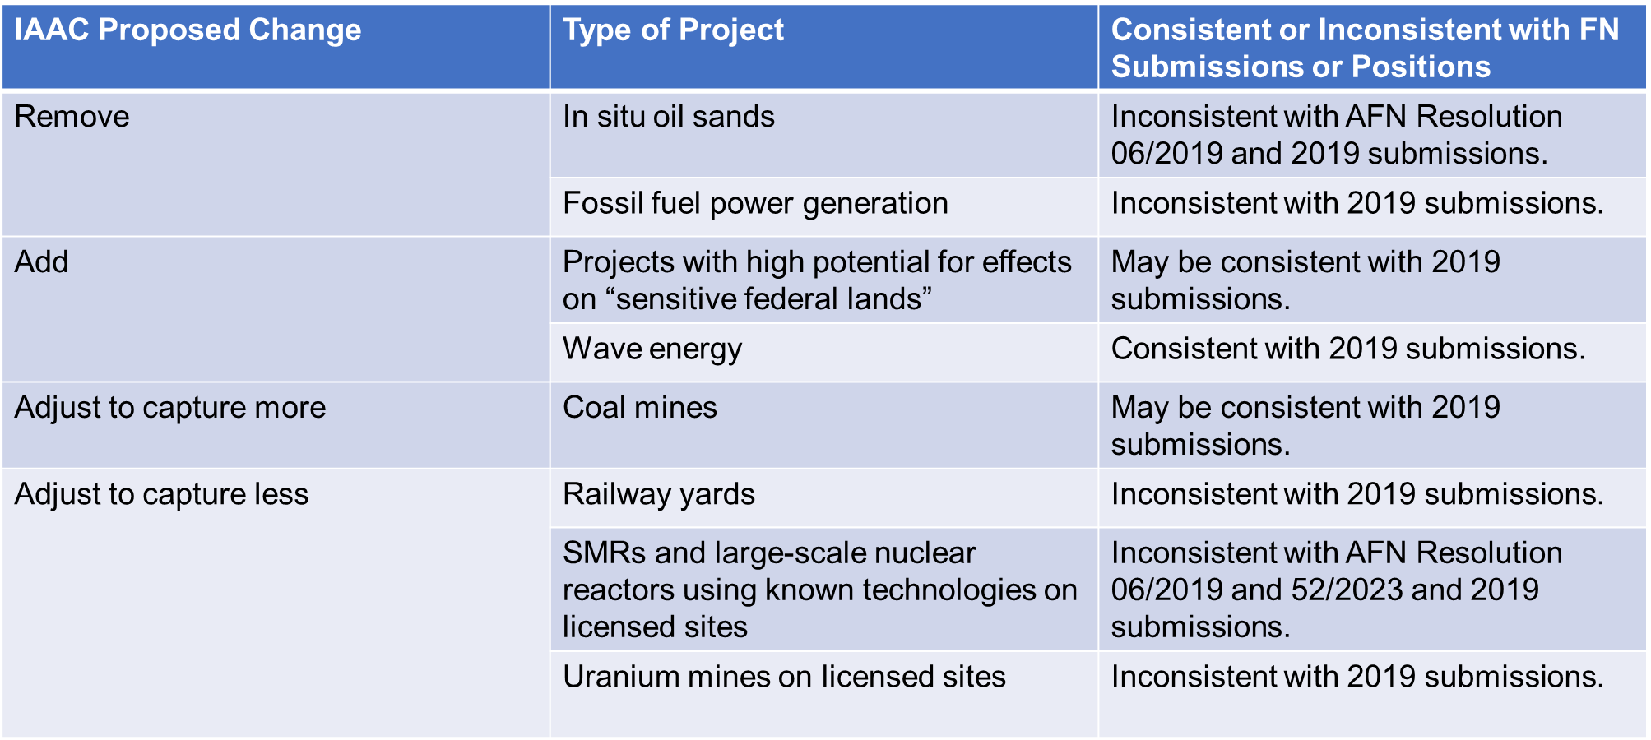
5 Year Review of the Project List

Slide 8
AFN Recommendations on Project List
Assess for consistency with UN Declaration;
Employ Rights lens for the review;
In situ oil sands operations – consult with First Nations in the region;
Do not remove SMRs and other nuclear projects – adopt amendment;
Proceed with lowering thresholds for coal mines;
Mandatory consideration of effects on First Nations, with active and involved participation of First Nations;
Designation requests from First Nations inform changes.

Slide 9
Indigenous Co-Administration of federal IA
IAA at s. 114 empowers co-administration agreements but a regulation is required.
Co-administration agreements would be optional, and the AFN would not be involved in negotiating individual agreements.
The opportunity to co-administer an assessment, or part of an assessment, would be limited to the framework set out in the IAA.
First Nations would not necessarily be able to apply their own processes, unless they met the requirements of the IAA.
Notes:
Modern Treaty and Self-Governing First Nations may have authorities related to RAs. Other First Nations could be recognized as a jurisdiction under the IAA and be a formal signatory to an RA if they enter into a Co-Administration Agreement.

Slide 10
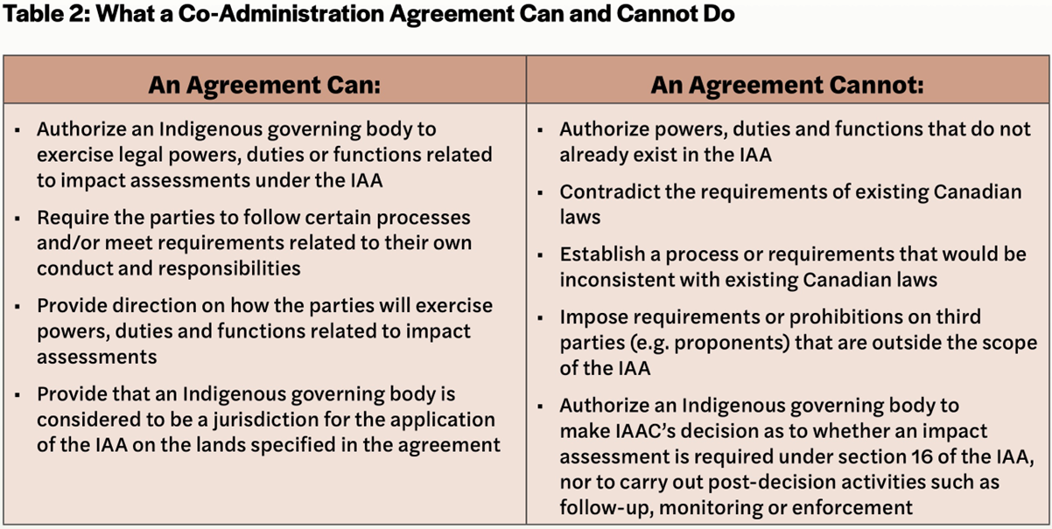
What a Co-Administration Agreement Can and Cannot Do

Slide 11
AFN Recommendations on ICA Regulation and Policy Approach
UN Declaration guide ICA regulation(s) and policy approach;
Proceed with enabling regulations that empower the full scope of duties, powers and functions;
Support true First Nation-led assessments in parallel;
Advisory body on eligibility and readiness must remain advisory and include regional and Treaty representation (i.e. Numbered Treaties distinct from Modern Treaties);
IAAC cover Indigenous Governing Body liability and litigation costs;
Integrate First Nation decision making into designation decisions;
Flexible approach to increase responsibilities with increasing capacity;

Slide 12
AFN Recommendations on ICA Regulation and Policy Approach (Continued)
Include First Nations in inter-governmental policy dialogue;
Facilitate access to federal resources (i.e. scientists, technicians and subject-matter experts);
Include final determinations as powers that could be exercised by an Indigenous Governing Body;
Support First Nations capacity building;
Include post-decision phase authorities;
Clarify how duty to consult will be satisfied when Indigenous Governing Body is co-administering federal impact assessment; and
Shared decision making as foundational to policy development.

Slide 13
First Nation-led Assessments
Growing number of First Nation led assessments.
  Assessments conducted pursuant to First Nations laws and protocols; different than First Nation co-administration of federal IAA.
Can inform whether a community provides or withholds FPIC.
IAA requires the federal impact assessment to consider First Nation led assessment along with other factors.
Outstanding issue is adequate funding.
  IAAC has indicated there is some funding available for “pilot projects” in First Nation led assessment on an ad hoc basis.

Slide 14
Draft Resolution 04/2024, First Nations Leadership in Impact Assessment
THEREFORE BE IT RESOLVED that the First Nations-in-Assembly:
Urge the Government of Canada to implement the changes proposed by First Nations in their calls for improvements to the Project List in order to ensure that projects that may impact First Nations rights, title, and jurisdiction, including, but not limited to, in situ oil sands projects and small nuclear reactors, remain subject to federal impact assessment under the Impact Assessment Act (IAA).
Call on the Government of Canada to, in partnership with First Nations, amend the IAA to bring it in line with the minimum standards articulated in the United Nations Declaration on the Rights of Indigenous Peoples (UN Declaration).

Slide 15
Draft Resolution 04/2024, First Nations Leadership in Impact Assessment
Call on the Government of Canada, in the implementation of the IAA to:
  Uphold its commitments under the UN Declaration;
  Utilize joint development processes to strengthen consultation and collaboration with First Nations for any future regulatory or policy development under the IAA;
  Ensure that any future amendments, regulations or policies maintain or enhance the existing protections and opportunities for First Nations in federal impact assessment;
  Promptly adopt Indigenous Co-Administration Agreement Regulations to enable the negotiation of co-administration agreements with those First Nations who wish to pursue them;
  Prioritize capacity support for First Nations and allocate a specific funding envelope to support First Nation-led impact assessments;
  Recognize, respect, implement and enforce First Nation-led impact assessments where First Nations have taken self-determined action to adopt and apply their own process;
  Ensure that the requirement to conduct a federal impact assessment is maintained for all major projects that have the potential to impact the rights and interests of First Nations, including those projects that are deemed to be “clean” or “green” or necessary for the transition to net-zero energy; and
  Provide adequate funding directly to First Nations to support their full, direct, and unfettered participation in joint regulatory and policy drafting processes under the IAA.

Slide 16
Draft Resolution 04/2024, First Nations Leadership in Impact Assessment
Call on the Assembly of First Nations to:
  Share information and facilitate dialogue with First Nations to support joint development of regulations and policies related to federal impact assessment;
  Convene a community of practice with First Nations leaders, technicians, representatives, academics, and practitioners with experience in First Nation-led impact assessment to share experiences and lessons in First Nation led impact assessment;
  Develop a toolkit to support First Nations in their work to adopt their own impact assessment procedures, processes, and requirements, while building on existing First Nations-led toolkits; and
  Advocate for the maintenance, as a baseline, of the protections and opportunities for collaboration afforded to First Nations in the current version of the IAA and amendment that any changes in law, policy or regulation are as strong or stronger than the current protections for the rights and interests of First Nations.

Slide 17
Climate Action Update

Slide 18
Draft Resolution 39/2024, Reaffirming Support for the Joint Committee on Climate Action
THEREFORE BE IT RESOLVED that the First Nations-in-Assembly:
Call on the Prime Minister and National Chief of the Assembly of First Nations (AFN) to consider the recommendations in the Annual Reports of the Joint Committee on Climate Action (JCCA) as the basis for joint AFN-Canada climate action, with proposed biennial meetings to review progress.
Direct the AFN to ensure discussions at the JCCA reflect the priorities set out in the AFN National Climate Strategy, as well as those identified by First Nations by way of resolution.
Call on the Government of Canada to commit to fully implementing and funding the recommendations identified within the First Nations Climate Leadership Agenda (FNCLA), including regional-specific recommendations.
Call on the Government of Canada to ensure that discussions from the JCCA, as well as from First Nations rights- and title-holders, are mainstreamed across all federal departments working on climate change related work, including the development of new policy and regulatory guidance.
Direct the JCCA to work with First Nations rights- and title-holders to break-down the siloes in relevant federal departments and to take a whole-of-government approach to implement the recommendations outlined in the FNCLA in its federal climate policy.

Slide 19
Thank You / Merci

