Slide 1

We Can Do Better
Getting the best for our children: First Nations Child and Family Services
Presented by
Cindy Blackstock
October 17, 2024

Slide 2

Disclosure
The Caring Society is a co-complainant to the First Nations Child and Family Caring Society et al v. Attorney General of Canada proceedings.
The Caring Society respects the other parties but takes a different view on issues and prefers an open, transparent and accountable negotiation process.
The Caring Society is, and will remain, apolitical and independent.
We recommend that First Nations consult with their legal counsel and their child and family service experts

Slide 3
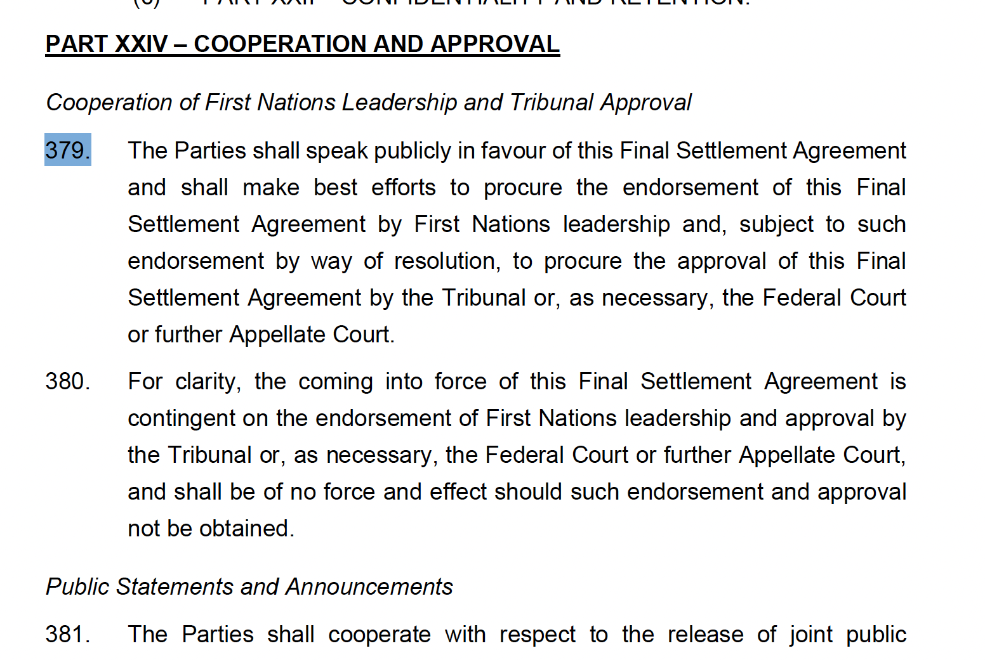
AFN, COO, NAN and Canada’s obligation to promote the FSA to First Nations Leadership

Slide 4

Just released
Terms and Conditions (Appendix 10)
Tripartite Agreement: Canada, Chiefs of Ontario, Nishnawbe Aski Nation
FSA Party Amendments
Section 42 (e) on capital and 42 (f) on post majority supports

Slide 5

Still Missing: FSA Elements
Alternative Dispute Resolution mechanism mentions enabling legislation which is not included in the FSA. Will only be provided after the Tribunal approves the agreement
Provincial/federal agreements for the provision of First Nations Child and Family Services

Slide 7
FSA Approval: two steps to finalization
First Nations Leadership endorsement by resolution (para. 379)
Canadian Human Rights Tribunal: FSA parties will bring a motion within 30 days of approval to have the Tribunal’s orders and jurisdiction replaced by the Final Settlement Agreement

Slide 8

What you need to know
Agreement effective 2023/24 meaning 9 years left
Nothing binding Canada to ensure non-discrimination after that
Draft FSA is on child and family services
AFN, COO, NAN, Canada want to finish Jordan’s Principle FSA by March 31, 2025
Canada has not discharged its duty to consult
No clear process for receiving and discharging amendments
No opt out provisions
Parties will bring an order within 30 days for approval of the FSA

Slide 9
Key FSA structural weaknesses
10 years (only 9 left) and no enforceable accountability for Canada after
Indian Act centric and inconsistent with UNDRIP and Honour of Crown
No decision making for First Nations post approval
Secretive, bureaucratic and party centric governance
Exclusive control of “apolitical” secretariate(s) by AFN, COO and NAN
Poor funding structure will not stop/prevent discrimination for chldren
ADR is expensive (52.8M)and ineffective
Ceases Tribunal jurisdiction and replaces all CHRT orders (including actuals orders)

Slide 10
FSA Governance
First Nations cede decision making post FSA approval
Reform Implementation Committee (RIC) sole entity to recommend changes to Canada re: the funding, regional reps nominated and chosen by FSA Parties and all are bound by a confidentiality agreement
Sets out 6 additional entities that report to the RIC
Total amount spent on administration (including the ADR) is 137.7M (Appendix 1).

Slide 11

A Regional Reform Implementation Committee will not fix FSA governance flaws
RIC supplants First Nations decision making
Regions nominate representatives and Parties to the Agreement choose and appoint
RIC operates confidentially thus proper representation difficult if not impossible
Parties, including Canada, oversee and control 6 committees/structures and technical groups

Slide 12
Reform Implementation Committee Terms of Reference (Appendix 8)
Section 2.1
The Committee (RIC) is the sole entity charged by the FSA with making recommendations to Canada in regard to the Reformed FNCFS Program
Section 5.1 Administrative team consisting of ISC Employees
Appendix A: Confidentiality - all proceedings confidential and confidentiality survives the agreement

Slide 13
Caring Society Recommendations: inclusive, transparent and accountable governance
First Nations retain decision making with advice from Children’s Chiefs Committee that reports to Chiefs and Regional Chiefs’ organizations. Proceedings and documents are presumptively public.
National Advisory Committee with representatives appointed by regions and national representatives from the Caring Society and AFN and Canada. Technical advisory committee to report to Chiefs Committee and Chiefs in Assembly and regional Chiefs Organizations and experts. Proceedings are presumptively public.
Expert Advisory Committee mandated by the Tribunal to reform ISC develops its own terms of reference and is funded for activities for the same. Reports to the Tribunal, Chiefs in Assembly and publicly.
Replace RIC and 6 other committees in the FSA. Money saved would go to children and families

Slide 15
Current Funding Draft FSA
Value: 45 Billion plus actuals
Security: CHRT orders on most amounts (appeal periods have expired)
Accountability: CHRT has jurisdiction and can enforce orders
Children’s Services: Funding allocated to service providers AND some funding to First Nations for prevention.
Value: 47.8B no actuals
Security: 1 year funding with 9 -year projection subject to annual parliamentary appropriations
Accountability: First Nations Tribunal: cannot order more funds or address systemic cases
Funding for Children and Families Services: Misalignment between responsibilities and funding. Agencies shortchanged nearly $10 Billion over 5 years; no capacity building funding for First Nations.

Slide 16

Existing CHRT orders on Child and Family funding
2018 CHRT 4- Canada pays the actual cost of intake and assessment, building repairs, legal and (prevention/least disruptive measures actuals replaced by 2022 CHRT 4)
2018 CHRT 8- Canada to pay for band representatives
2021 CHRT 41- Canada must fund the actual cost of capital for the provision of child and family services and Jordan’s Principle
2022 CHRT 4- Canada must fund prevention at 2500 per resident on reserve adjusted by inflation and population, post majority services, and band representative services. The Expert Advisory Committee is mandated to develop and implement a work plan to ensure Canada’s discrimination stops and does not recur.

Slide 17

Canada’s Current Funding Obligations
AIP from December 2021 to December 2026 19.8 B
Capital order granted on November 16, 2021 so it was just getting rolling in fiscal 2021/2022
Adjusted for inflation and population – approx. 22.5 billion over five years
Doubled for ten-year time frame= 45 B plus actual costs for capital, intake and assessment, children in care, building repairs and child and family related legal.
Not covered by current CHRT orders but currently committed via AIP (housing: remaining 1.37B ending 27/28) (Appendix 1)

Slide 18
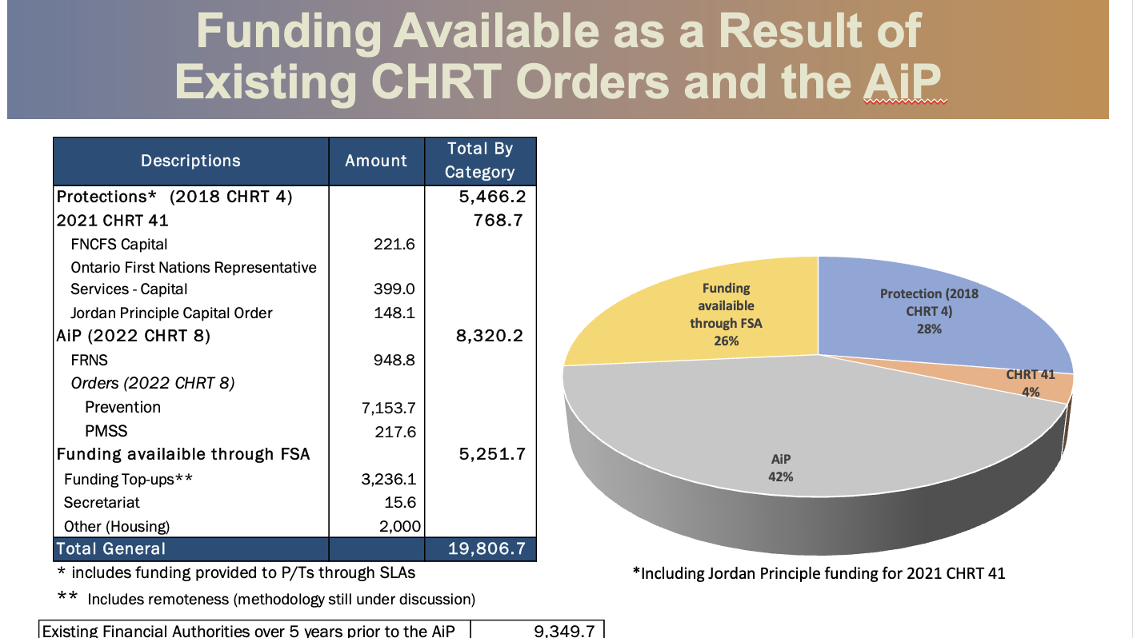

Slide 19

Roll over of current spending in FSA Appendix 1: approx. 4.49B per annum
Baseline funding ($1.28B)
Prevention ($1.42B)
IT/Results/Emergency/Household: 204.1M
FN Rep in Ontario (84.3 M)
FN Rep outside Ontario (127.3M)
Post Marjority(120.7M)
Capital (424.2M)
Housing 413.1M
Remoteness (23/24) was 414.5M

Slide 20

Terms and Conditions: Appendix 10
ISC Risk Assessments on Recipients before receiving funds (governance, finances, governance capacity). Annual Re-reviews
If Risk Assessment raises red flags for ISC they can use one-year fixed agreement
ISC terms and conditions set out how funding can be used by each recipient

Slide 21

Regional Variations (para 45) but no new funding from Canada
Para 45 says First Nations, Regions and Sub Regions can discuss variations with Canada but …
“ Canada shall not be obligated to provide any additional funding to that First Nation or regional or sub-regional organization beyond what is provided by the Reformed Funding Approach”

Slide 22
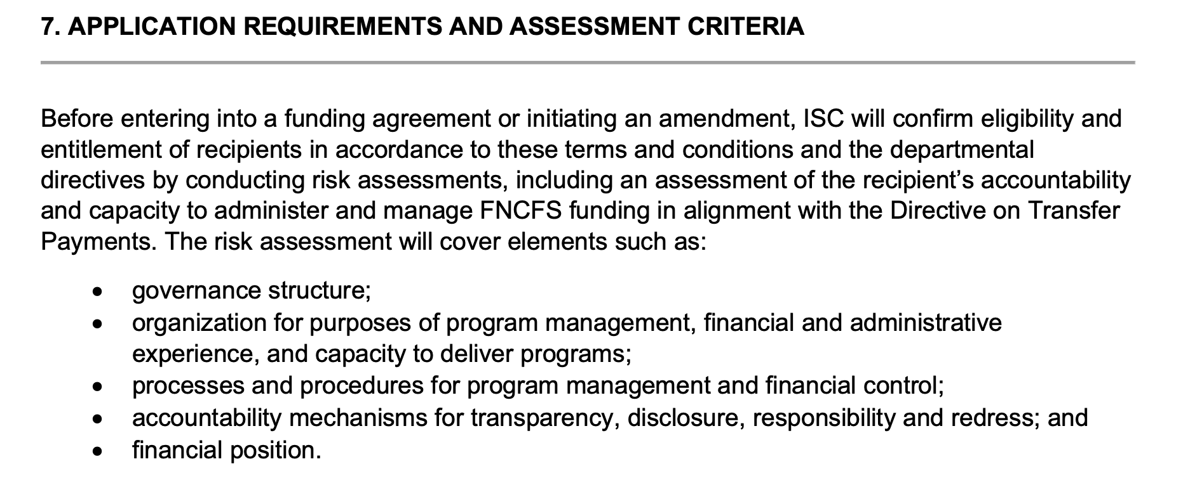
FSA Funding: Subject to Terms and Conditions (Appendix 10, Section 7)

Slide 23

Capital: FSA Replaces Actuals Order with Fixed Amount
No information on how fixed amount was calculated
Current ISC capital spends are artificially low due to Canada placing projects on “pause” or delaying approvals
Section 42: ISC will assess, rank, and fund proposals based on such factors as the link between the proposed project and the Reformed FNCFS Program’s funded services and activities and the availability of existing ISC-funded capital assets for use by the First Nation or FNCFS Service Provider.

Slide 24
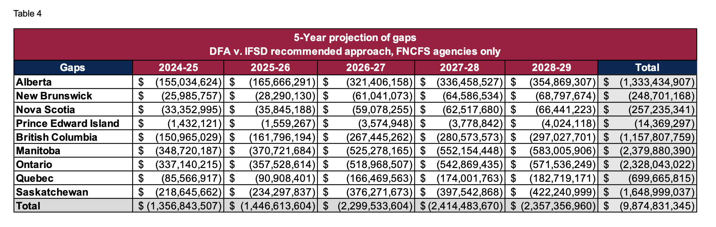
IFSD: FSA Agency Gaps by Region (5 yrs)

Slide 25
Part XXV: Enforcement of Funding Commitment
Para 383. Any and all funding commitments by Canada or amendments agreed to by the Parties in this Final Settlement Agreement remain subject to annual appropriation by the Parliament of Canada or other necessary approval processes required by the Government of Canada.

Slide 26
Accountability for Canada: Not strong and Not In time for kids
Para 384 says – if Parliament does not appropriate sufficient funding depriving benefit the Parties can go to court. The Party may seek to open the CHRT complaint or initiate a new complaint.
Para 385 – The FSA supersedes and replaces all of the orders of the Tribunal related to the discrimination found by the Tribunal
Para 241 ADR Tribunal does not have jurisdiction to:
  Amend the FSA
  Order Canada to fund new things or increase funding for existing terms or
  Introduce new indexing factors

Slide 27
Canada off the hook
If Canada fulfills the terms of the FSA but discrimination occurs there is no provision to force more funding
If Canada turns down funding for a First Nation or Region to make regional variation
After 10 years there is no FSA to enforce

Slide 28
FSA is Indian Act based
Uses Indian Act definitions for First Nations child and First Nations
Restricts federal funding obligations to on reserve
No clear mechanisms to hold provinces accountable for funding/providing services on and off reserve

Slide 29
Research suggests a minimum 2-5 year transition: FSA taking 5 months. What does this mean on the ground?
First Nations Agencies will have to lay off staff, reduce existing prevention services, close programs and transfer responsibilities with no extra funding for change management.
First Nations Agencies likely to experience shortfalls in protection and least disruptive measures budgets effective April 1, 2024
First Nations retaining prevention funds must be ready to provide the services without clear capacity funds or time.
Post majority services will be the responsibility of First Nations.
Expectation of coordination of services but no tools and very limited time to do it.

Slide 30
COO, NAN and Canada Trilateral Agreeement Highlights
Review of the 1965 Indian Welfare Agreement (Ontario)
Canada to pay Band Representative Services off reserve via Jordan’s Principle until 2029 (will have discussions with Ontario)
Mediation and Arbitration with Right of Appeal
Does not exclude more funding as per the FSA process
Governance Funding for COO and NAN
Section 4.01: Funding for Chiefs of Ontario and Nishnawbe Aski Nation to participate in discussions with Ontario (includes legal)
Section 4.02: Ontario Technical Table ($130,000)annually for 5 years starting in 2022)
Section 4.03: Funding for Chiefs of Ontario ($540,632) for reform of 1965 agreement and implementation of reformed funding approach

Slide 31

Examples of other Concerning Provisions
Para. 220 – ISC will develop and implement trauma-informed and cultural humility training … including First Nations culture, worldview and history
Para. 188 re: Program Assessment “in the spirit of a renewed nation-to-nation relationship with with the Parties to co-develop policy recommendations that shall inform options ISC will bring forward for Canada’s consideration
National Secretariate- technical NGO with only AFN, COO and NAN on the board of directors. Determines which regions get regional secretariates.

Slide 32
Accept now and fix later? Not a strong position for First Nations
Amendments; Only FSA Parties can amend the agreement with unanimous agreement.
Only the Reform Implementation Committee can recommend changes to Canada (Appendix 10, Section 8)
Order Canada to do something? The FSA eliminates all CHRT orders and its jurisdiction. ADR cannot order more $ or address systemic issues.
Is there more money coming? Adjustments of some factors by population and inflation. No binding provision for more funds in the FSA within or beyond year 10.

Slide 33

Caring Society Recommended Amendments
Restore First Nations as decision makers informed by their child and family service experts on the ground, regionally and nationally
Hold Canada accountable for its discrimination toward our kids
Eliminate secrecy in decision making
Include Elders, Knowledge Holders and Young People
National master agreement to stop the discrimination nationally.
Regional variations and agreements for distinct circumstances and cultural diversity
Retain Tribunal jurisdiction and orders and adapt to change going forward
Binding and Effective ADR

Slide 34
Interested Party Status at the Tribunal on FSA Approval Motion
First Nations and/or their Agencies can apply for interested party status at the Tribunal if a motion is brought to approve the draft FSA and their views are not represented by the current CHRT parties.
In general, interested parties must have a unique perspective, not duplicate submissions of the other parties, delay the hearings, etcetera.
Getting independent legal counsel and filing as groups with similar interests (i.e.: like the BC Leadership Council did on Jordan’s Principle) is encouraged.

Slide 35



Doing Better for our Children
Do not recommend FSA approval even with regional representation
Consistency with resolution 40/2022 and subject to review by regional and national technical experts
Chiefs, including those outside of AFN, must retain decision making and approve any long-term reform proposal for Jordan’s Principle or CFS

Slide 36
fncaringsociety.com
@CaringSociety
CaringSociety
fncaringsociety
Spiritbearandfriends
@SpiritBear
Email: info@fncaringsociety.com

