Slide 1
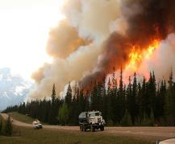
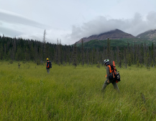
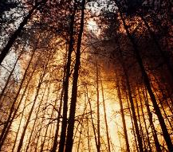
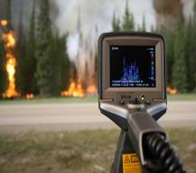
The Canadian Wildland Fire Prevention and Mitigation Strategy
Assembly of First Nations
National Emergency Management Forum
March 5, 2024

Slide 2
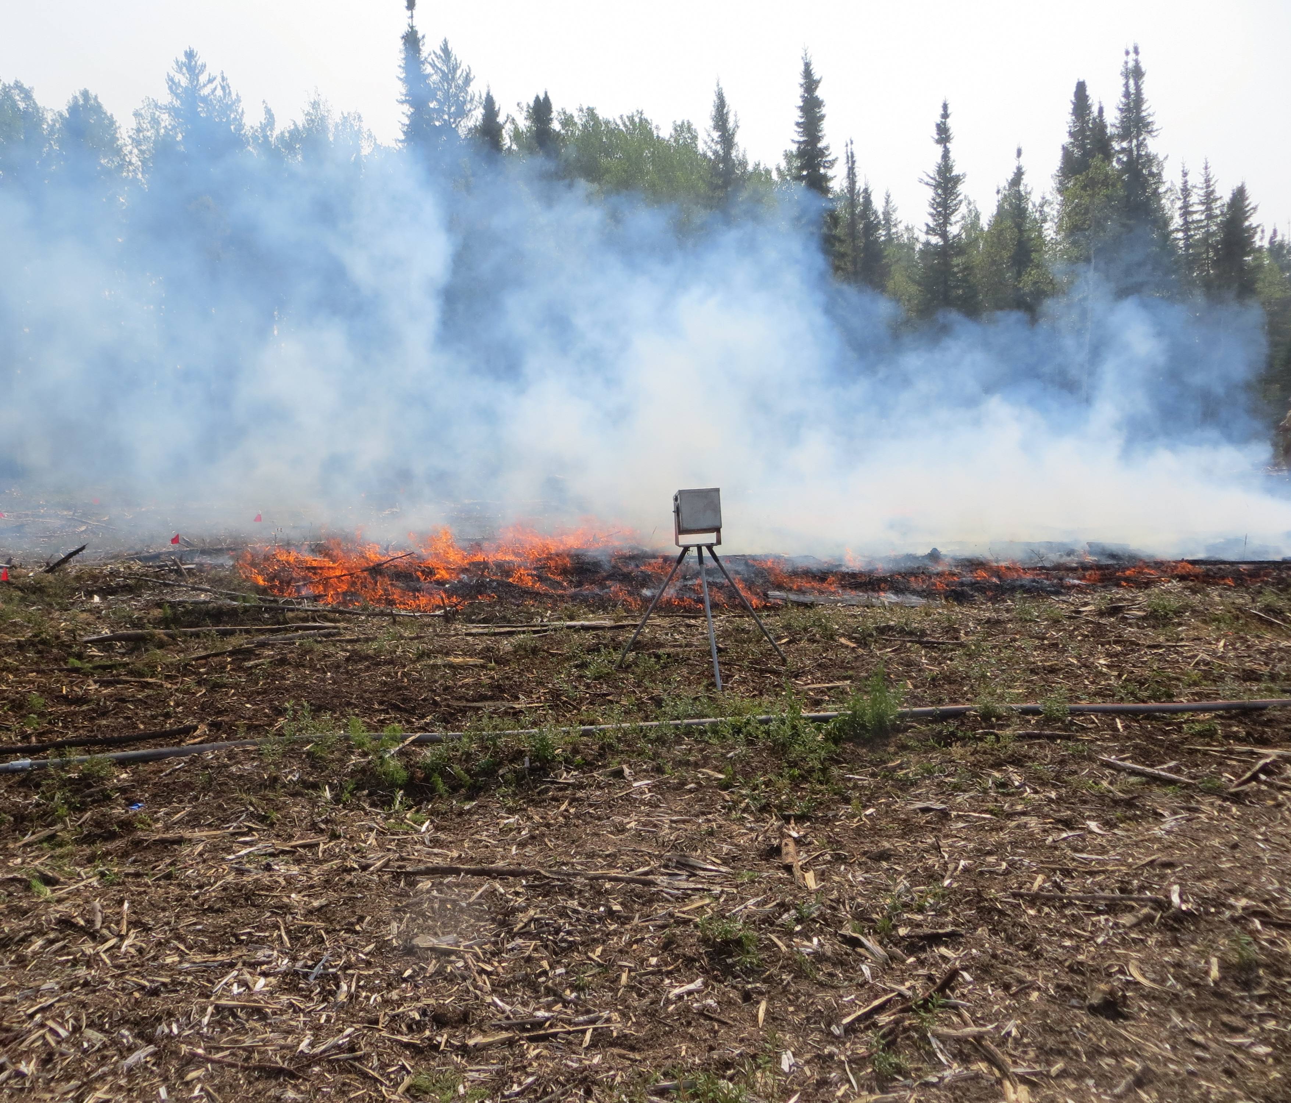
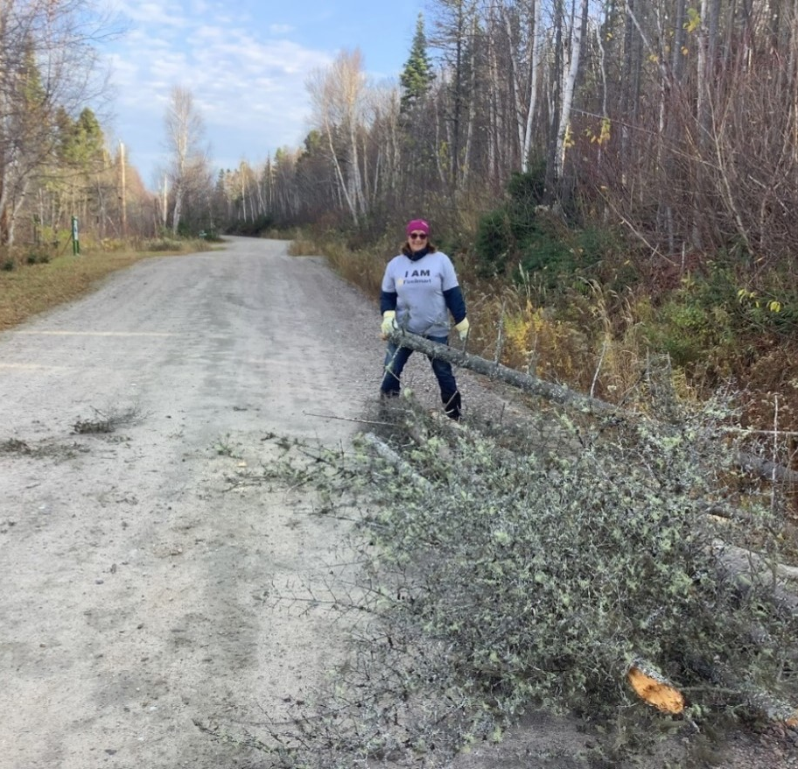
Objectives
Provide an overview of the progress on the draft CCFM Canadian Wildland Fire Prevention and Mitigation Strategy (the Strategy).
Present the draft Strategy’s vision, goals, commitments and targets.
Receive feedback on various elements of the draft Strategy.

Slide 3
First Nations have an important relationship with wildland fire and experience disproportionate impacts from its effects
We must be united in our approach to adapt to and live with wildland fire…
…Indigenous Peoples and Indigenous Knowledge must be recognized, respected, and included in Canada’s wildland fire management. This Strategy seeks to ensure the diverse perspectives and considerations of First Nations, Métis and Inuit Peoples are included in wildland prevention and mitigation.

Slide 4
A whole-of-society call to action
The risk that wildland fires pose to people, infrastructure and the environment is increasing.
Considering the current and predicted future trends in wildland fire, suppression will not be sufficient. Greater emphasis on prevention and mitigation activities are needed.
The intense 2023 wildland fire season underscored the significance of what our future will look like if we do not take collective action today.
Prevention and Mitigation
Whole-of-Society Action
Canadian Council of Forest Ministers’ Vision:
By 2030 communities and infrastructure across Canada will be more resilient to the threat and impact of wildland fires
+
=

Slide 5
Canadian Wildland Fire Prevention and Mitigation Strategy (the Strategy)
Seeks to provide…
Informed by….
A whole-of-society approach: input from coast to coast to coast, many voices from a broad variety of sectors, groups, and organizations to develop pan-Canadian approaches to wildland fire resilience.
Achieved through…
Equity, inclusivity and self-determination, further advancing reconciliation in a meaningful way.
Shared goals and coordinated action that will complement and build on the prevention and mitigation work of partners.
A living document, that will evolve as progress is made and whole-of-society partners continue to shape the Strategy.
A pan-Canadian vision of wildland fire prevention and mitigation with flexible implementation.

Slide 6
Informed by the Canadian Dialogue on Wildland Fire and Forest Resilience (the Dialogue)
In February 2022, the CCFM hosted the Dialogue to drive whole-of-society conversations on wildland fire risk priorities and opportunities to enhance prevention and mitigation. Close to 100 organizations across Canada took part in five round tables. A What We Heard Report was published in June 2022.
Five Roundtables
What We Heard Report Key Themes
Dialogue launch
Safe communities and infrastructure
Financial instruments to support resilience
Wildland fire and forest management
Stable and significant investments are needed now to avoid guaranteed disaster response costs in the future
.Access to data is critical to inform resilience-building activities
Staying the course is not an option; the time for change is now
Indigenous Peoples perspectives on prevention and mitigation
Indigenous Peoples and their knowledge must be recognized, respected, and included in Canada’s wildland fire management.
A whole-of-society approach is mandatory; government leadership is critical
FireSmartTM Canada works but needs to become a truly national program
Wildland fire is a climate change adaptation issue; responses and activities must align with other adaptation efforts

Slide 7
Engagement
Engagement to date
Between February 2022 (the Dialogue) and the 2023 summer engagement sessions, the CCFM and Federal, Provincial and Territorial agencies have engaged with over 550-600 participants, including 209 Indigenous communities and organizations.
What’s next
Engagement was challenging due the extraordinary 2023 wildland fire season, multiple competing priorities and limited resource capacities.
The CCFM is committed to continuing to strengthen existing relationships and build new ones with whole-of-society partners to enhance Canada’s resilience to wildland fires.
On Thursday March 21, 2024, an engagement session will be held for 2022 Canadian Dialogue Indigenous communities and organizations to obtain feedback on various elements of the draft Strategy.
By Thursday, March 28, 2024, your written comments and questions on the draft Strategy components may be directed to the CCFM Wildland Fire Management Working Group: wfmwg-gtgff@nrcan-rncan.gc.ca.

Slide 8
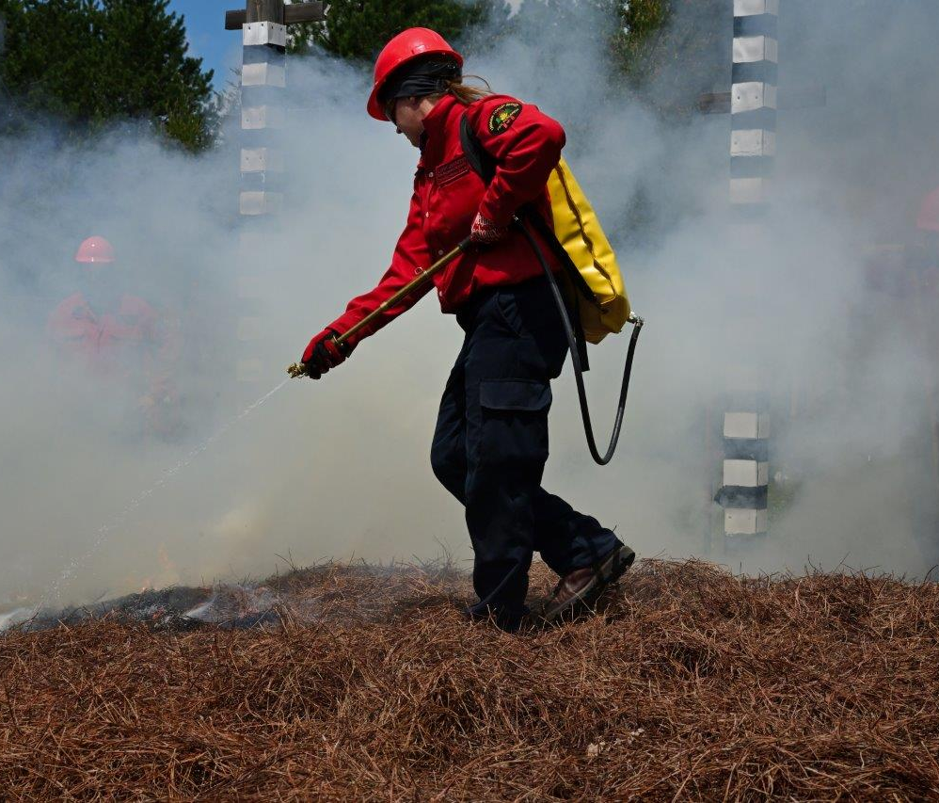
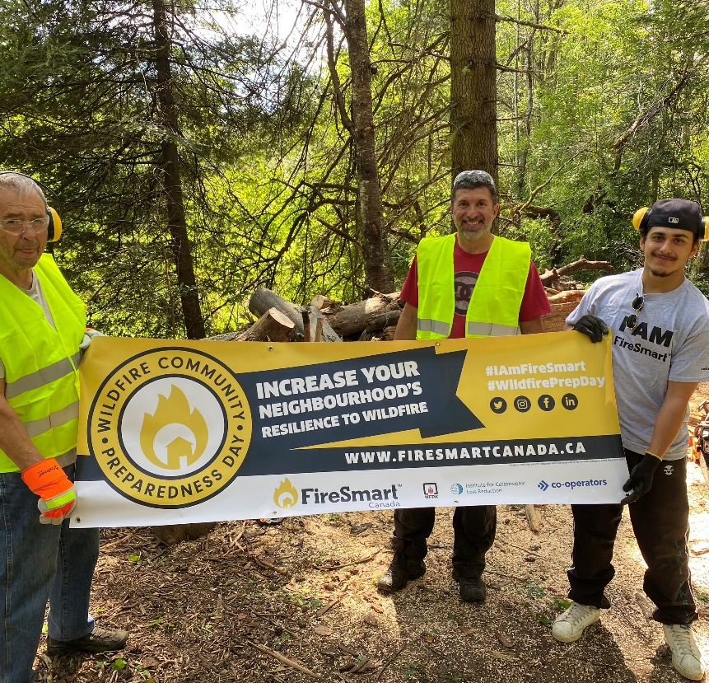
Discussion Questions
Do the draft Strategy’s vision, goals, commitments and targets resonate with you? Why or why not?
What suggestions do you propose for the successful implementation of the Strategy’s commitments and targets?

Slide 9
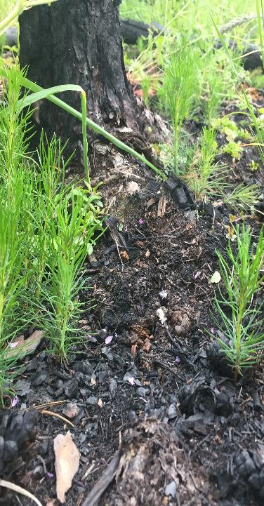
Draft Strategy Content: Vision
A resilient Canada where all parts of society are prepared, empowered, and engaged in preventing and mitigating the negative effects of wildland fires.
The future is one of unity where all parts of society coordinate and work together to prevent and mitigate the negative impacts caused by wildland fire.
Groups collaborate using the best available Indigenous and Western science, to create inclusive, common practices and shared responsibilities that everyone can follow and participate in.
Promoting awareness and action with a commitment to building prevention and mitigation capacity will better position Canada to maintain healthy and sustainable landscapes and communities, while minimizing wildland fire risk and severity.

Slide 10
Draft Strategy Content: Goals and Commitments
Increase knowledge and understanding
Expand investments in prevention and mitigation
Enhance whole-of-society collaboration and coordination
Strengthen First Nations, Métis and Inuit Partnerships
Commitments
Commitments
A pan-Canadian Wildland Fire Prevention and Mitigation group will be established to help identify and mobilize Whole-of-Society actions on wildland fire prevention and mitigation.
Develop and make accessible wildland fire risk assessment and risk planning resources and promote their adoption and integration across all sectors of society.
Collectively advance collaboration with First Nations, Métis and Inuit communities and organizations to remove barriers to participation and provide long-term support for Indigenous-led wildland fire prevention and mitigation efforts.
Goals
Commitments
Commitments
Public awareness campaigns aimed at promoting awareness and understanding of wildland fire prevention and mitigation actions across whole-of-society will be developed.
Training targeted at increasing wildland fire prevention and mitigation expertise across Canada will be developed.
Recognizing the need for sustained investment and focus to increase wildland fire resiliency, incentives and support programs will be created and/or enhanced to support the advancement of wildland fire prevention and mitigation efforts.

Slide 11
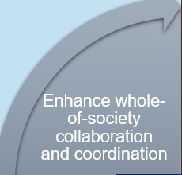
Draft Strategy Content: Goals and Commitments
Goal – Enhance Whole-of-Society Collaboration and Coordination
Enhance coordinated prevention and mitigation efforts across all sectors through common/shared understanding and use of standardized practices.
Commitment
A pan-Canadian Wildland Fire Prevention and Mitigation group will be established to help identify and mobilize Whole-of-Society actions on wildland fire prevention and mitigation.
Commitment
Develop and make accessible wildland fire risk assessment and risk planning resources and promote their adoption and integration across all sectors of society.

Slide 12
Draft Strategy Content: Goals and Commitments
Goal –Strengthen First Nations, Métis and Inuit Partnerships
Strengthened partnerships with First Nations, Métis and Inuit communities and organizations to ensure the inclusion of Indigenous leadership, traditional practices and Indigenous knowledge systems in wildland fire prevention and mitigation efforts.
Commitment Collectively advance collaboration with First Nations, Métis and Inuit communities and organizations to remove barriers to participation and provide long-term support for Indigenous-led wildland fire prevention and mitigation efforts.

Slide 13
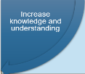
Draft Strategy Content: Goals and Commitments
Goal – Increase Knowledge and Understanding
Increase collective awareness and understanding across all sectors of society to enhance wildland fire prevention and mitigation practices.
Commitment Public awareness campaigns aimed at promoting awareness and understanding of wildland fire prevention and mitigation actions across whole-of-society will be developed.
Commitment
Training targeted at increasing wildland fire prevention and mitigation expertise across Canada will be developed.

Slide 14
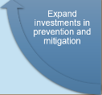
Draft Strategy Content: Goals and Commitments
Goal – Expand Investments in Prevention and Mitigation
Expanded investments, incentives, and programs to increase whole-of-society participation and uptake in preventing and reducing the impact of wildland fires.
Commitment Recognizing the need for sustained investment and focus to increase wildland fire resiliency, incentives and support programs will be created and/or enhanced to support the advancement of wildland fire prevention and mitigation efforts.

Slide 15
Draft Strategy Content: Targets
Proposed Targets
In 2024, a Canadian Wildland Fire Prevention and Mitigation group has been established and includes representation from whole-of-society partners.
In 2024, public awareness campaigns aimed at increasing knowledge and understanding of wildland fire prevention and mitigation have been launched, including mechanisms to measure public understanding and campaign effectiveness.
In 2025, CCFM jurisdictions have established dedicated prevention and mitigation governance structures and includes opportunities for whole-of-society leadership.
In 2025, develop and make available targeted training across jurisdictions, sectors, industries, and communities to strengthen expertise in prevention and mitigation.
In 2025, a Wildland Fire Risk Assessment Framework has been developed in collaboration with whole-of-society partners to inform future risk planning and mitigation activities.
In 2026, toolkits and other wildland fire risk planning resources have been developed and are easily accessible to support all communities in reducing wildland fire risk.
In 2026, whole-of-society partners have increased investments in prevention and mitigation activities and incentive programs and have begun tracking and reporting investments annually.
The Strategy will directly help Canada in achieving the National Adaption Strategy’s long-term goals and near-term targets related to wildland fire

Slide 16
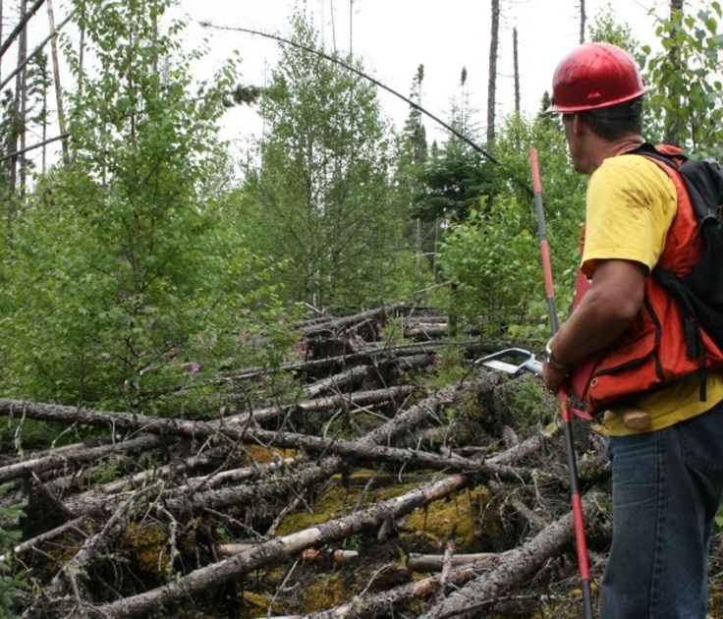
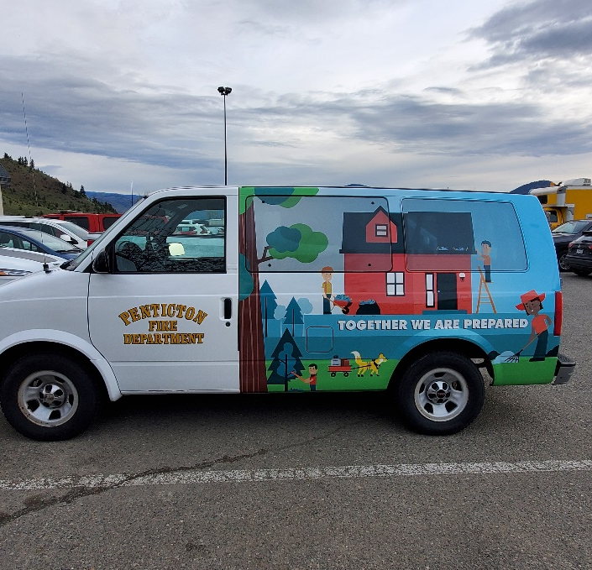
Finalizing the Strategy
March 2024 and ongoing
June 2024
Continue engagement with Indigenous communities, organizations and other partners.
Review engagement feedback and revise draft Strategy.
Public release of the Strategy.
Written comments and questions may be directed to CCFM Wildland Fire Management Working Group: wfmwg-gtgff@nrcan-rncan.gc.ca by Thursday March 28, 2024.

Slide 17
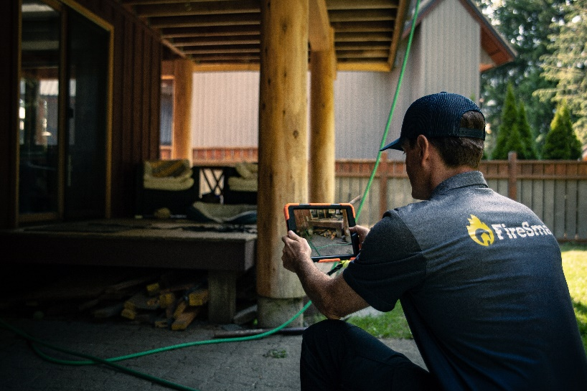
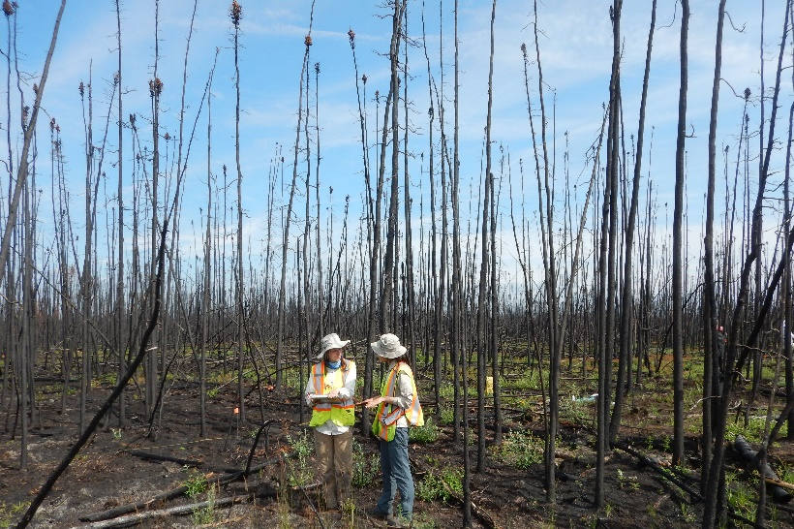
Implementing the Strategy
The Strategy is the first step in advancing not just a conversation but concrete actions towards ensuring Indigenous Peoples, Knowledge and perspectives are recognized, respected, and included.
The CCFM Wildland Fire Management Working Group will develop a collective implementation plan to guide CCFM efforts and leverage efforts of other implementation partners.
The “living” Strategy will continue to evolve as progress is made. Implementation will be ongoing and evergreen and require whole-of-society participation.
As a preliminary step, the CCFM will coordinate additional dialogue with First Nations, Métis, and Inuit communities, industry partners, and municipalities to further co-develop meaningful targets.
To implement the Strategy, what measures can be taken to encourage and support the active participation and leadership of First Nations?
What are the best approaches for co-developing targets?

