Slide 2
Leadership Transition
Effective March 1, 2024, Darrin Spence, our Chair, will be stepping down to pursue new business endeavours. We extend our heartfelt appreciation for his dedicated service.
We are pleased to appoint Vice Chair Jamie Scrimger as Interim Chair until a new Chair is elected. We are confident in Jamie’s ability to lead us during this transition period.

Slide 3
Darrin Spence, Chair
dspence@fnera.ca
(807) 632-8239

Slide 4
History

Slide 5
NOEMWG
After the February 2019 Provincial Planning Session hosted by EMO, Indigenous representatives of PTO’s and Tribal Councils developed a Working Group to come together on current Indigenous Emergency Management issues in the Northwestern Region of Ontario.
The Northwest Emergency Management Working Group evolved to include All Ontario Regions creating a unified representation.

Slide 6
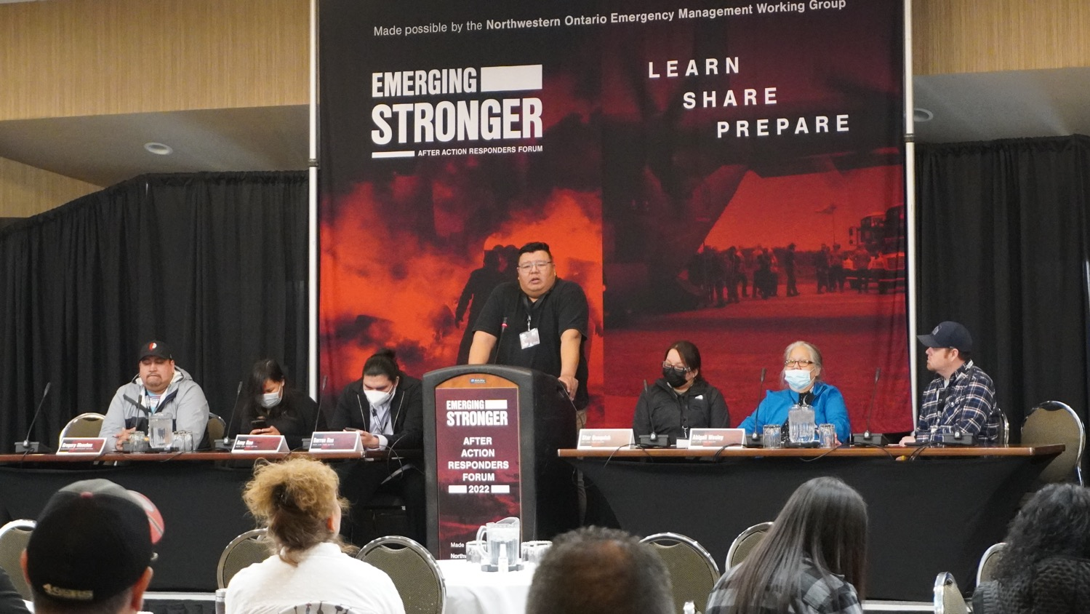

Slide 7







The First Nation Emergency Response Association was founded by the following representatives in response to multiple natural disaster emergencies throughout Indigenous Communities in the Province of Ontario. The board is primarily composed of EMCs and industry practitioners who possess firsthand experience in the field.

Slide 8
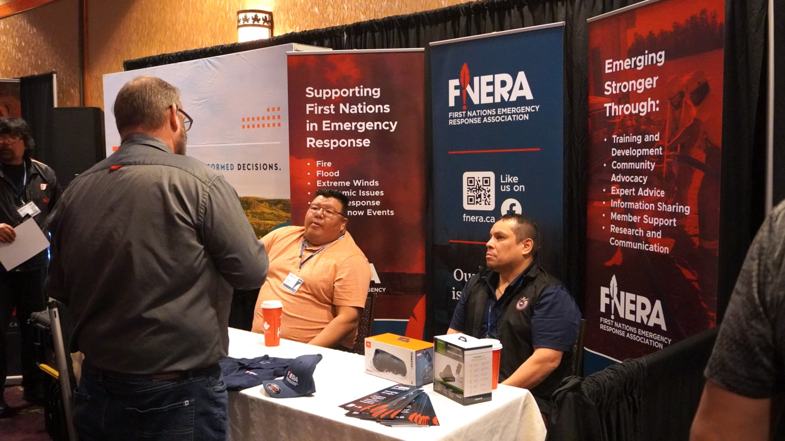

Slide 9
FNERA Context
FNERA is incorporated as a National not-for-profit
The importance of regional partnership has been made apparent in all Four Pillars of Emergency Management.
The key outcome of FNERA is to facilitate respectful dialogue and representation where Indigenous Communities are impacted and discuss emergency planning for all emergencies in Indigenous communities in Ontario.

Slide 10
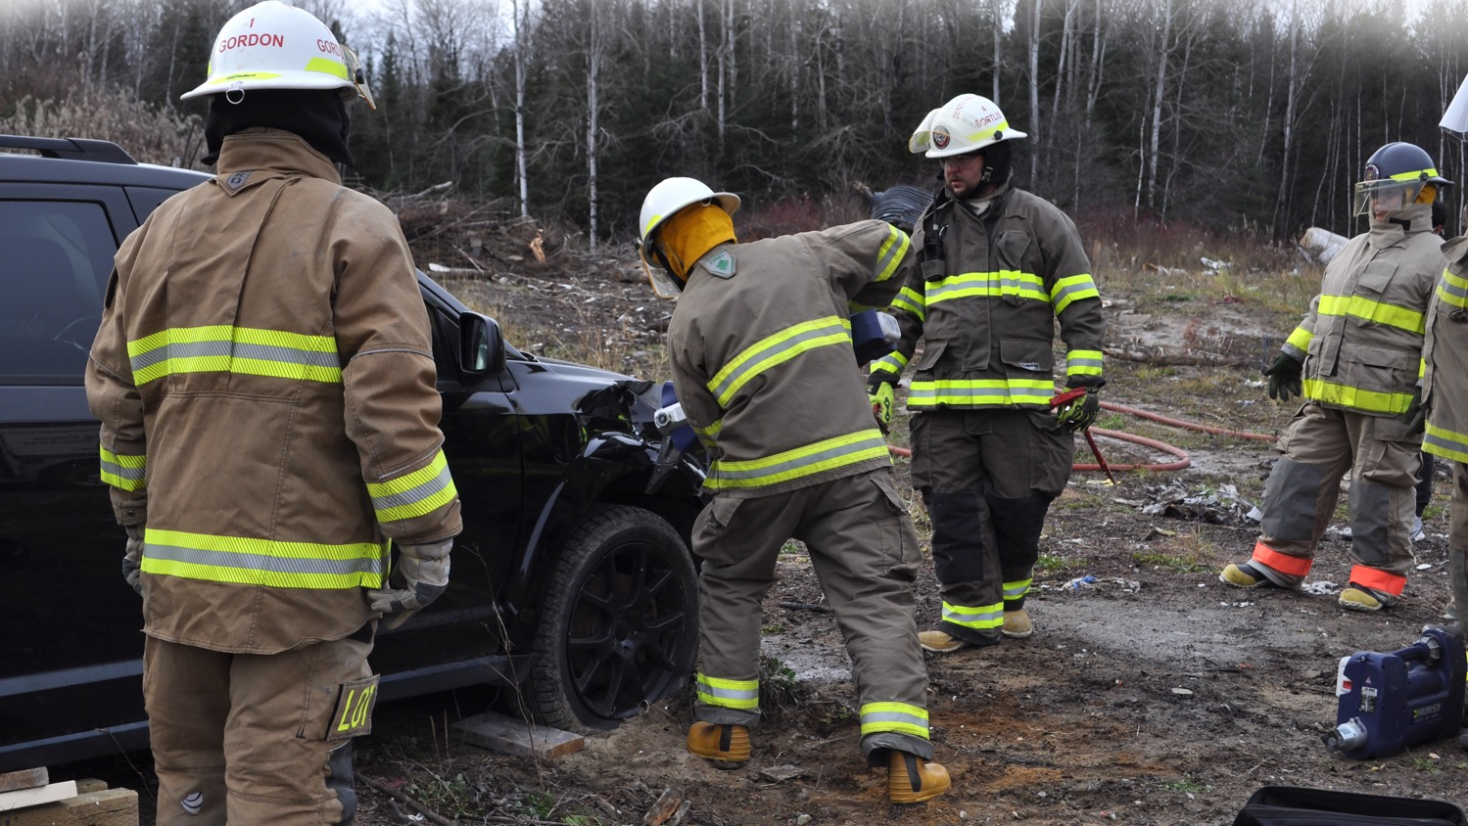
Our Mission is to Support First Nations-Led Emergency Management

Slide 11
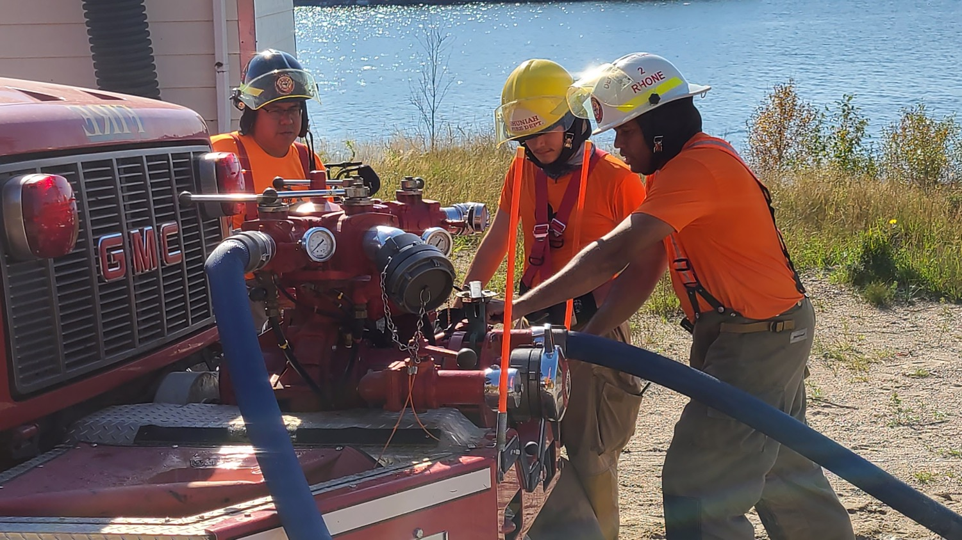
Advocating for First Nations in Emergency Response
- Fire
- Flood
- Extreme Winds
- Pandemic Issues
- Crisis Response
- Major Snow Events

Slide 12
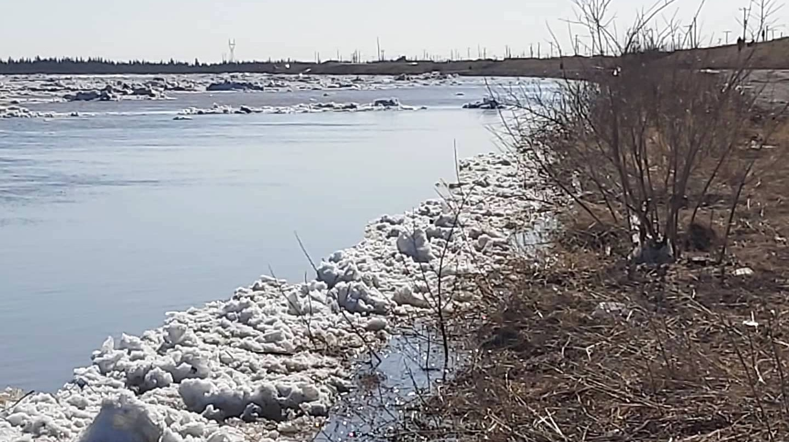
Emerging Stronger Through:
- Training & Development
- Community Advocacy
- Expert Advice
- Information Sharing
- Member Support
- Research & Communication

Slide 13
Mandate
Members of the Association will work together to establish:
Better information sharing and coordinated efforts for emergency management in Ontario.
To advocate for Indigenous inclusion in all Emergency Management policies at all levels of Government.
A one stop shop for planning regional approaches to enhancing operational priorities from a Indigenous perspective to better collaborate with Federal and Provincial Partners.
To champion the Sovereignty of Indigenous Governance regarding Emergency Management.
To provide an avenue for all partners to raise issues and to provide updates on the progress of new and key initiatives.
Promote Emergency Management training opportunities that support an Indigenous Perspective to educate and prepare community members and Leadership.
Notes:
Maya

Slide 14
Members

Slide 15
Current Membership
The membership of the Association will include the following:
Core/Founding Group (Indigenous Organizations involving Emergency Management in Ontario)
  IFNA, NAN, GCT #3, Nokiiwin, and Anishinabek
  IAO – Administrative Support
Sub-Committees Regional
  Chiefs Advisory
  Project-specific
  Ad-hoc

Slide 16
Board of Directors
Chair – Darrin Spence
Vice Chair – Jamie Scrimger (Nokiiwin)
Board member – Maya Boivin (NAN)
Board member – Suzanne Nicholas (AIAI)
Board member – Kevin Ramcharan (NAN)
Board Member – Nicholas Rhone (IFNA)
Board Member – Kieran Davis (GCT3)
Board Member – Faith Ezeazolo (Anishinabek Nation)

Slide 17
Invitees
On a case-by-case basis, the following may be invited:
  Indigenous organizations/communities
  Other invitees as identified by Board of Directors
  EMO, IAO, ISC and FNHIB representatives as identified by Board of Directors

Slide 18
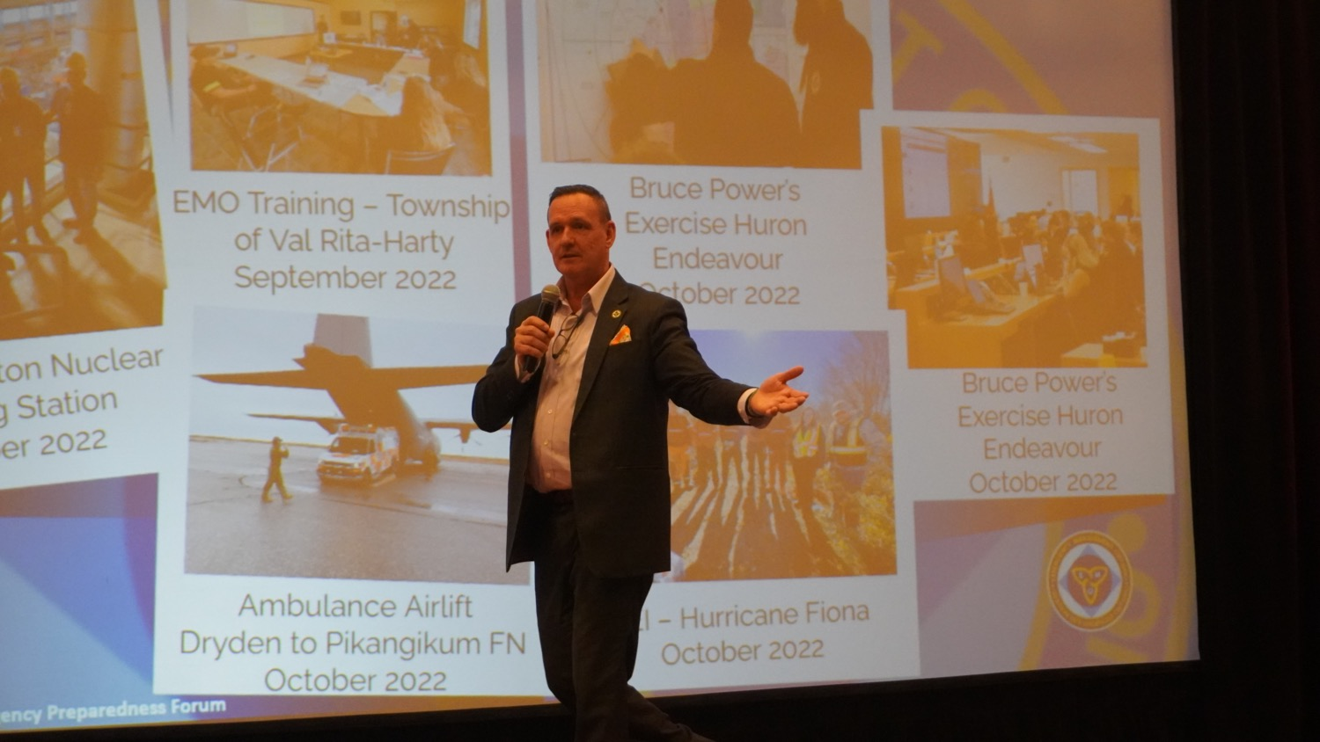

Slide 19
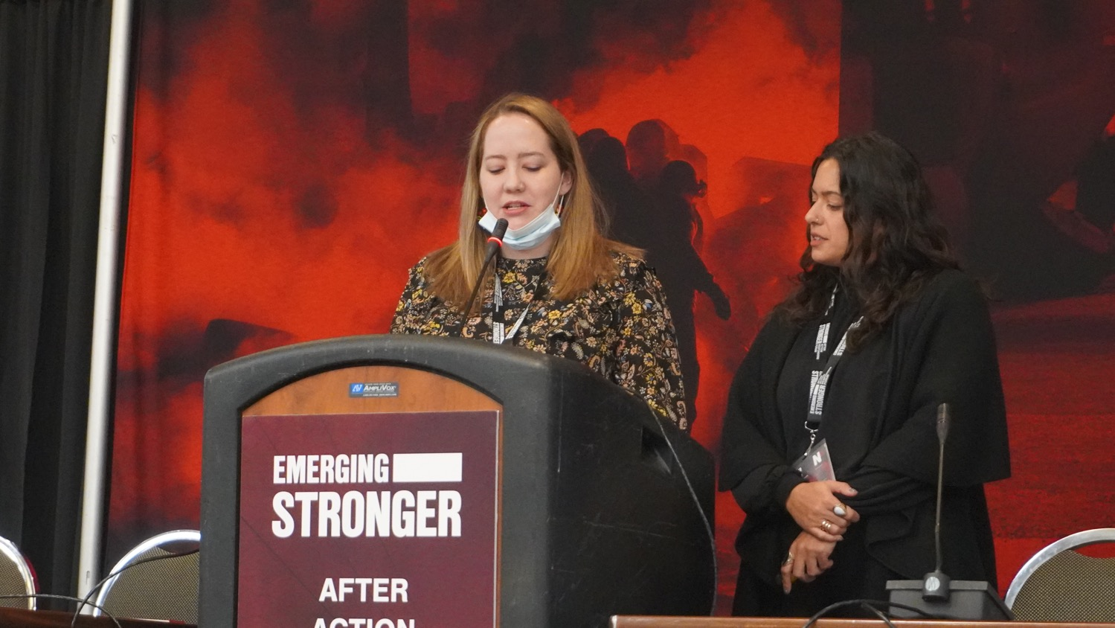

Slide 20
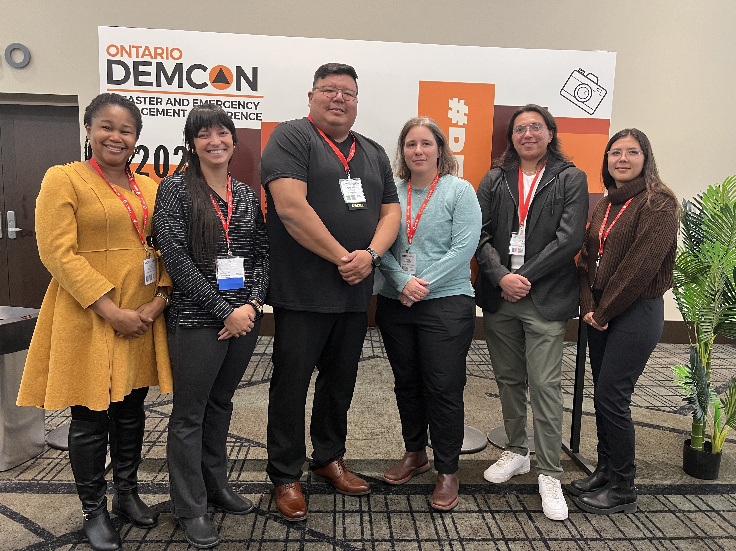

Slide 21
Evolution of Emergency Management

Slide 22
Evolution of Emergency Management
Six Nations Fire and Emergency Services: Training Center for Excellence
Nation to Nation hosting/service provider
Supporting the development of Certified First Nation Emergency Management training
Expanding IMS/ICS to include First Nation Content

Slide 23
Evolution of Emergency Management
Providing advocacy for First Nation Emergency Management within a number of provincial and Federal level committees
  Operationalize Joint Command Model
  Provincial Emergency Management Strategic Action Plan
  All Hazards Working Group (Developed by EMO, in the training stage)
  Canadian Interagency Forest Fire Center Inc
  Joint Emergency Management Steering Committee & Basic Emergency Management (EM200) Advisory Group

Slide 24
Evolution of Emergency Management
IFNA provides external services
Providing a conduit for access to community level and regionally specific First Nation consultation in relation to Emergency Management
Notes:
Maya

Slide 25
Enhance & Support First Nations

Slide 26
Enhance & Support First Nations
Provide non-political information to Communities and Chiefs
Create culturally appropriate Training, Operations, and Trainers
Resource Pool
  Connect with Service Providers
  Train the Trainer in Emergency Management
Assist with Funding tools
Build Capacity, Youth Empowerment, Reduce 3rd Party Impact
Direct link to EMO, MNRF, ISC, and IAO in regard to Emergency Management
Identify funding streams and as well shortcomings of funding scopes from the Federal and Provincial Policy

Slide 27
Next Steps
Provide First Nation Communities with a portal of resources
Establish a Community/Chiefs advisory committee
Build up Membership once the Association is officially launched

Slide 28
Current Projects
Developing the Governance of the Group
Establish funding (every member volunteers their time)
Create Sub Committees
  HIRA’s for social threats within emergencies
  Develop training material with Indigenous Content along with ISC and EMO
  Evacuation Risk Assessment Tool
  Policy Development

Slide 29
Future
FNERA is a new and upcoming association, the Federal and Provincial Governments are seeking input and collaboration on emergency management projects with First Nations.
As experts in this field, FNERA is looking to fill this gap and we would like to establish a Community/Chiefs Advisory Committee and Technical Expert Advisory Committee to help steer our group.
Notes:
Darrin

Slide 30
Like
us on
fnera.ca

