Slide 1


Assembly of First Nations (AFN)
First Nations Fire Protection Strategy
Webinar Series
Are We Ready?
Emergency Response Plan for
First Nations Persons of all Abilities and Disabilities
October 30, 2025

Slide 2

AFN Accessibility/ Disability Policy Mandates
Resolution 71/2024 - Rejecting the Accessible Canada Act and Advancing Distinct First Nations Accessibility Legislation (DFNAL)
Resolution 15/2022, Major Investment Needed to Build Fully Accessible First Nations
Resolution 25/2021- Strengthen First Nations Distinctions Based Approaches on Accessibility / Disability.
Notes:
New

Slide 3

DISTINCT FIRST NATIONS ACCESSIBILITY LEGISLATION
In 2022, A Distinct First Nations Accessibility Law Discussion Guide was developed to guide engagements with First Nations, regions and leadership on the four legal options:
1: First Nations Regulations under the Accessible Canada Act.
2: Legislation where individual First Nations design their own law.
3: A new First Nations accessibility law that applies to all First Nations.
4: First Nations Accessibility Law within First Nations Health Law.
A Draft Distinct First Nations Accessibility Framework was drafted with guidance of the First Nations Persons with Disabilities (FNPWD) and Knowledge Keepers Advisory Circle.
The Seven Sacred Teachings or laws guide the Framework. These laws act as a foundation to facilitate a reconnection to the Spirit, the Land and the Peoples.

Slide 4
AFN Shadow Report to the: United Nations Convention on the Rights of Persons with Disabilities (CRPD)
In 2022, Canada submitted its joint 2nd/ 3rd Periodic Report to the (CRPD). The AFN submitted a Shadow Report to the UN-CRPD in February 2025.
The AFN report identifies four systemic barriers that Canada’s official report fails to address and advocates for key recommendations to build Distinct First Nations Accessibility Legislation (DFNAL).
Barriers: Infrastructure Gap, Misdiagnosis, Lack of Disability Data for First Nations, & Colonial Policies.
The AFN report reflects several engagements with First Nations Persons with Disabilities (FNPWD), leadership, and technical experts and cross-sectorial disability policy collaboration.

Slide 5
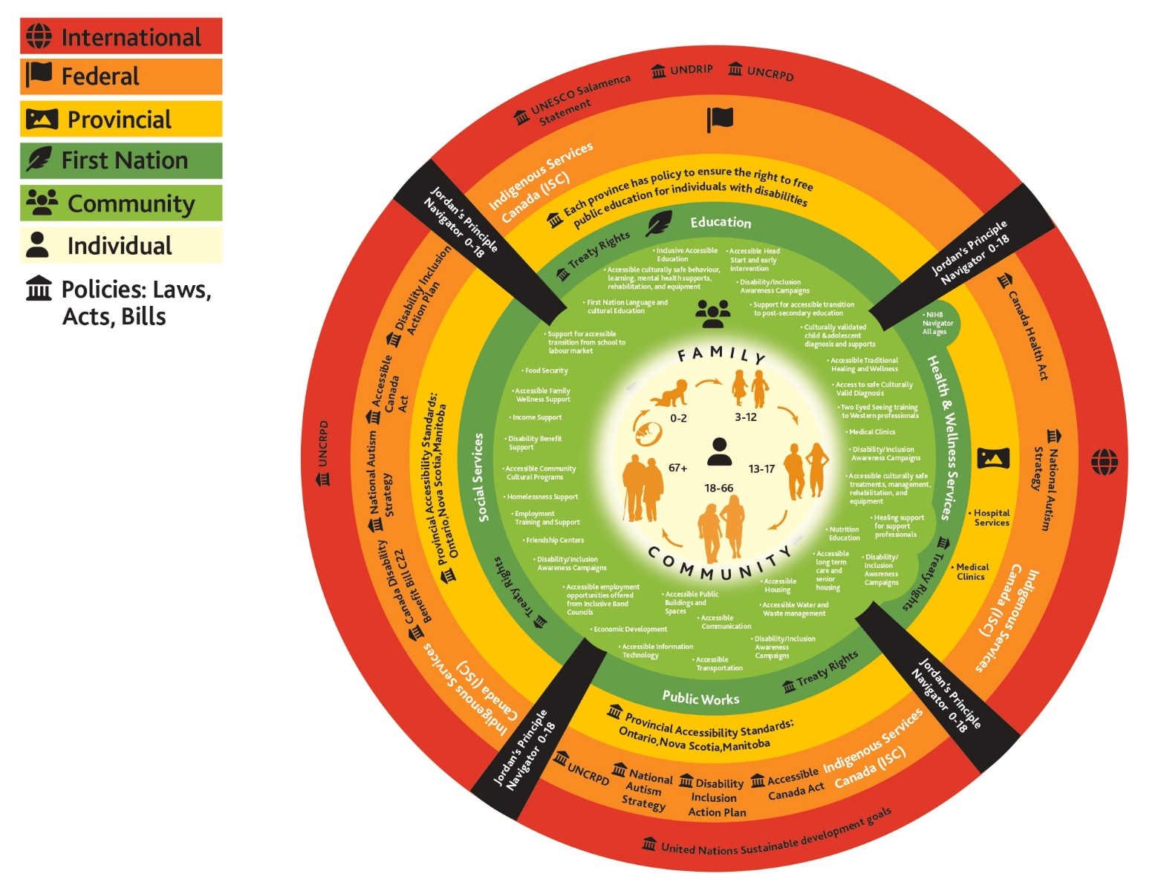
Taking a Poll to get a Pulse: Status of Accessibility / Disability in First Nations
Accessibility and Disability Surveys: Analysis
Survey for FNPWD (and for undiagnosed individuals)
Survey for Jordan’s Principle Navigators
Survey for NIHB Navigators
Survey for First Nations Health Centres
Emergency
Response

Slide 6
Survey Findings: First Nations Evacuation Strategy

Slide 7
Evacuation: Disability Funding and Supports

Slide 8
Emergency Response

Slide 9
Local Police: Education and Awareness

Slide 10
An Accessible Emergency Response Plan: Are We Ready?
A First Nations Accessible Emergency Response Plan will support ensuring public health/ safety in First Nations. FNPWD can face barriers, and emergencies can make barriers worse.
We are working to ensure an effective emergency response for persons of all abilities and FNPWD is the same as for everyone else and available to everyone at the same time; including all types of emergencies:
the needs of your First Nation, clients, and employees before emergencies occur
the new barriers created by emergencies.
the changes needed to deliver your services in an accessible way.
the feedback you receive about accessibility from those who use your services.
Has your First Nation developed an Accessible Emergency Response Plan to meet the needs of FNPWD. We want to hear from you!

Slide 11
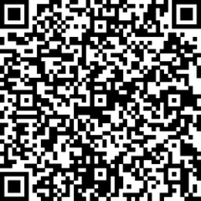
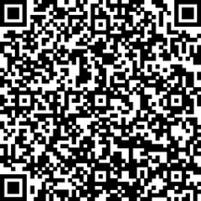
Distinct First Nations Accessibility Legislation: Dialogue Sessions Stay Tuned! EN FR
Distinct First Nations Accessibility Legislation (DFNAL)
DFNAL is grounded in First Nations’ right to self-determination and jurisdiction and rooted in time immemorial legal traditions upholding the rights of the Lands, the Waters, and the Peoples.
DFNAL Regional Engagements: March 2026:
1) Eastern / Quebec/ Ontario: 1-day Dialogue Session
2) Western / Northern: 1-day Dialogue Session

Slide 12

Miigwetch!
The AFN acknowledges the countless disability advocates over the decades that have made this work possible, including Wendall Nicholas and Doreen Demas, and many more!
Contact
Marie Frawley-Henry
mfrawley@afn.ca
Senior Policy Analyst
Assembly of First Nations

