Slide 1
Assembly of First Nations (AFN)
Survey Findings to Inform
A Distinct First Nations Accessibility Law
Update to the 2024 Jordan’s Principle Service Coordinator Gathering
March 07, 2024.

Slide 2
Key Updates Accessibility/Disability Inclusion
The Accessible Canada Act (ACA) came into law in 2019, and First Nations will be subject to the ACA in 2026.
AFN Resolutions:
AFN Resolution 15/2022, advocates to extend the date for implementation in First Nations and to secure major investments for First Nations and the regions to become accessible.
AFN Resolution #10/2018, directs the AFN to work with Employment and Social Development Canada (ESDC) to secure resources to develop distinct First Nations accessibility legislation.
AFN Resolution #15/2022, Major Investment Needed to Build Fully Accessible First Nations.
In 2022, A Distinct First Nations Accessibility Law Discussion Guide was developed to guide engagements with First Nations, the regions and leadership to build fully accessible First Nations governments.
Advocacy efforts are ongoing to secure long-term funding to engage with First Nations to advance legal options to inform A Distinct First Nations Accessibility Law.

Slide 3
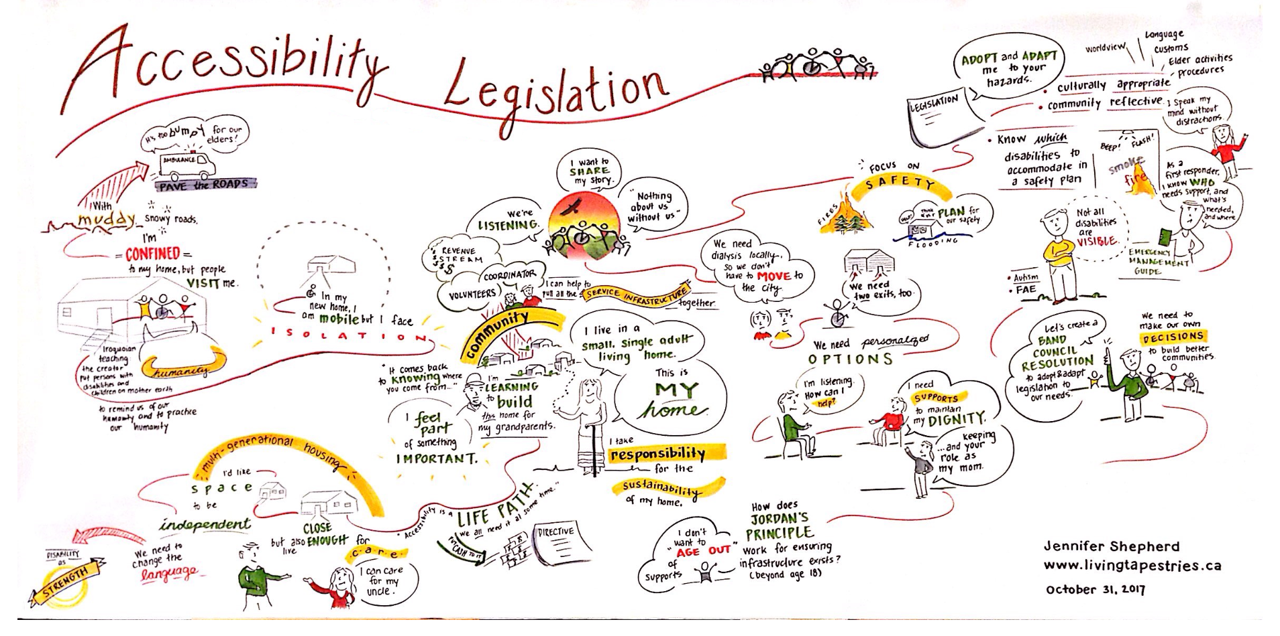
A DISTINCT FIRST NATIONS ACCESSIBILITY LAW
In 2023, A Draft Distinct First Nations Accessibility Framework was drafted with the guidance of the First Nations Persons with Disabilities (FNPWD) and Knowledge Keepers Advisory Circle, and others.
The framework is informed by the Seven Sacred Teachings or Seven Sacred Laws. These laws act as a foundation to facilitate a reconnection to the Spirit and the Land to guide a change of heart and mind that is in balance with Natural Law.
Moving This Work Forward - Accessibility and Disability Surveys: Current Analysis
Survey for FNPWD (and for undiagnosed individuals)
Survey for Jordan’s Principle Navigators
Survey for NIHB Navigators
Survey for First Nations Health Centres

Slide 4
Jordan’s Principle Poll Results: What we Heard!
How many people are included in your Jordan’s Principle case load?

Slide 5
Case Load: Top Barriers and Supports for Clients with Disabilities
Do you have enough support to manage caseload? 43% No 8% Not Sure
Do you have enough support to manage caseload? 49% Yes
Top Barriers to Caseload Management
Top Supports for Caseload Management
Caseload is just too high:
“The rate of new referrals and current caseload is unsustainable…”
Need admin support, need an administrative professional.
New to the job, feeling overwhelmed/alone:
“I am just starting out with this position. Some days are super busy and I am basically a "one man show"
Missing support from Leadership
Geographic barriers to finding support professionals and new Navigators.
Travel, logistics and communication complications with serving “off-reserve” clients.
Accessible Management /Supervision /Regional Support
Teamwork:
“A confident team with the capacity to work together in navigating community resources and systems.”
Admin – Administrative Professional:
“Administrative assistant plays an important role in my management of my caseload as the administration assistant plays a key role in processing payments for the service delivery.”
Strong organizational strategies and tools/technology to support organization
Wraparound services with other social service organizations

Slide 6
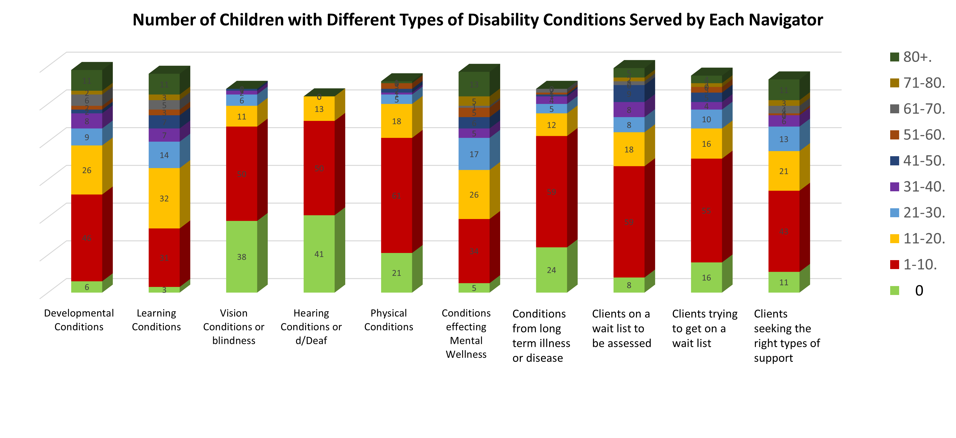
Jordan’s Principle Supporting First Nations Children with Disabilities

Slide 7
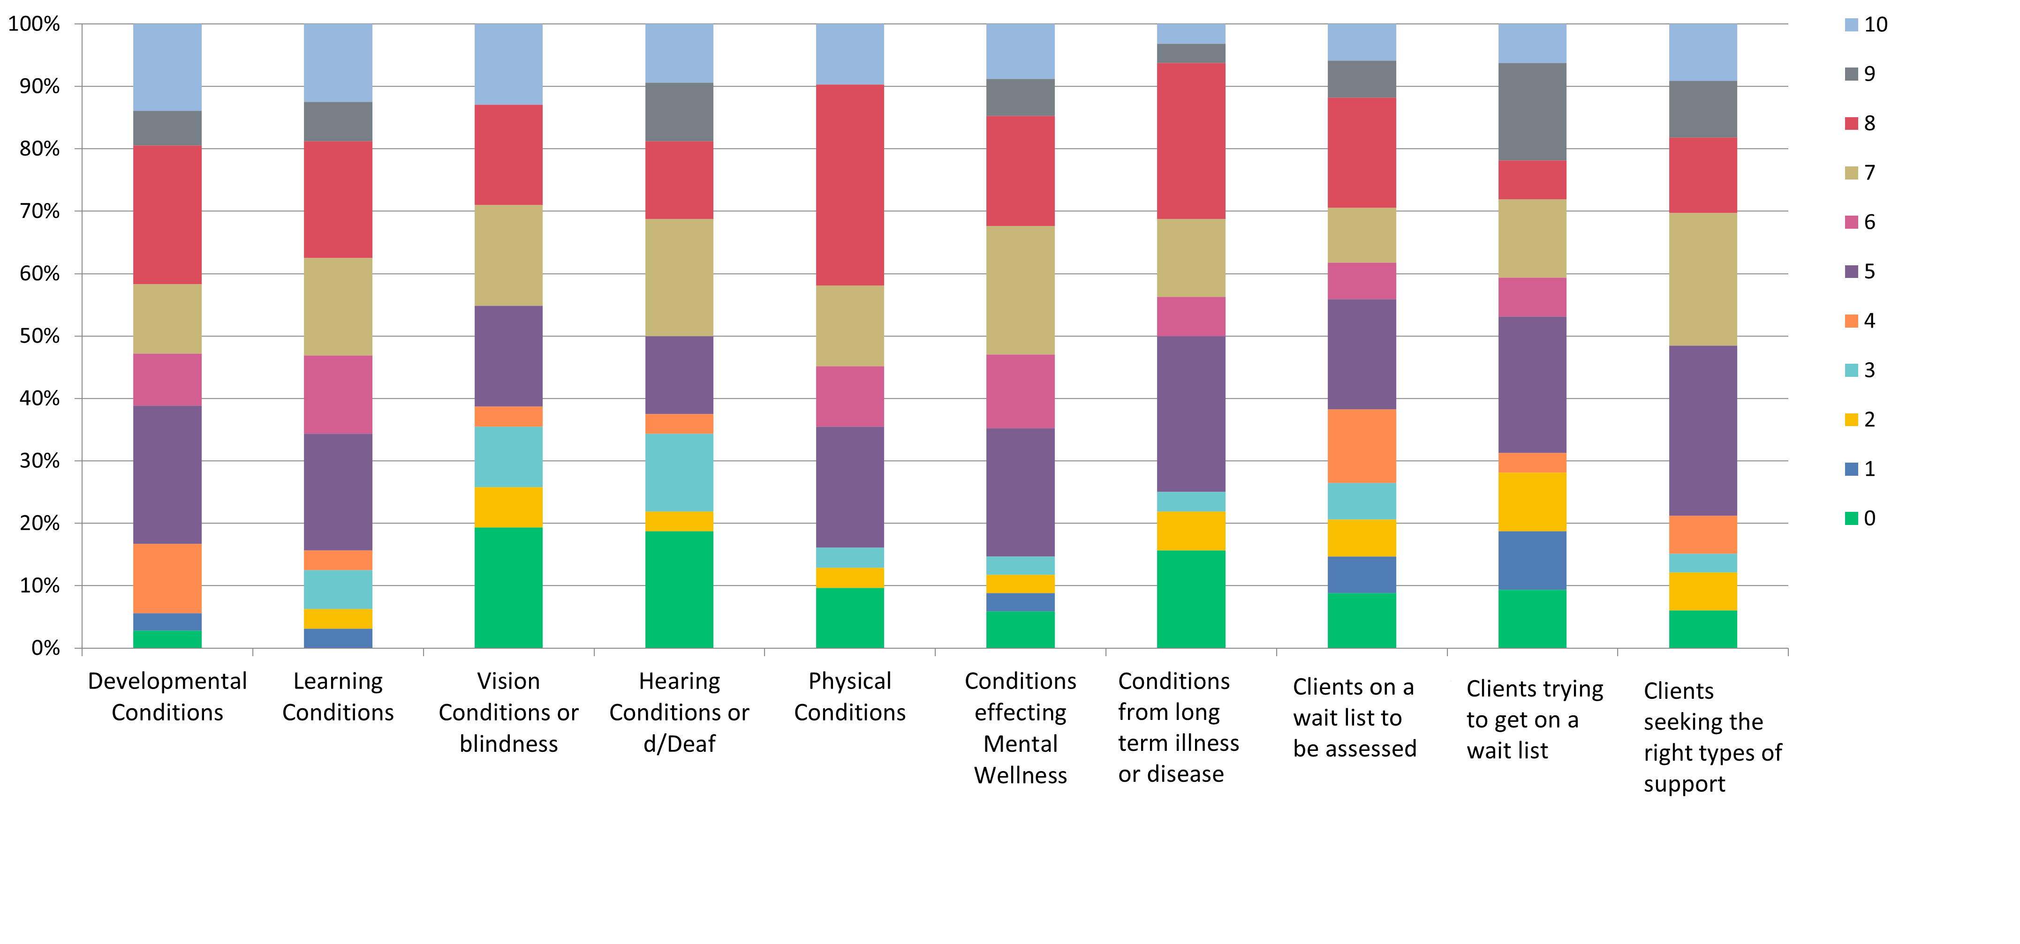
How well are you able to respond to clients with disabilities needs on a scale of 1-10, with 1 being not at all and 10 being completely?
Over half reported they were able to meet the needs of clients with:
Developmental Conditions
Learning Conditions
Physical Conditions
Mental Wellness Conditions
(rating their ability to respond to client needs at 7-10/10)
Less than half reported meeting the needs of clients with:
Vision Conditions
Hearing Conditions
Conditions resulting from long term illness
Those who are on a wait list to be assessed or diagnosed
(rating their ability to respond to client needs at 1-4/10)

Slide 8
Health System: Top Barriers to Supporting Clients with Disabilities
Culturally appropriate mental health services are rare.
Specialists can be harder to see than generalists, either due to lack of availability or due to lack of ability to get referrals.
Referrals and diagnosis can be difficult due to waitlists and lack of specialists and family doctors.
Some parents may be avoiding physiotherapy due to “co-pays.”
Urban residents or those close to an urban center have more access to specialized services; travel or availability of services can be a barrier for non-urban residents.
Northern communities have less access to specialized services due to lack of local availability.

Slide 9
Top Support:
“Wrap Around” Services
and
Support Professionals Working Together
96% reported opportunities to collaborate across sectors.
“We collaborate with other programs in our organization as well as in community. This helps with referrals and connecting clients to community supports.
This creates access to ‘circle of care’ people. This helps with receiving support letters from experts in different areas of child development.”
Do you have the opportunity to collaborate with other support professionals in or outside of your service area?

Slide 10
Miigwetch!
The AFN acknowledges the countless disability advocates over the decades that have made this work possible, including Wendall Nicholas and Doreen Demas, and many more!
Contact:
Marie Frawley-Henry
mfrawley@afn.ca
Senior Policy Analyst
Assembly of First Nations

