Slide 1
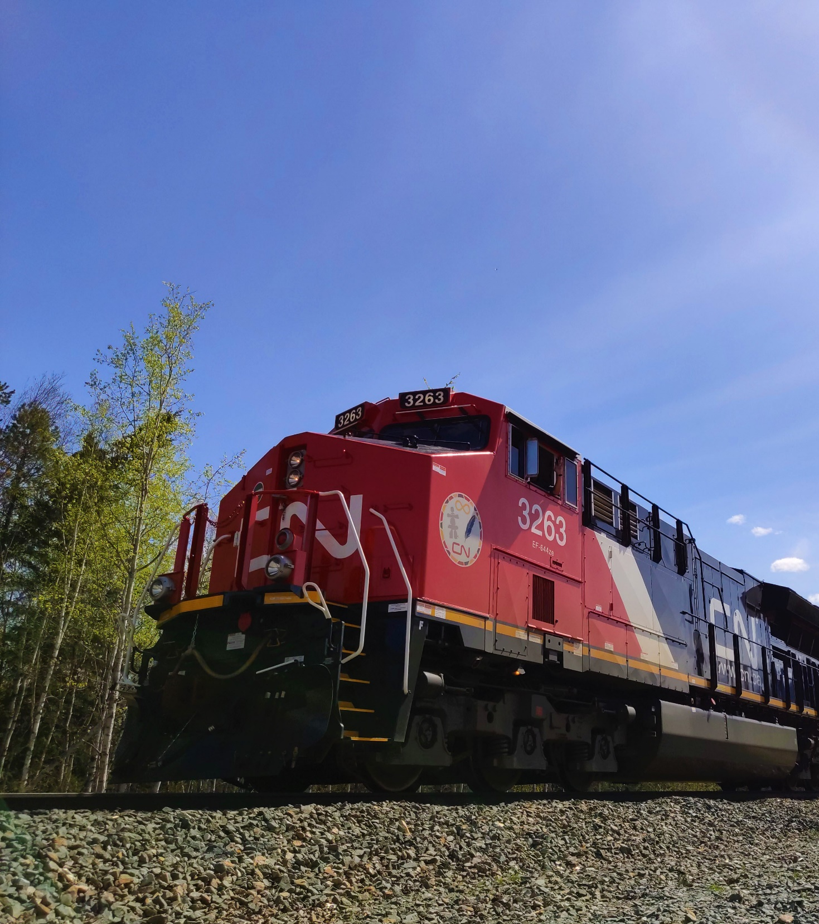

CN Rail Resources
and
Outreach Opportunities
Steven Santelli
Indigenous Relations Manager
Prairie Region

Slide 2
Who we are
A world‑class transportation leader and trade‑enabler
2022 HIGHLIGHTS
Essential to the economy, to the customers, and to the communities it serves, CN safely transports about 300 million tons of natural resources, manufactured products, and finished goods throughout North America every year.
CN connects Canada’s Eastern and Western coasts with the U.S. South. CN and its affiliates have been contributing to community prosperity and sustainable trade since 1919. CN is committed to programs supporting social responsibility and environmental stewardship.
CN operates within or adjacent to nearly 230 reserve lands of more than 120 First Nations and Métis peoples in eight provinces in Canada and seven reservations in the United States.
24,000
employees*
C$17.1B
revenue
60.0%
operating ratio
C$2.8B
capital investments
18,600
route miles
C$108.7B
market capitalization*
* As at Dec. 31, 2022
5.7M
carloads

Slide 3

Introduction
Strategic Pillars
Emergency Response Plans
Ask Rail Application
Protective Direction 36
Safety and Technology
Equipment and Resources
Training Opportunities
Railway Personnel
Key Route Risk Assessments
Notes:
-No need to read each line out loud.

Slide 4
Indigenous Relations:
Five Strategic Pillars
Cultural Awareness and Employee Engagement
People and Employment
Community Engagement and Relationships
Economic Reconciliation
Environmental Stewardship and Safety
Internal training
Diversity and inclusion within CN’s workforce
Proactive meaningful engagement
Procurement and business development
Protecting the environment and promoting safety

Slide 5
Indigenous Relations Managers
BC North & Alberta North
Karla Graf, 604-679-8039
BC South
Tyler Mitchell, 403-835-9430
Prairies
Steven Santelli, 204-232-7652
Ontario
Theresa Nelson, 705-943-6011
Quebec and the Maritimes
Jennifer Jerome, 514-209-9018
Employment Partnerships
Vanessa James, 780-643-7723

Slide 6
CN Incident Response Teams
Environmental Team
Emergency response planning and execution
Dangerous Goods Team
Incident response
Regulatory compliance
Incident site remediation and restoration
Outreach and training opportunities
Regulatory compliance
Corporate support
Drills and deployment exercises
Notes:
-CN has two distinct Teams that are involved in emergency response preparedness and planning.
-These two teams work very well together, and as a Team provide a safe and effective response to incidents.
-Large portions of their respective portfolios is involved in Training and Preparedness and Planning.

Slide 7
CN DG System Protection
Dangerous Goods Officers
HAZMAT Specialists
Environmental Officers
Environmental Protection Specialists
Contractors / Service Providers
Technicians / Industrial Fire Fighters / Industrial Hygienists
Environmental Contractors
Remediation
Industry Partners
Technical Specialist, CANUTEC, Product SME’s

Slide 8
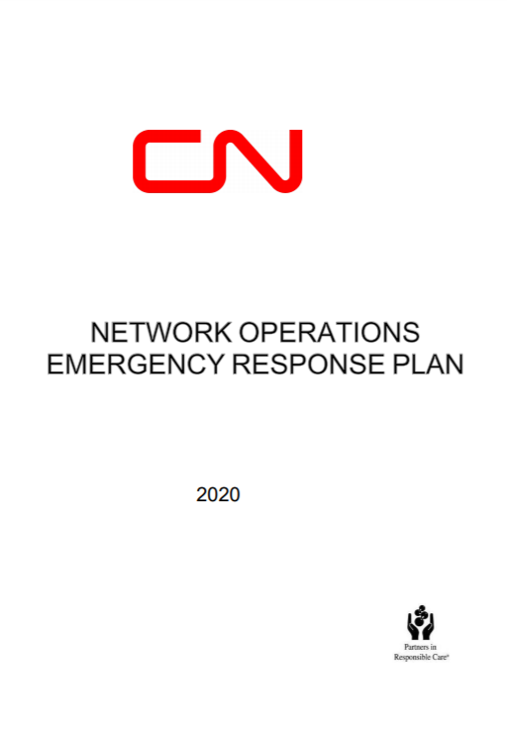
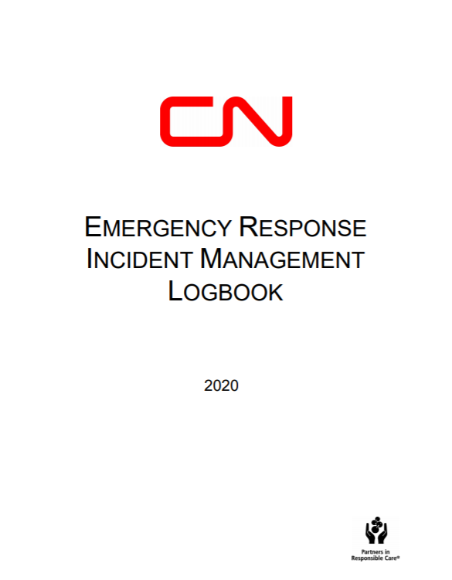
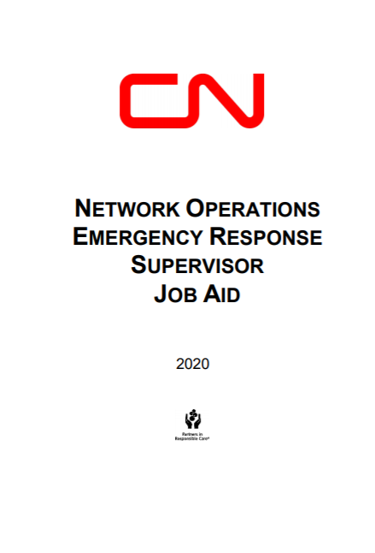
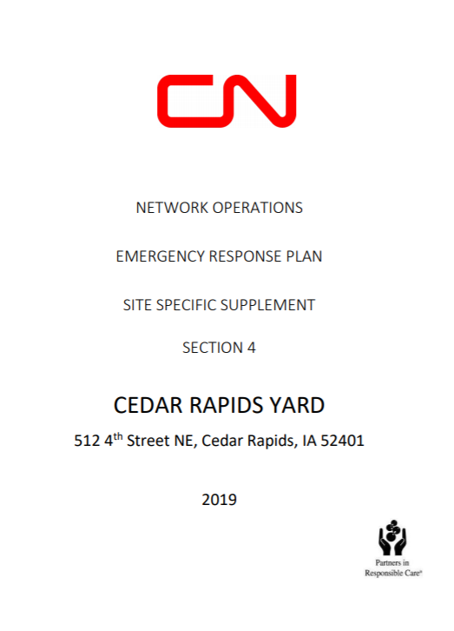
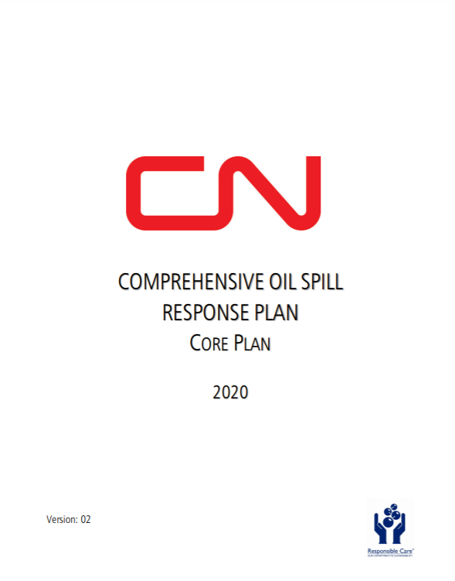
CN Emergency Response Plans
Regularly reviewed for updates and accuracy
Over 325 Yard Plans
Notes:
-CN has a variety of emergency response plans to help keep people, the environment and property safe.
-The NOERP has been prepared to communicate the plans, programs, personnel,
and CN-maintained resources to effectively initiate an emergency response, manage the incident, and
mitigate it in a safe, efficient, and well-coordinated manner.
-Depending on the country and or province, different emergency response plans are in effect.

Slide 9
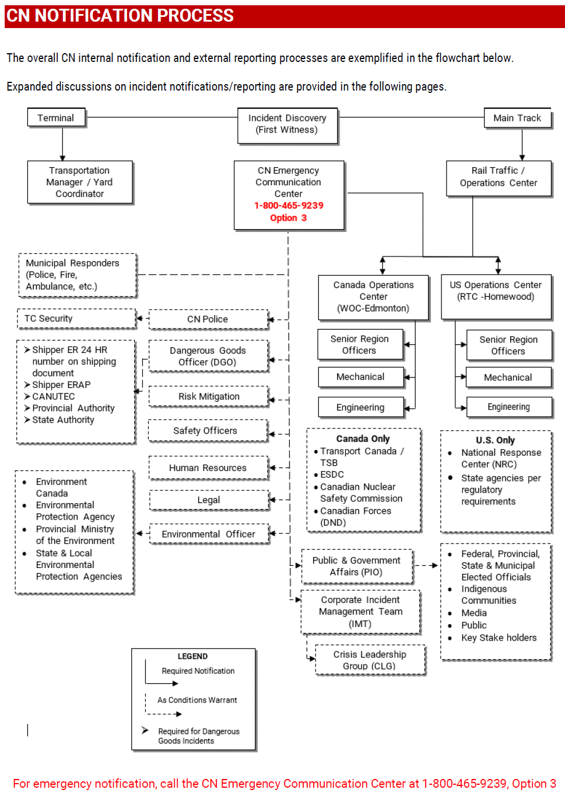
Incident Notification Process
Notes:
-The incident notification process is updated every three years to ensure compliance.
-The process meets federal notification requirements outlined by a variety of Federal departments (TDG, Railway Safety Act).

Slide 10
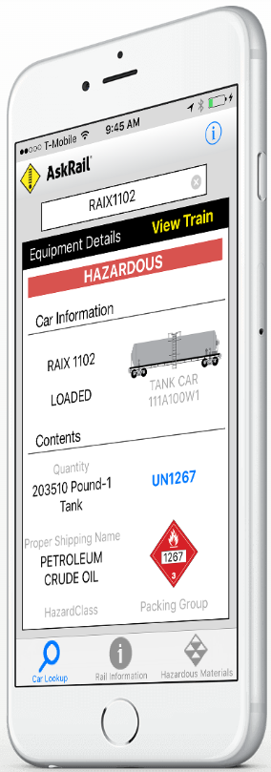
AskRail Application
Free for First Responders
Notes:
-AskRail is free to download and use.
-Designed to be used by public first responders.
-Users must be trained on the application prior to being able to use it.

Slide 11
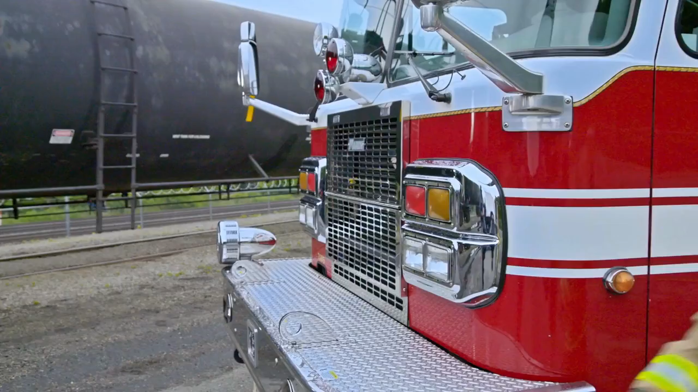
AskRail App Video

Slide 12
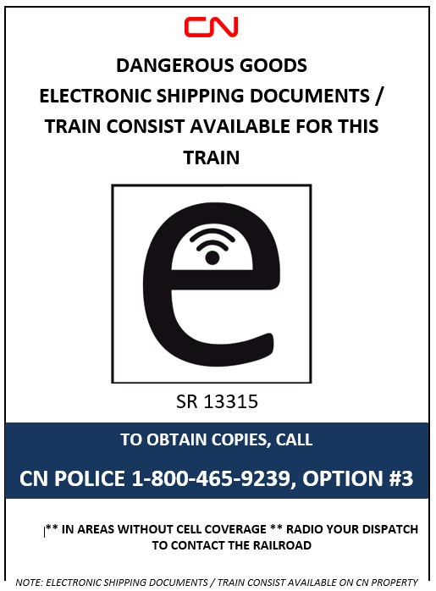
Electronic Shipping Documents (SR13315.2)
CN is making the transition from paper copies of shipping documents to electronic shipping documents.
When on the scene, you have multiple options to retrieve a consist:
1: contact the crew for the consist (paper or electronic),
2: the crew can Bluetooth and or email a copy,
3: call CN Police to retrieve an electronic version,
4: use the AskRail App, and
5: reach out to your DGO or CN manager on scene for a copy.
The information may be displayed inside the first locomotive.
The certificate holder must be able to provide first responders, inspectors, peace
officers, or CANUTEC with a copy of the electronic shipping document immediately
upon request from the time the information is requested;
Note: Every effort should be made to provide the electronic shipping document
without delay from the time the information is requested so that first responders,
inspectors, peace officers, or CANUTEC are able to perform their duties in a timely
manner.
Notes:
-The train consist is located with the Conductor in the lead locomotive.
-Consist can be emailed to responding personnel.
-Individual waybills and Safety Data Sheets (SDS) for each effected commodity can be emailed to responding personnel.

Slide 13
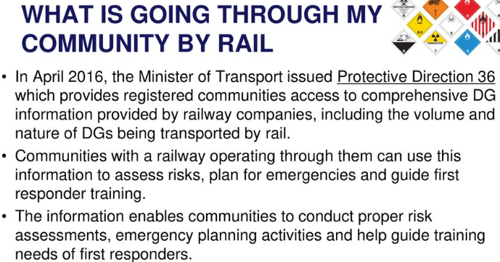
Protective Direction 36 – flow study reports
Available for your community
Notes:
-CN has long shared with communities a list of dangerous goods that go through their community, but after Lac Magentic, Transport Canada created an official way for communities to register for the information.
-These reports contain information about dangerous goods and registered communities now receive an annual report which provides information on the type of dangerous goods moving through a jurisdiction which can be shared with the public.
-As well, CN publishes on its web site information about the DG moving through each province on its network.
www.cn.ca/dg

Slide 14
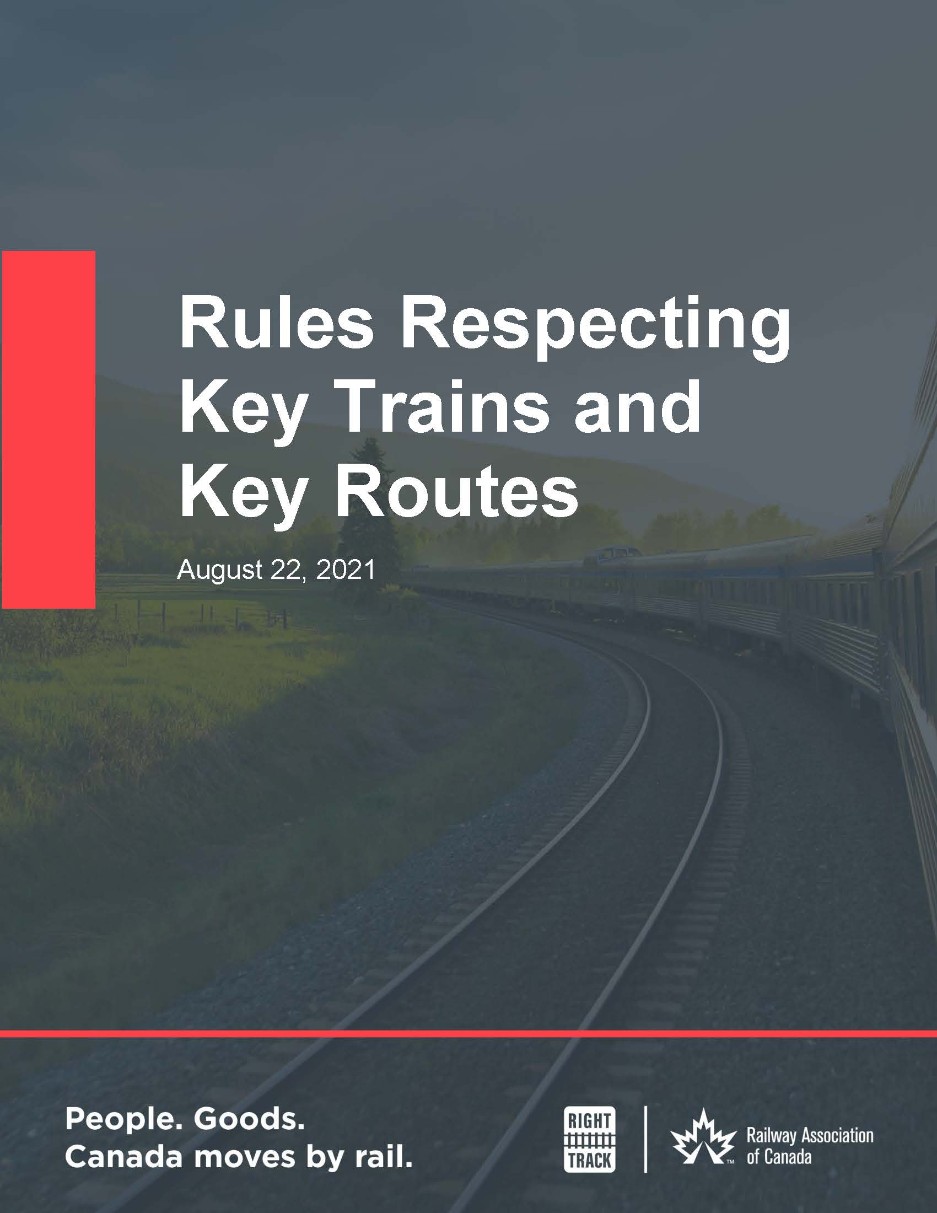
Key Route Risk Assessments
Risk Assessments for Key Routes
Mandated under Transport Canada Rules
Identify opportunities to enhance protection, adding additional measures and/or new technology
Key Route = any track on which, over a period of one year, is carried 10,000 or more loaded tank cars or loaded intermodal portable tanks containing dangerous goods
Assessments for all Key Routes must be completed at least every 3 years
Notes:
-Key route = as defined in the Transportation of Dangerous Goods Act, 1992 or any combination thereof that includes 10,000 or more loaded tank cars and loaded intermodal portable tanks
-Source: Rules Respecting Key Trains and Key Routes (canada.ca)
-Communities can submit their input at: https://www.cn.ca/en/safety/moving-dangerous-goods or simply go to www.cn.ca/dg and scroll to the bottom of the page.

Slide 15
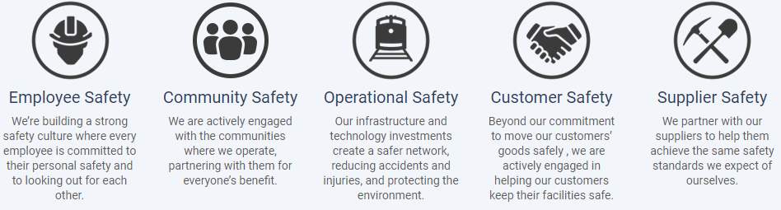
Safety is a Core Value at CN
Download your copy of the Customer Safety Handbook
at www.cn.ca/safetyhandbook
Notes:
-At CN we engage with internal and external stakeholders and rightsholders to ensure everyone has the tools and training to remain safe.
-Examples: TransCAERS events, the CN Campus, Winter Safety Plan, Fire Risk Mitigation Plan, table top and training scenarios, etc…

Slide 16

Safety at CN
Operation LifeSaver
Operation LifeSaver is dedicated to preventing collisions at railway crossings and railway trespassing incidents in Canada. We believe the key to achieving this goal is public education.
Notes:
-OL is funded by the Railway Association of Canada (RAC) and provides free training to communities.
-The IT Team is trained to deliver the messaging across the country.
-A variety of languages are available in the handouts available on the OL site.

Slide 17

Technology at CN
Ultrasonic Rail Testing: Identifies rail defects that could lead to broken rail
Hi-Rail Geometry and Joint Bar Inspection: Detects missing bolts and cracks in joint bars
Autonomous Track Inspection Program: Real time monitoring, 3D imaging, collects data on ballast, ties, spikes, plates
Automated Inspection Portals: Real time 360-degree cameras utilize AI technology to detect defects.
Bridge Management Program: Field inspections of bridge structures, including dive surveys for large structures, augmented with the use of un-manned aerial vehicles and other technologies e.g., Sonar, LIDAR
Transport Canada Inspections: Federal agency employees conduct inspections of CN and its infrastructure
Notes:
-CN utilizes both in person, traditional technology and new AI to work together to create a safe and effective rail network.
-The above technologies listed do not include all technology at CN.
-Detectors and or inspection programs are federally regulated, and CN meets and more often exceeds the federal requirements.

Slide 18
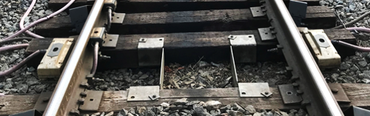
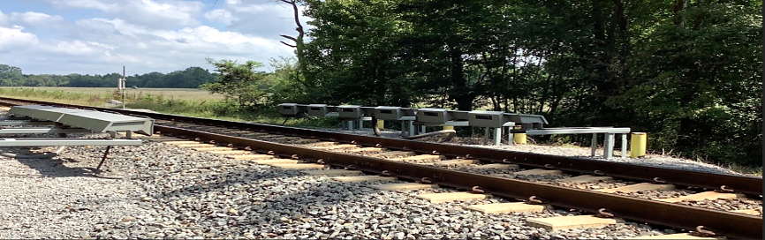
Dense network of advanced detector technologies
Technology at CN
Detecting for:
Hot bearings and wheels
Acoustic bearing
Wheel impact load
Wheel profile
Dragging equipment
High/Wide Load
Scales for overweight
High Water
High Wind
Landslide
Hot Bearing Detector:
Monitors wheel bearing temperature on passing rolling stock, and immediately alerts train crews of issues that require corrective action
Acoustic Bearing Detector:
Assesses wheel bearing sound signature to identify compromised components well in advance of a heat-generating failure.
Keeping trains on track and limiting stoppages to increase network fluidity
Notes:
Our advanced detector technologies across our network help us inspect and analyze a number of mechanical components and other issues ranging from shifted loads or loads that may be too high or wide; or if there are high wind, water or landslide conditions.
Here’s a glimpse at two of our advanced detector technologies:
Hot Bearing Detectors monitor wheel bearing temperatures on passing rolling stock to immediately alert crews of any issues, so the train can be stopped and inspected. Dragging Equipment Detectors – which identify low-hanging hazards on the undercarriage – are often added to Hot Bearing Detector sites for added protection.
Acoustic Bearing Detectors assess wheel bearing sound signature to identify compromised components well in advance of a heat-generating failure.
Overall, these advanced technologies and data analytics help us take preventative and proactive measures to keep trains on the track and safely reaching their destinations.

Slide 19
Technology at CN
Wayside Inspection System: Detects Hot bearings & Hot wheels
  Wheel Impact Load Detectors: Detects wheel imperfections
  Dragging Equipment Detectors: Detects dragging equipment
Ultrasonic Rail Testing: Identifies rail defects that could lead to broken rail
Hi-Rail Geometry and Joint Bar Inspection: Detects missing bolts and cracks in joint bars
Autonomous Track Inspection Program: Real time monitoring, 3D imaging, collects data on ballast, ties, spikes, plates
Automated Inspection Portals: Real time 360-degree cameras utilize AI technology to detect defects.
Bridge Management Program: Field inspections of bridge structures, including dive surveys for large structures, augmented with the use of un-manned aerial vehicles and other technologies e.g., Sonar, LIDAR
Transport Canada Inspections: Federal agency employees conduct inspections of CN and its infrastructure
Notes:
-CN utilizes both in person, traditional technology and new AI to work together to create a safe and effective rail network.
-The above technologies listed do not include all technology at CN.
-Detectors and or inspection programs are federally regulated, and CN meets and more often exceeds the federal requirements.

Slide 20
Responding Railway Personnel
CN Mechanical Department
Charged with the wrecking operations at an incident
CN Transportation Department
Moves trains from A to B
Inspects trains at departure and arrival terminals
Highest ranking officer works with the Authority Having Jurisdiction at an incident (unified command)
CN Engineering Department
Maintains the infrastructure (track, bridges, signals)
Conducts repairs and maintenance on railway vehicles
Notes:
-The three largest departments at CN are mechanical, transportation and engineering.
-At almost 100% of all incidents, at least 1 person from each department will be on site.
-The Authority Having Jurisdiction is generally the local Fire Department.

Slide 21
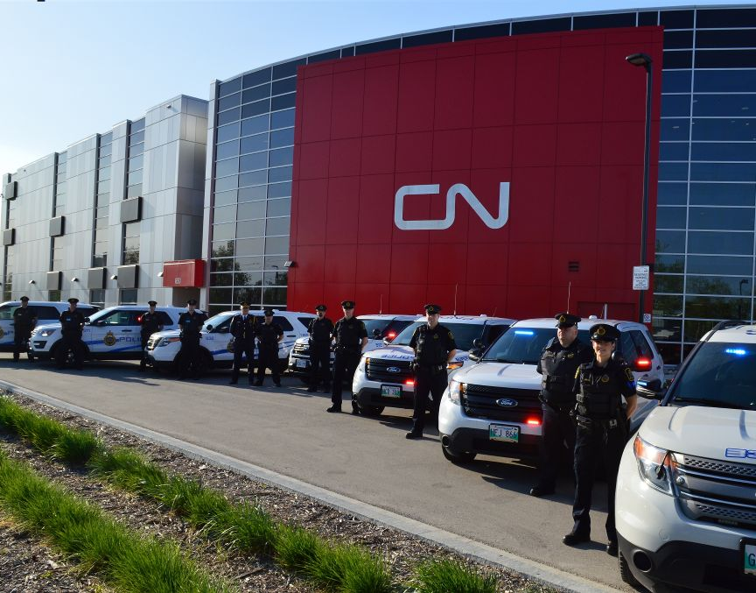
Responding Railway Personnel
CN Police
Provide site security at an incident.
Provide Operation LifeSaver classes.
1-800-465-9239 option #3
Notes:
-CN Police is a Federally Regulated Police Department which focuses on the safety and security of the communities that CN serves, and protecting its people, property and resources.
-Communication centre located in Montreal is French and English, 24/7 365.
-All calls are recorded.

Slide 22
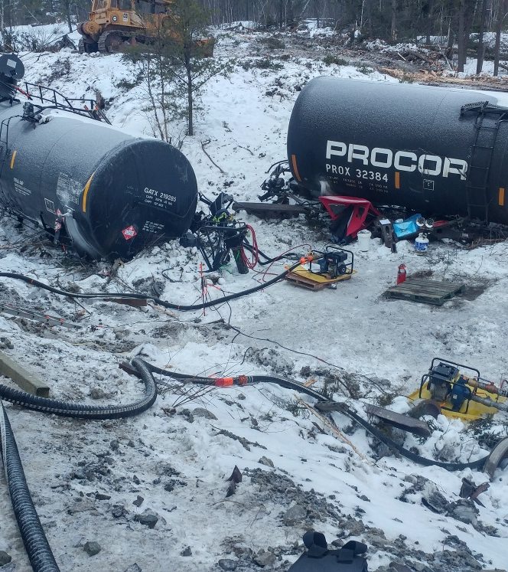
Responding Railway Personnel
ER Contractors and
Service Providers
Verified by CN to work on property through the eRailSafe program.
Provide specialized equipment, personnel and resources.
Notes:
-eRailSafe is the contractor compliance system for the Canadian Railroad Industry.
-All contractors who work for CN on a regular basis must register and be compliant.

Slide 23
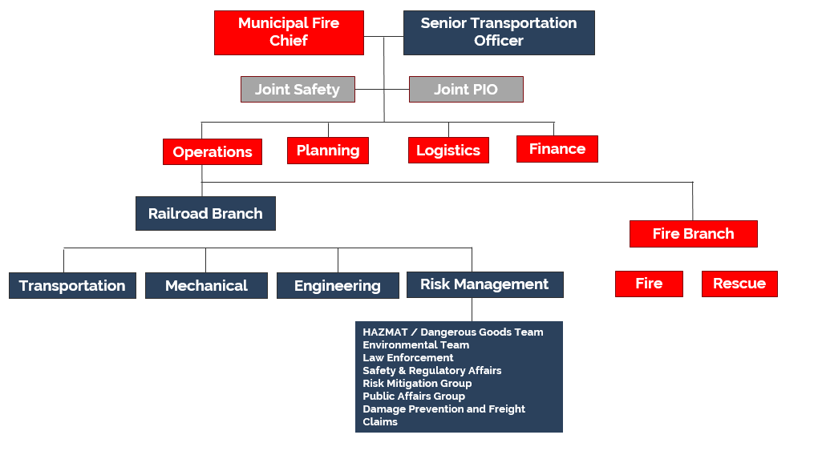
Unified Command
An Incident Command System application used when more than one agency has incident jurisdiction or when incidents cross political jurisdictions.
Agencies work together through the designated members of the UC
The senior person from agencies and/or disciplines participating in the UC, to establish a common set of objectives and strategies and a single Incident Action Plan.
Incidents where first responders, regulators and CN are on site together, Unified Command will be used.
Notes:
-CN utilizes the Incident Command System.
-Responding supervisors and managers are trained to a minimum of ICS 100 and ICS 200.
-The highest-ranking CN transportation officer typically works with the Authority Having Jurisdiction (AHJ) which usually is the fire department.

Slide 24
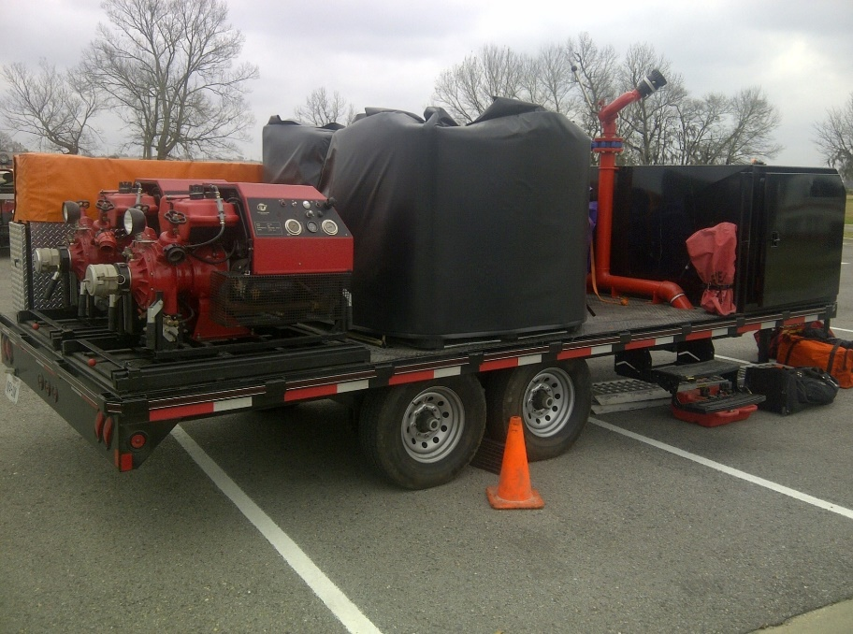
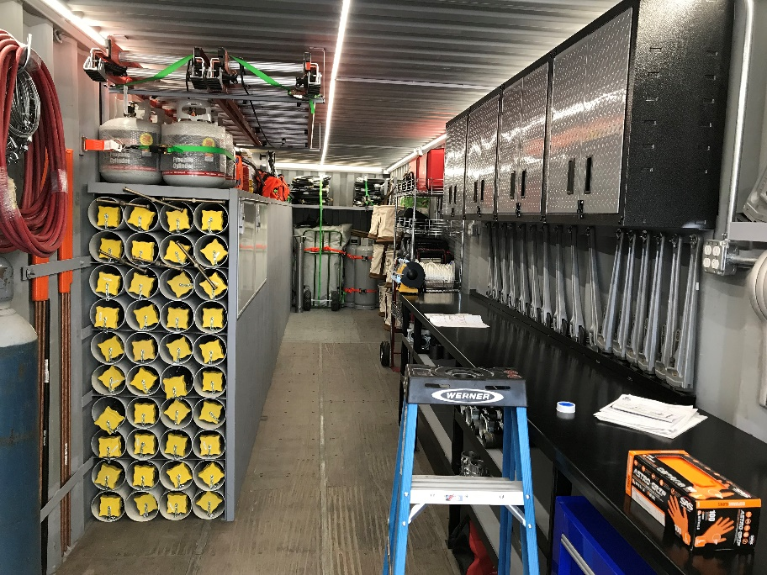
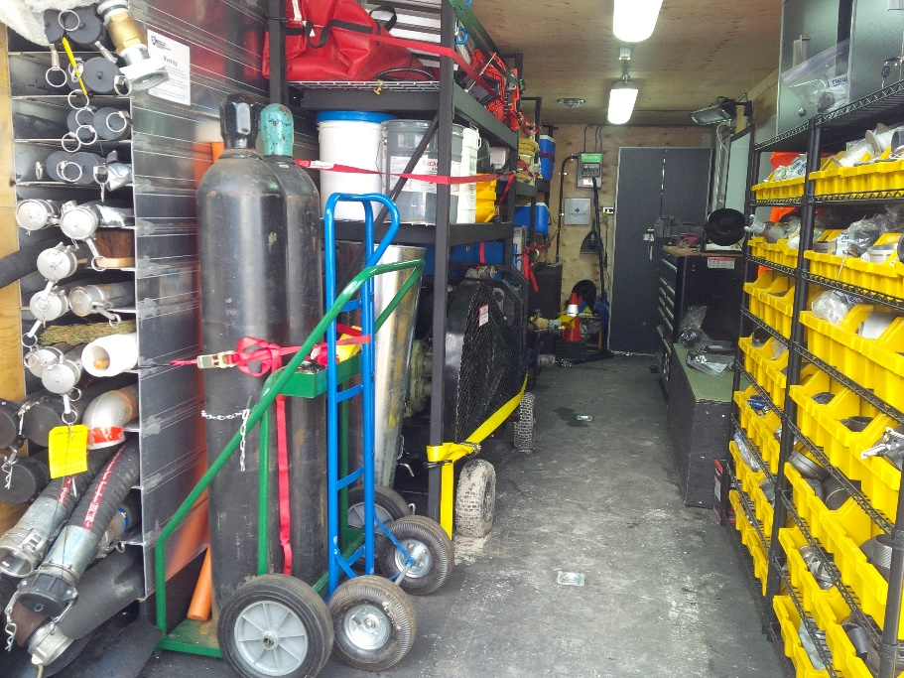
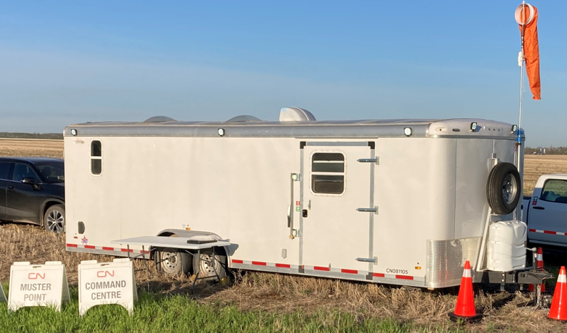
CN Emergency Response Equipment
Compressed Gas Trailers (2)
Fire Trailers (9)
Static Liquid Trailers (4)
Compressed Gas Trailers (2)
Fire Trailers (9)
Command Trailers
Equipment is used to help mitigate an incident and supplement ER contractor capacity
Notes:
CN has a variety of emergency response assets and equipment strategically staged throughout its North American operations.
CN has incident command trailers staged throughout the network to help provide a safe and secure space to meet.

Slide 25
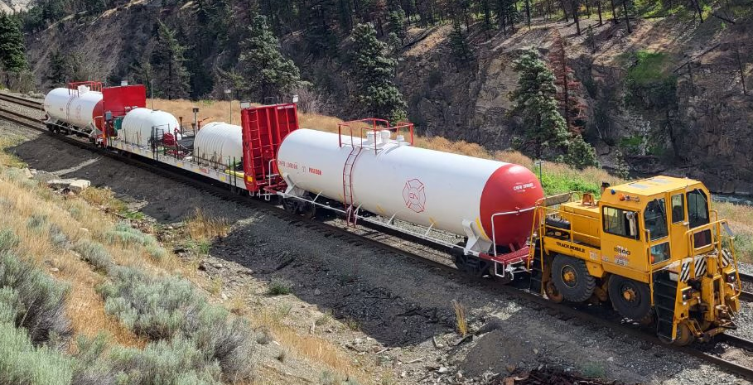
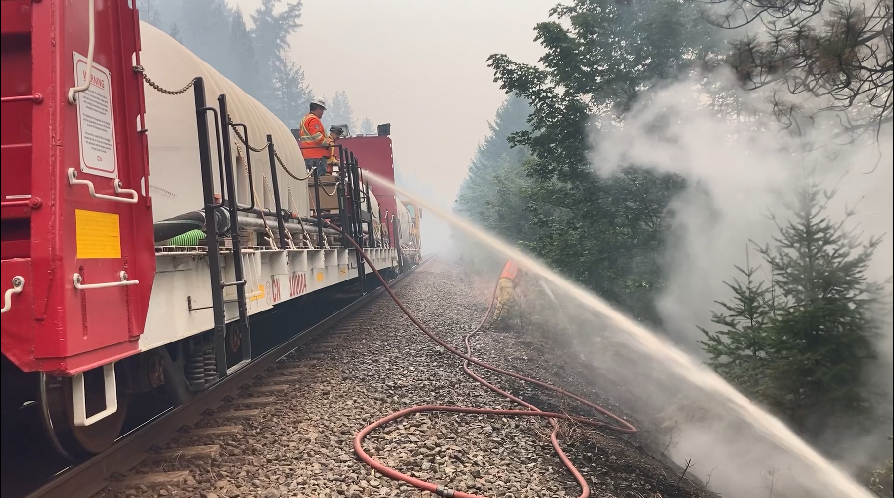
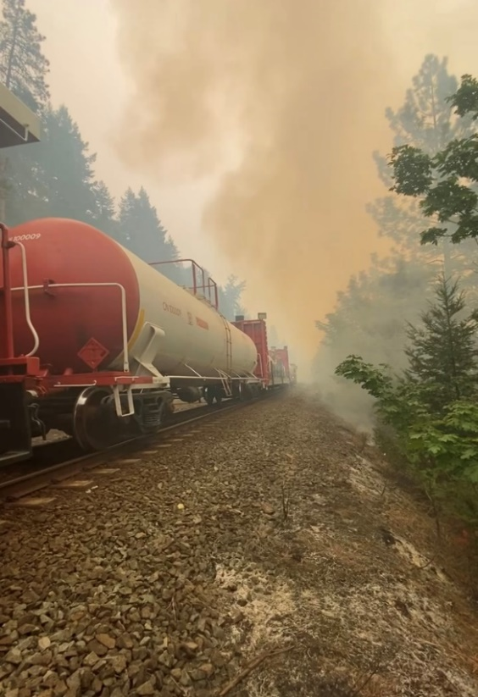
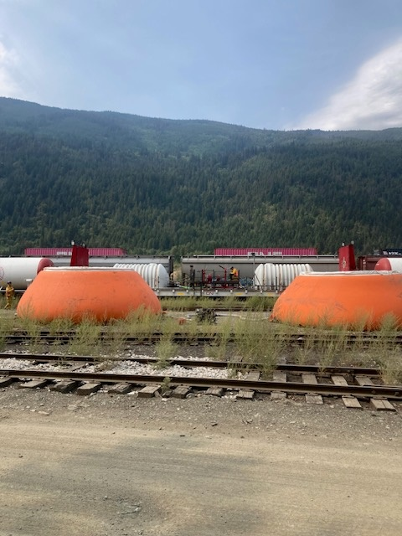
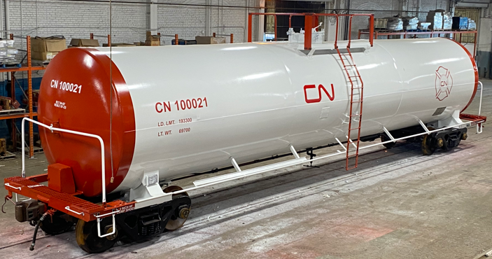
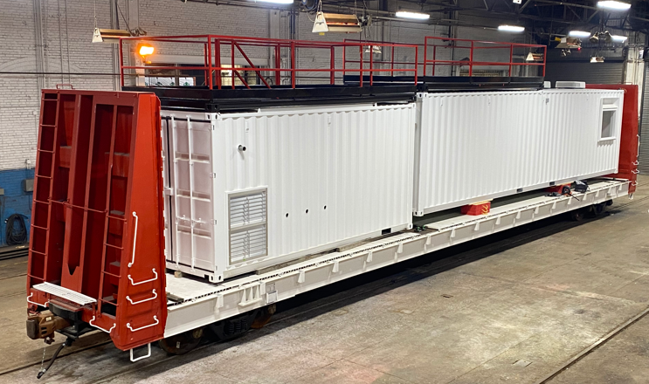
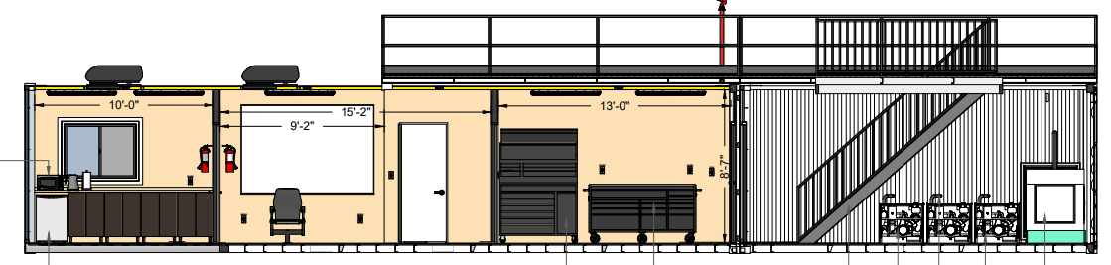
CN Emergency Response Equipment
Fire Prevention and Suppression
Poseidon, Neptune, and Trident
Community Partnership
Notes:
-CN has wildfire response equipment: used by CN and or qualified contractor to lay down water or suppressant and or mop up after a fire.
-Reference the CN Extreme Weather Fire Risk Mitigation Plan which is publicly available.

Slide 26

TransCAER and Responsible Care
An outreach effort to train community emergency personnel situated near rail lines where dangerous goods are transported.
The Chemistry Industry Association of Canada (CIAC) is responsible for drafting the Responsible Care Codes that member companies adhere to.
The movement (started in Canada and now global) follows the “cradle to grave” philosophy.
Notes:
-CN promotes its outreach activities under these two banners.
-Typically, industry uses the word ‘TransCAER’ as the generic term for outreach activities.
-CN is audited every three years to ensure its compliance with Responsible Care.

Slide 27
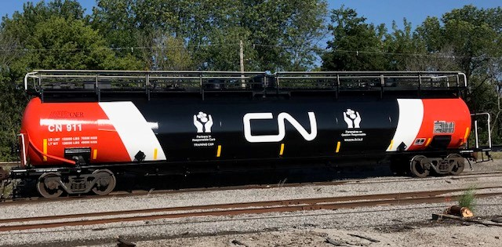
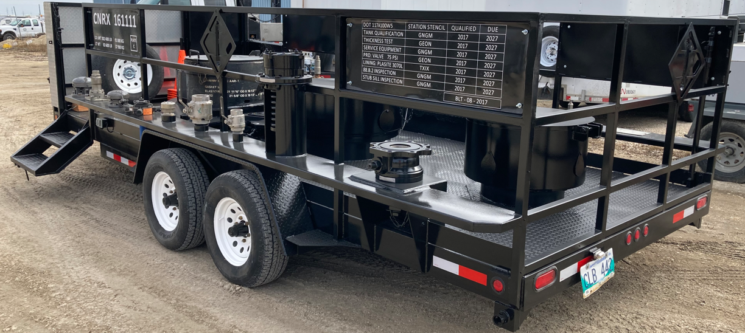
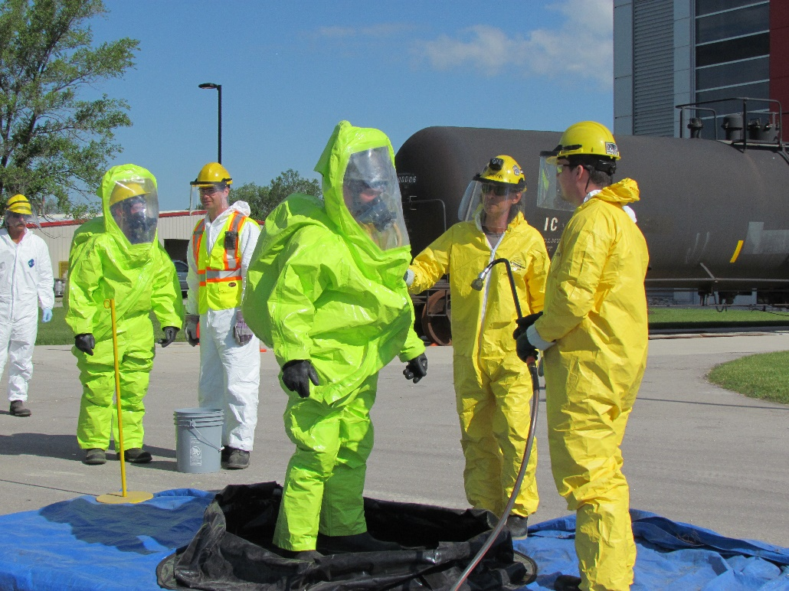
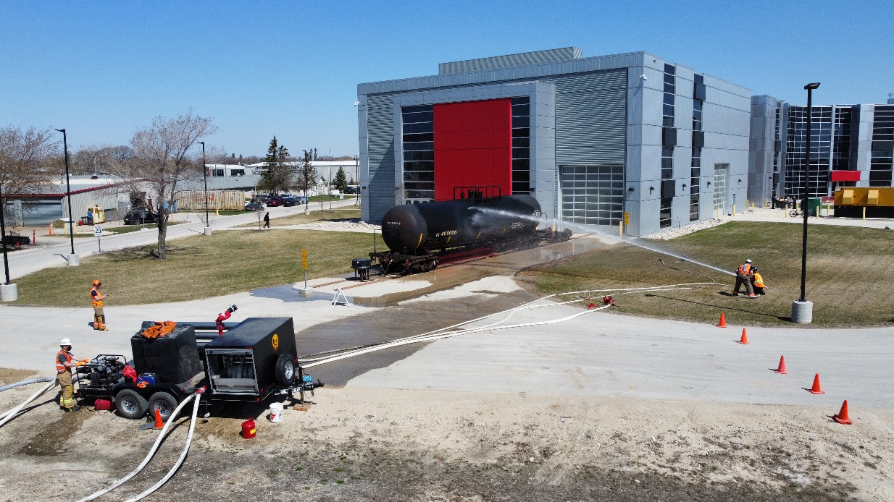
Outreach and Training Opportunities
Notes:
-CN, through its many Teams, provides a variety of outreach and training opportunities with communities.

Slide 28
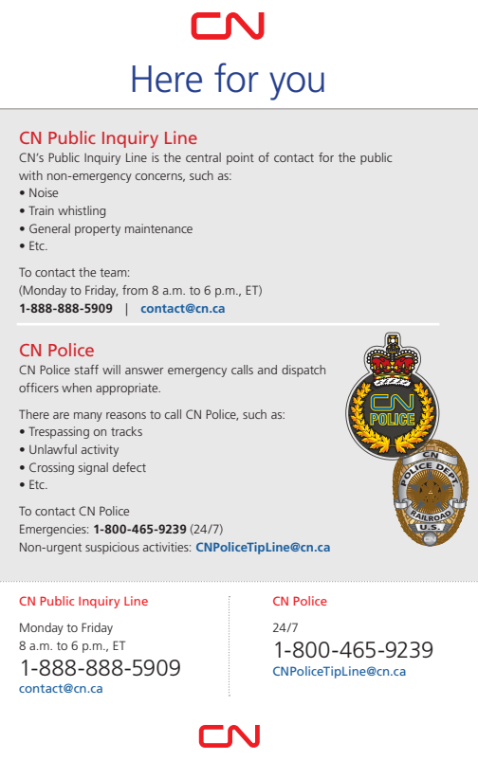
Notes:
This document is available to communities to post publicly. There is a PDF version to share and or print.

Slide 29
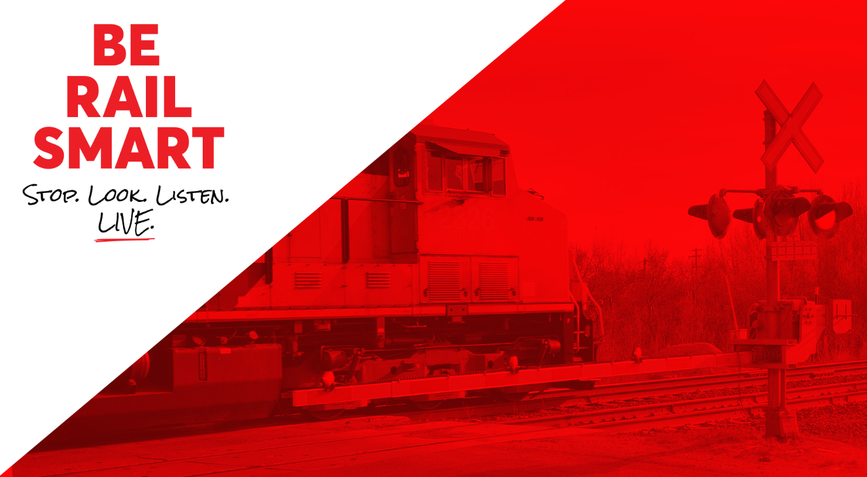
Railway Safety Week
Sept 23-29, 2024
Take the Pledge
Notes:
-When RSW occurs, the ‘take the pledge’ link will become active.
-Mention that RSW occurs every year, but that CN prioritizes safety above all else.

Slide 30

Thank you
Steven Santelli
204-232-7652
Steven.Santelli@cn.ca
CN Police 1-800-465-9239

