Slide 1
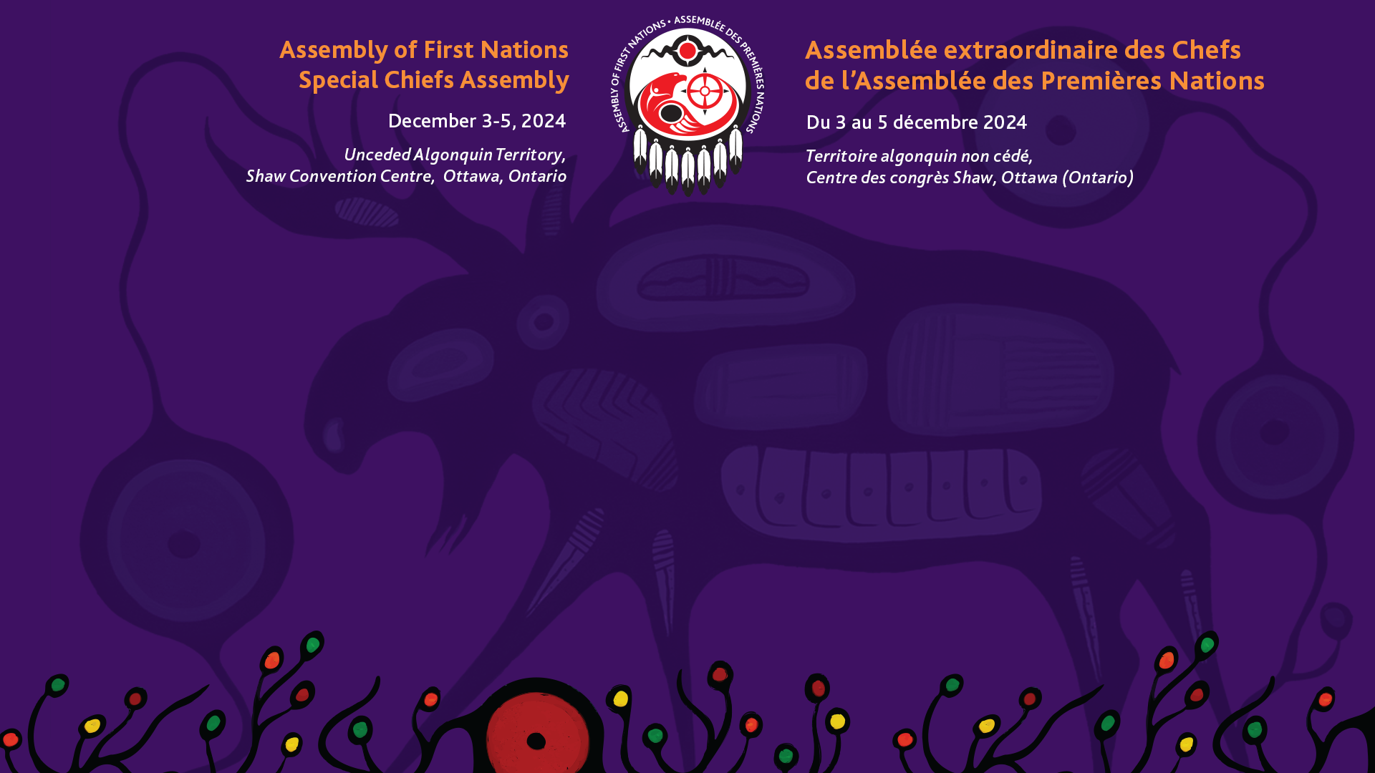
First Nations Citizenship Plenary
Natasha Beedie, Director of Rights and Governance
Aaron Asselstine, Acting Senior Director of Rights and Governance

Slide 2
Background
Canada has incrementally removed certain discriminatory elements of the Indian Act through policy, regulatory, and legislative measures.
In 2017, the Government of Canada initiated Bill S-3, An Act to Amend the Indian Act in response to the Superior Court of Quebec decision in Descheneaux c. Canada (Procurer general).
Bill S-3, addressed sex-based inequities in registration, allowing descendants of First Nations women who lost status due to marriage to a non-Indian man to become eligible for registration. Bill S-3 also removed the 1951 cut-off date from registration provisions.
This Bill failed to address the broader denial of self-determination in the registration provisions of the Indian Act.

Slide 3
Background
In 2019 and 2020, the AFN published a series of discussion papers on transitioning to First Nations control of citizenship along with a guide to establishing membership codes.
In 2021, a group of plaintiffs launched a constitutional challenge (Nicholas v. AGC) to address ongoing inequities faced by individuals with a family history of enfranchisement under the Indian Act.

Slide 4
AFN Mandates
AFN Resolution 42/2022, Demand for Consultation on Amendments to the Indian Act (1985), calls on the Government of Canada to not table any legislative amendments until it has adequately consulted with First Nations and provided the necessary resources for community engagement.
The AFN continues to advocate to the Minsters of ISC and CIRNA to provide funding for adequate engagements with First Nations on any amendments to the Indian Act, as well as to fund First Nations to reassert jurisdiction over their citizenship.

Slide 5
Bill C-38
After a brief period of engagement, the Minister of Indigenous Services Canada introduced Bill C-38, An Act to amend the Indian Act (new registration entitlements), in Parliament to remedy the impacts of historical enfranchisement.
The Bill means that individuals whose status under the Act was reinstated after enfranchisement, would be able to transmit status to their direct descendants to the same extent as individuals who were never enfranchised.
Currently, only women who were reinstated after being enfranchised for marrying non-status men can transmit status to their direct descendants to the same extent as individuals who were never enfranchised.
First Nations have consistently called on the Government of Canada to end the process of legislative assimilation through the Indian Act, and to fully recognize First Nations’ inherent right to self-determination over citizenship. Bill C-38 does not address the need for transformative change and the full recognition of First Nations’ authority over citizenship.

Slide 6
Implications for First Nations
Statistics Canada estimated that the removal of known sex-based inequities from the registration provisions of the Indian Act since legislative amendments in 2017 and 2019 could result in almost 256,000 newly registered persons by 2041.
Despite these estimates, Canada has not indicated an increase in funding for the cost for First Nations to deliver services to more citizens.
Currently, First Nations can explore paths to assuming control of their membership under section 10 of the Indian Act or by negotiating self-governing agreements and modern treaties through Crown-Indigenous Relations and Northern Affairs Canada.

Slide 7
Indigenous Advisory Process
The IAP, was launched on November 20, 2023, to bring together First Nations regional and national organizations to provide guidance to ISC on how to consult and cooperate with First Nations to address the second-generation cut-off.
Phase 2 of the IAP is set to open callouts for proposals in Winter 2024, with an allotted $10,000 available for engagements on second-generation cut-off.
The AFN is pursuing opportunities with ISC to support First Nations to engage in reforming elements of the Indian Act surrounding enfranchisement, deregistration, the second-generation cut-off, and to promote First Nations’ rights to self-determination over citizenship.

Slide 8
United Nations Committee on the Elimination of Discrimination against Women
The Committee identified the following issues with respect to First Nations’ citizenship in Canada:
  (a) The provisions of the Indian Act setting forth that after two generations of “out-parenting” Indian status cannot be transmitted to a child, as well as requiring that there be two Indian parents to transmit status to a child.
  (b) The ongoing lack of action to reinstate membership to the Indian Bands ( natal and other ) to woman and their descendants who were automatically removed from their Indian Band membership.
  (c) The legal provisions of the State party preventing First Nations women and their descendants from obtaining reparations for human rights violations regarding the Indian Act.
  (d) The low registration of new membership: the lack of effective policies ensuring that unregistered Indigenous women and girls, as well as Indigenous women living off-reserve can access programs and benefits.

Slide 9
The Committee recommends that the State party:
(a) Amend section 6 of the Indian Act to remove status categories s.6(1)(f) and s.6(2), and any other legal provision that do not recognize the equal rights of women and men to transmit their Indian status to their children and eliminate all remaining categories and classes of Indian status, including differentiations in eligibility caused by pre- and post-1985 birth and marriage dates.
(b) Review records to grant status to First Nations women, and their descendants who were previously denied status and are now eligible.
(c) Repeal all domestic legal provisions restricting access to comprehensive reparations for the violation of human rights of First Nations women and their descendants, including those stemming from the Indian Act, and develop a mechanism to address reparation claims, in coordination with First Nations women and their descendants.

Slide 10
Next Steps
The AFN continues to monitor Bill C-38 and has called on the Government of Canada to provide adequate resources to all First Nations to engage with their community members.
The AFN is will continue to advocate for the removal of gender-based discrimination in the Indian Act, and removal of two generation cut-off of status for registration.
The AFN will work with Canada to implement the UNDA APMs related to citizenship and to provide adequate and sustainable funding for First Nations to support self-determination over citizenship.

