Slide 1
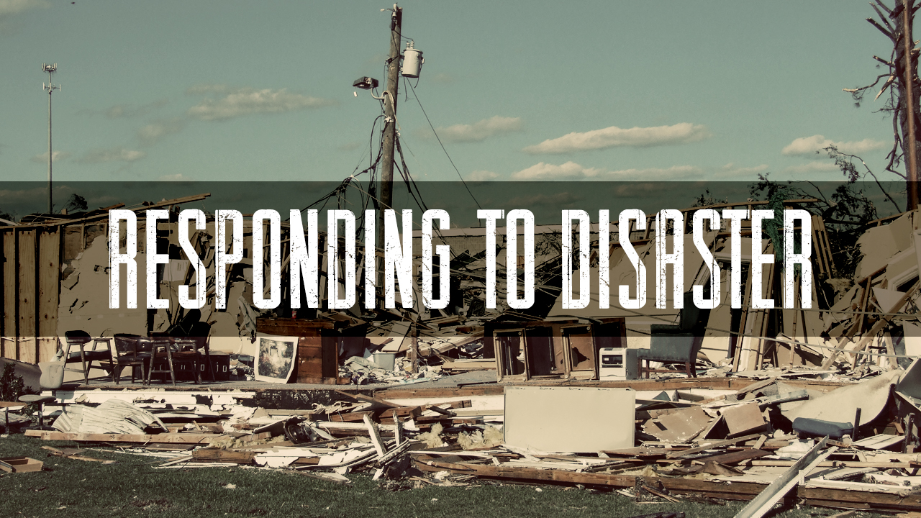
Skills for High-Stress Operations
March 2021 retrieved from https://fbctlh.org/ministries/natural-disasters/

Slide 2
Cam Challenger
http://specialrescueops.com/sro-advanced-incident-support-team/
https://www.teaam.ca/

Slide 3
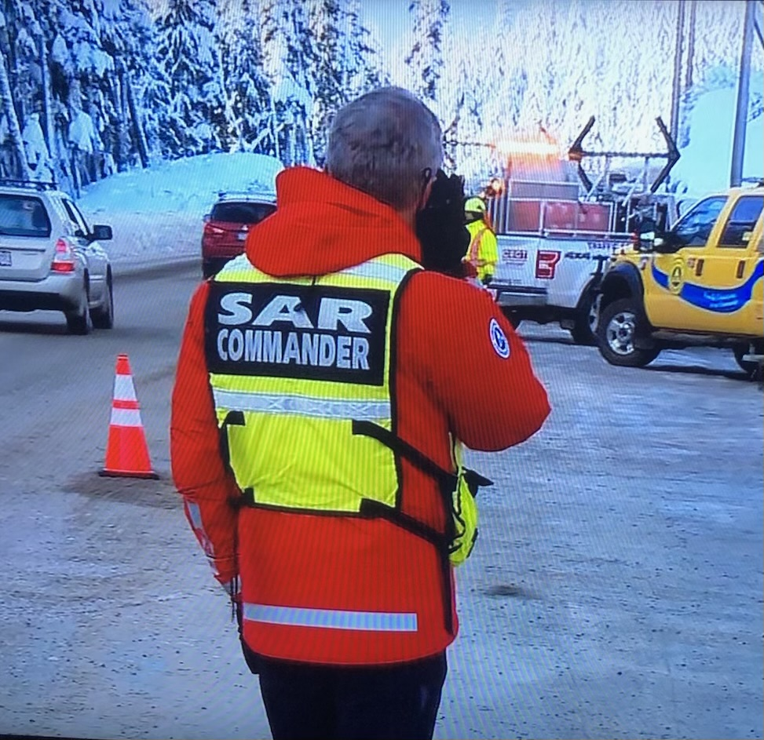
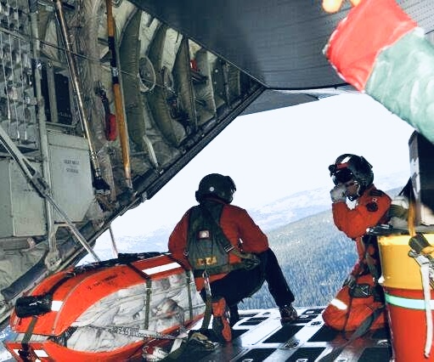
Paul Berry
https://www.cvgsar.com/

Slide 4
Learning Intentions
Introductions
What is Stress?
Recognition Prime Discission Making
BTSF
Hazard Assessment
Critical Incident Supports
Reflection to Action

Slide 5
What is Stress?
Our experiences
Negative
Positive
Training/experience
Our Selves
Preps
Currents
Triggers
Relationships
People we know
People we don’t
Organizational
Notes:
Preps: Sleep/ intakes/ medical conditions etc.
Currents: Physical/ mental/ emotional/ spiritual
Triggers: Family, children

Slide 6
4 1 2 5 2 7 2 4 6 0 6 0 3 1 3 0 2 8
(Stolovich and Keeps, 2020)

Slide 7
Write the Sequence
(Stolovich and Keeps, 2020)
Notes:
Require 30 second time with bomb (ticking sound?)

Slide 8
4 1 2 5 2 7 2 4 6 0 6 0 3 1 3 0 2 8
(Stolovich and Keeps, 2020)

Slide 9
What is Stress?
Approach
sets us up for the follow on actions/emotions etc. (Appraisal Theory)
Compensation
conscious or unconscious
Level of Stress
Personal
Notes:
Real or perceived

Slide 10
What is Stress?
“The Fog of Emergencies”
Time, vagueness, incomplete information etc.
Saturation
Number of pieces of information we can handle
New events/situations
Notes:
Real or perceived

Slide 11
What is Stress?
A real or perceived, inability to meet the current circumstances, with the current resources
Notes:
Real or perceived

Slide 12
Recognition Prime Decision Making
Slow down
Gordon, G. (2012). Risk management – High risk low frequency events in the fire service. Department of Homeland Security, Federal Emergency Management Administration, U.S. Fire Administration

Slide 13
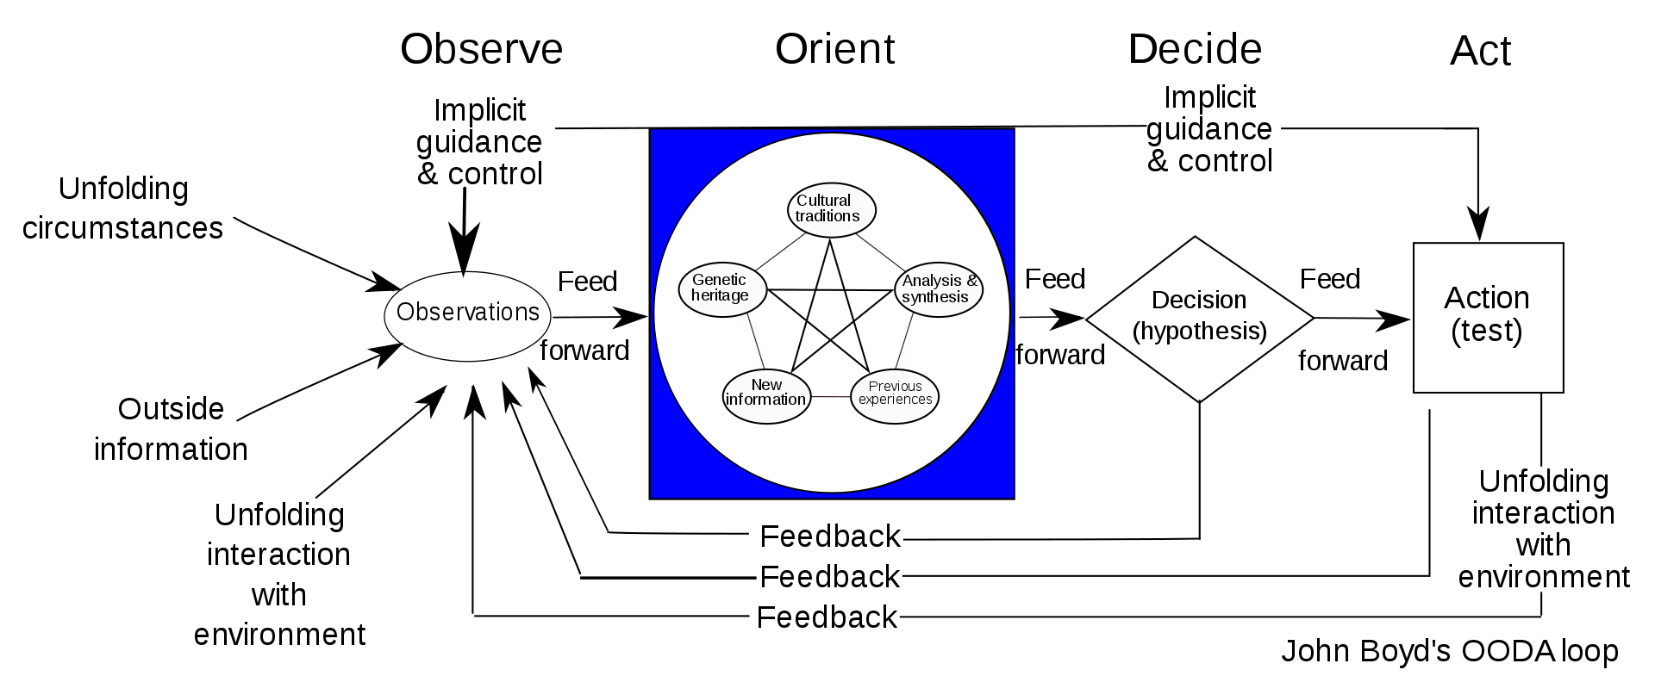
Recognition Prime Decision Making
March 2021, retrieved from https://en.wikipedia.org/wiki/OODA_loop
Notes:
Ooda loop- graphic is busy

Slide 14
Recognition Prime Decision Making
S Stop
T Think
O Observe
P Plan
E Execute
E Evaluate
Notes:
Paul- discusss through example

Slide 15
What do you do to be prepared?

Slide 16
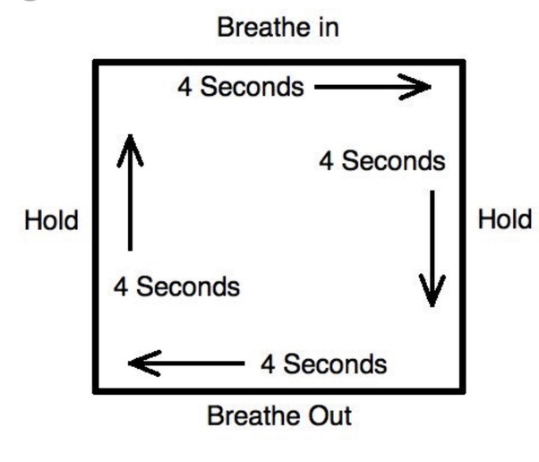
BTSF
Breath
And outside of the event
meditation
March 2021, retrieved from https://www.quora.com/How-are-soldiers-trained-to-stay-calm-during-combat
Mike Lauria , Annals of Emergency Medicine Dec 2017. Vol 70 Issue 6, p 884.
https://pjmed.libsyn.com/106-psychological-skills-training
Notes:
Cam

Slide 17
BTSF
Talk (self talk instructional and motivational)
Short Specific – (You got this!)
First person/present tense
Positive
Say it with intention
Speak kindly to yourself
“Click the mic, count to two, talk”
“Load the flare, pull hammer, shoot”
“I can do this, keep going!”
March 2021, retrieved from
Mike Lauria , Annals of Emergency Medicine Dec 2017. Vol 70 Issue 6, p 884. from the PJ Medcast
https://pjmed.libsyn.com/106-psychological-skills-training
Notes:
Add animation of specific examples to this slide following each bullet

Slide 18
BTSF
See (Mental Rehearsal)
Visualize
Steps or task you want to do, vivid & specific detail
Timing
Order and timing of how you would do it
Emotion of task
Emphasize seriousness to lay neuro-networks. Stay in “role”
March 2021, retrieved from
Mike Lauria , Annals of Emergency Medicine Dec 2017. Vol 70 Issue 6, p 884. from the PJ Medcast
https://pjmed.libsyn.com/106-psychological-skills-training
Notes:
Again with the specific examples

Slide 19
BTSF
Focus (Focus/Trigger Word) before you start your task
Cognitive signal to a single task
To focus relevant environmental & event cues
Help to refocus after intense stress
March 2021, retrieved from Mike Lauria , Annals of Emergency Medicine Dec 2017. Vol 70 Issue 6, p 884. from the PJ Medcast
https://pjmed.libsyn.com/106-psychological-skills-training
https://medium.com/@michaelusiagwu/5-successful-trigger-words-to-boost-your-b2c-sales-today-991f1ea034a6
Notes:
“Go!”
“Get up!”
“Okay, lets roll!”
“Slow is smooth, smooth is fast

Slide 20
BTSF
Blue Angels Preflight Brief
https://www.youtube.com/watch?v=KlAPamTbryg
March 2021, retrieved from
Mike Lauria , Annals of Emergency Medicine Dec 2017. Vol 70 Issue 6, p 884. from the PJ Medcast
https://pjmed.libsyn.com/106-psychological-skills-training
https://www.fastrunning.com/training/motivation/cool-runnings-lessons-beyond-bobsleigh/9979
https://www.nytimes.com/2014/02/23/sports/olympics/olympians-use-imagery-as-mental-training.html
https://healthmanagement.org/c/hospital/news/er-clinicians-benefit-from-mental-rehearsal-of-trauma-scenarios

Slide 21
Hazard Assessment
What is out of the ordinary?
5’s and 25’s

Slide 22
Lets see…

Slide 23
Critical Incident Stress
Normal responses to abnormal events
Feeling overwhelmed and helpless
Fear, worry and exhaustion
Increased frustration
Lack of appetite, intestinal issues
Lack of patience and feeling short/snippy with others
Lack of sleep or difficulty sleeping
Difficulty concentrating and making decisions
March 2021, retrieved from https://www.bcsara.com/cism/management/

Slide 24
Critical Incident Stress
What might help…
Eat healthy foods, low in sugar and fat, vegetables and protein are better
Drink lots of water – to flush out stress hormones and chemicals
Get regular exercise – preferably outdoors, best in natural surroundings, even a brisk ten minute walk relieves stress – exercise increases blood flow through blood cleansing organs removing stress hormones and chemicals
Avoid alcohol and drugs – they may dull the pain, but can add new problems and complicate recovery
March 2021, retrieved from https://www.bcsara.com/cism/management/

Slide 25
Critical Incident Stress
What might help…
Avoid doing the “instant replays” or dwelling on the incident – reliving the incident in your mind may release more hormones and chemicals – distract yourself when you feel those thoughts come on
Maintain social connection – find someone supportive to talk to
Talk about how you are feeling and encourage family and associates to do so as well. Talking helps make sense of what can be an overwhelming experience
Keep to your usual routine, it helps establish and maintain a sense of normalcy
Make efforts get adequate rest and sleep
Try to maintain a healthy balance between family, work, and volunteering
Keep supporting others (e.g. SAR team) who may be experiencing similar feelings and symptoms
March 2021, retrieved from https://www.bcsara.com/cism/management/

Slide 26
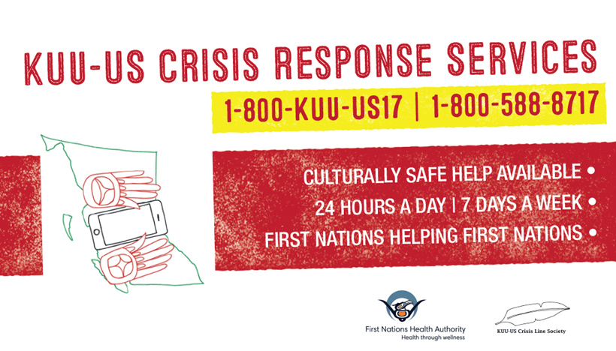
Critical Incident Stress
What might help…
https://www.fnha.ca/what-we-do/mental-wellness-and-substance-use
March 2021, retrieved from https://www.fnha.ca/what-we-do/mental-wellness-and-substance-use

Slide 27
Critical Incident Stress
What might help…

Slide 28
Critical Incident Stress
What might help…

Slide 29
Guided Practise
4 seasons in a year
12 months
7
24
60
60
31
30
28
Turn to a partner and discuss/figure out the remaining supports
(Stolovich and Keeps, 2020)
Notes:
Require 30 second time with bomb (ticking sound?) Should we move this to the culminating activity… they can then apply strategies

Slide 30
Ready go!
4 1 2 5 2 7 2 4 6 0 6 0 3 1 3 0 2 8
(Stolovich and Keeps, 2020)
Notes:
30 second timer?

Slide 31
Reflection Question
What stressors most impact your ability to lead?
How will you apply these skills to assist you,
your team during high stress situations?

Slide 32
Thank so much for spending your time with us.
Can you be the help your communities and Nations need?
Cam Challenger
Emergency Management Educator/
Response Specialist
Holistic Emergency Preparedness & Response/
Survival and Outdoor Specialty (SOS) Gear
Cell# 604.816.8655
Office Main# 778.225.0500
cam@holisticepr.com
http://www.holisticepr.com
Paul Berry BEd, MEd
Emergency Management Educator/
Response Specialist
Holistic Emergency Preparedness and Response
Survival and Outdoor (SOS) Gear
Cell# 250-897-5133
Office Main # 778-225-8655
paul.berry@holistic.com
http://www.holisticepr.com

