Slide 1
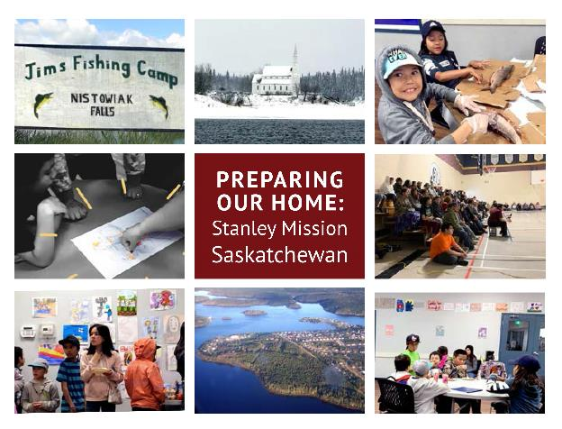
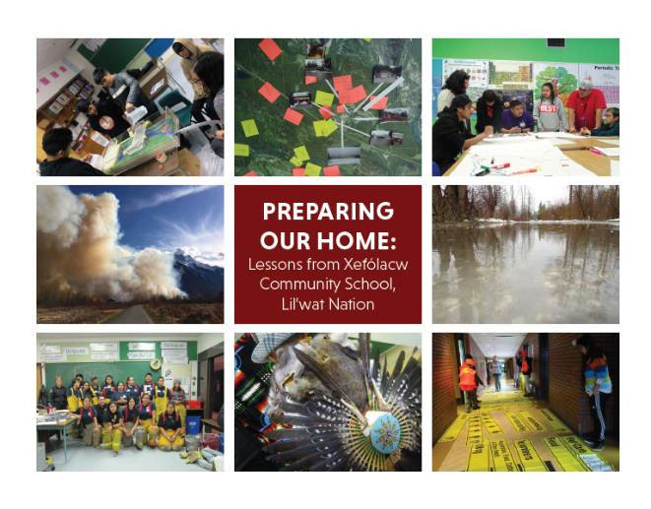
Preparing Our Home: First Nation youth and Intergenerational Emergency Management
Notes:
Welcome and thank you everyone for being here today. Land Acknowledgement?
My name is …… and I have the privilege of helping you learn about Crime Prevention Through Environmental Design. Today we are going to discuss the theory behind this concept, the core principles, and the steps to be taken in order to create and implement a successful design.
I encourage you to ask any questions throughout the presentation, and please let me know if I can speak louder, quieter, faster, or slower.

Slide 2
Dr. Lilia Yumagulova, Banting Postdoctoral Fellow, USask Program Director, Preparing Our Home
Community preparedness: A Journey
Kxwu7lh
Carime Quezada
Notes:
“with respect to this canoe journey there will be extremes of weather and climate
there will be portages rapids waterfalls riptides swells crests gales typhoons tsunami
forest and grass fires droughts sandstorms blizzards toxic sludge customs agents
so bring waterproof windproof heatproof coldproof insulated breathable comfortable
light wash `n wear bedding clothing attitudes and a thick skin
you might want to bring a tent some bushsmarts and navigating knowhow
but please no cellphones beepers laptops palmtops modems (p.447)”.
Peter Cole (2002) aboriginalizing methodology: considering the Canoe
Peter Cole is a member of the Douglas First Nation, one of the Stl’atl’imx communities in SW British Columbia, and also has Celtic heritage

Slide 3
Niá:wen ki' wáhi Tahawennon:tie

Slide 4
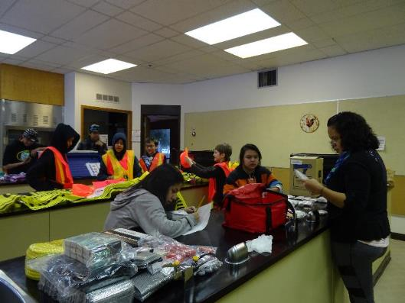
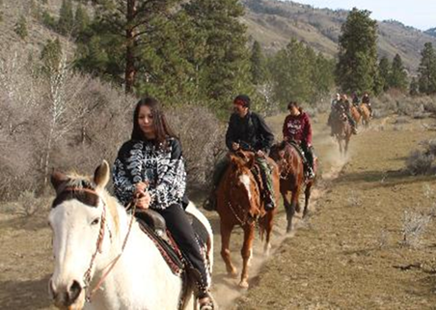
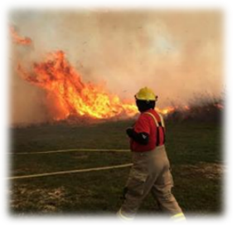
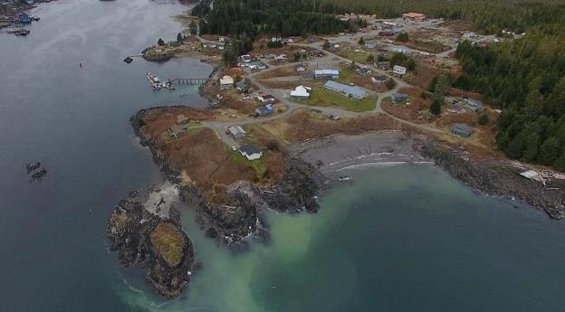
Preparing Our Home approach
Indigenous science
Land-based learning
Community mapping
Youth-Elder intergenerational learning
Capacity building
Technical training
Peer mentoring
Youth leadership

Slide 5
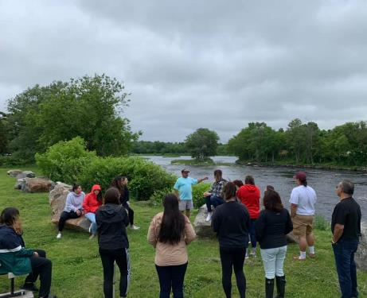
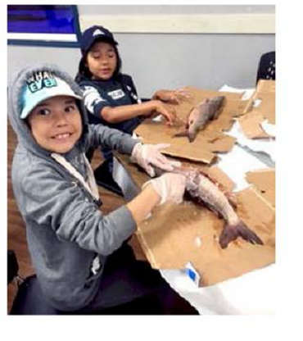
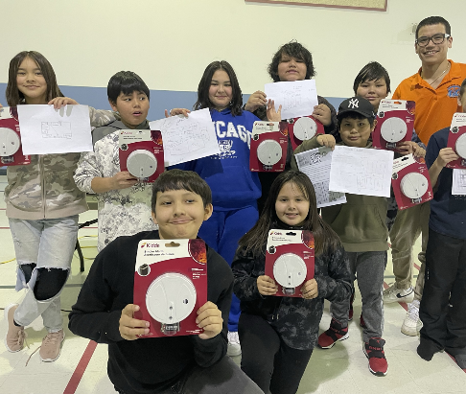
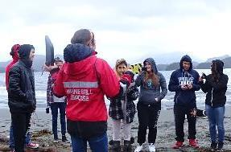
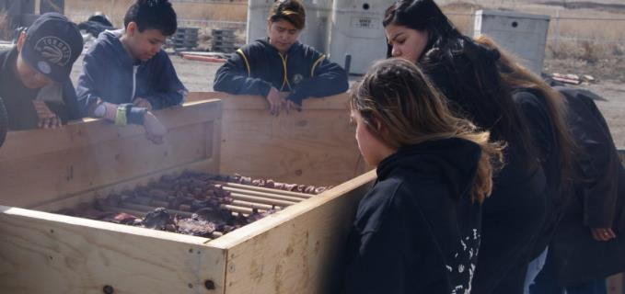
Building resilience in communities through nation-to-nation learning
Hazard and Asset Mapping
Food preparation and food security
Personal, family and community preparedness
Fire safety

Slide 7
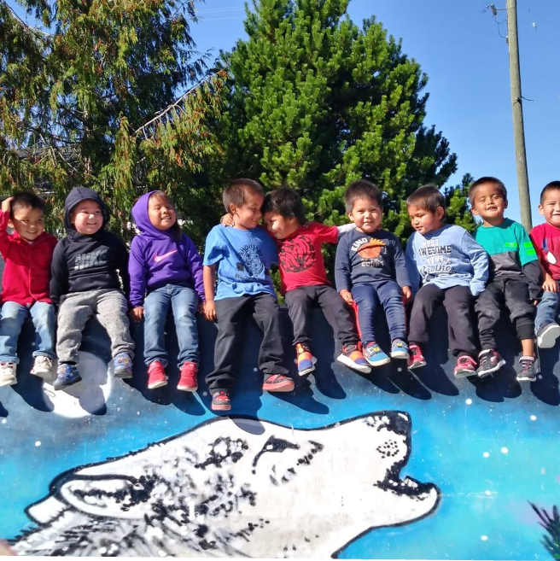
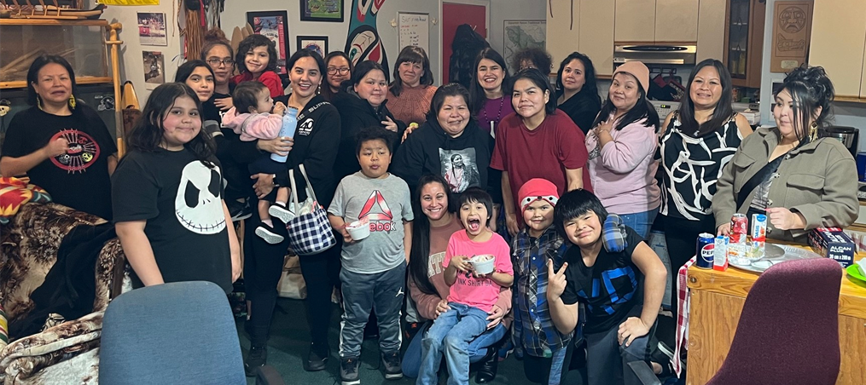
It is never too early to start emergency preparedness
First Nations Single Moms Living off reserve
Early childhood programs

Slide 8
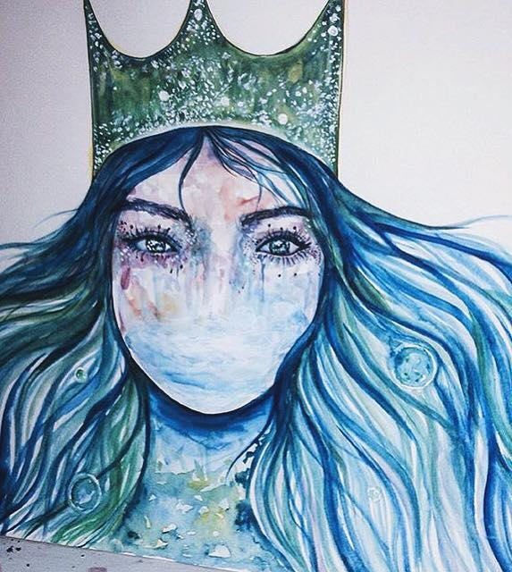
Find your VOICE and once you do, uplift others
Queen of the Sea - Allaura Langford, Curve Lake First Nation

Slide 9
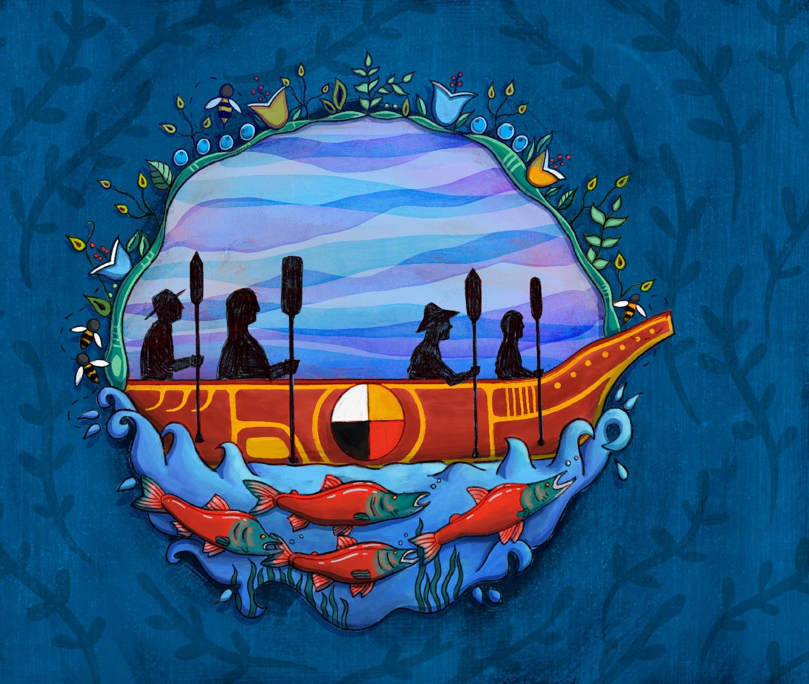
Restoring connections: Indigenous Emergency Management
Artwork: Santana Dreaver (Kinistin Saulteaux Nation and Mistawasis Nehiyawak ) and Joshua Pawis-Steckley (Wasauksing First Nation)
Notes:
Santana

Slide 10
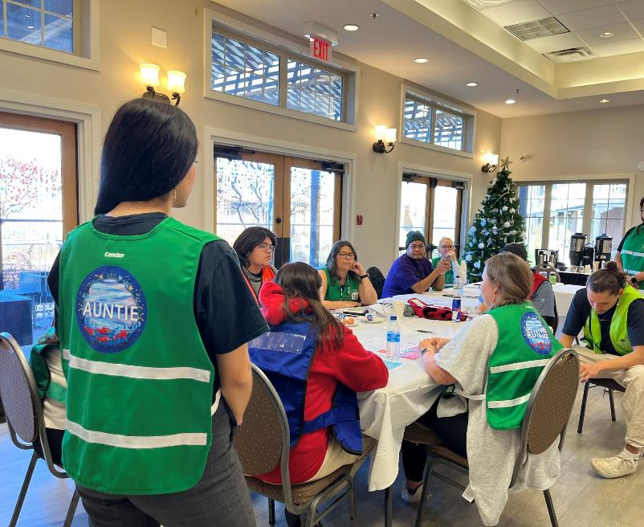
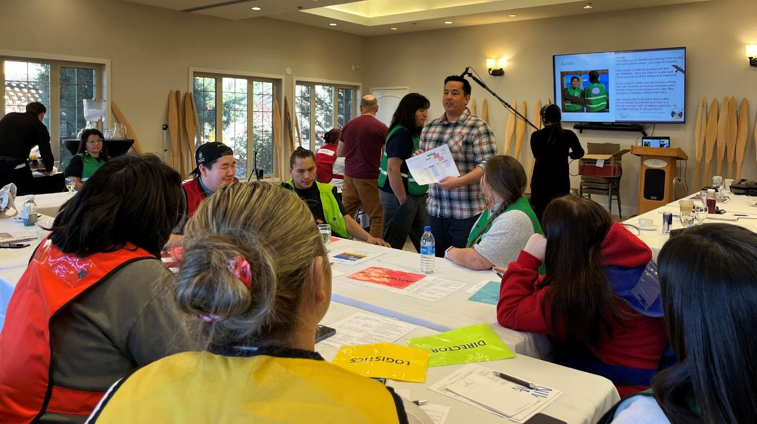
Youth-led tabletop exercise
Wildfire evacuation scenario
“Auntie” role in the Emergency Operations Centre
Youth sourced photos, art and videos
Notes:
Santana

Slide 11
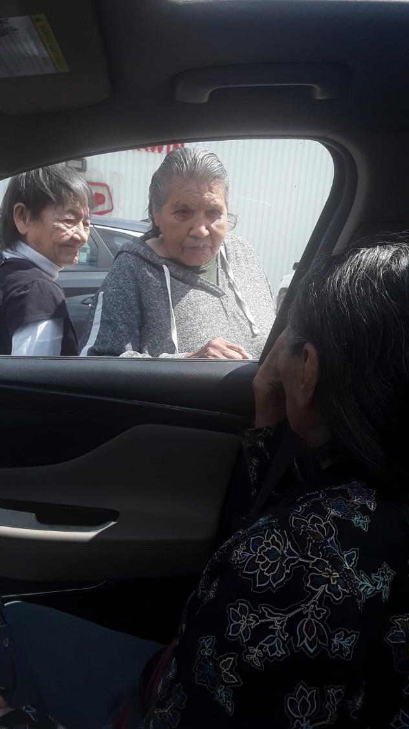
2 DECISION 2PM June 28
Consider your different roles. What are your next steps?
What factors do you need to consider for your decision-making?
Some older community members and those with health issues want to evacuate now but need help. How will you support them?
Key actors:
Chief and council, EPC, Councillors?
4
Photo credit: Sheena Charles, Stanley Mission, SK
Notes:
FireSmart, etc
Runners for elders/people withPrompts for your group members:
- Inform leadership and work on decision – evacuation alert template/ BCR/ SOLE
Ask SPSA to set up a coordination call with other agencies
Get messaging to community about the hazard and how to protect their homes
Spot forecasts – ECCC and SPSA
Broadcast intrusive alert?
Evacuation planning – where, when, who, and how?
Protect/ FireSmart critical infrastructure – the bridge, community buildings
Public works team – activate them to work on the evacuation routes, out phones to inform them about Evac Alert and help them get ready
Contact neighboring communities for ESS supports
Identify vulnerable households and help them prepare/ plan for special evacuations
Pre-evacuation for vulnerable folks?
Potentially planning for a helicopter?

Slide 12
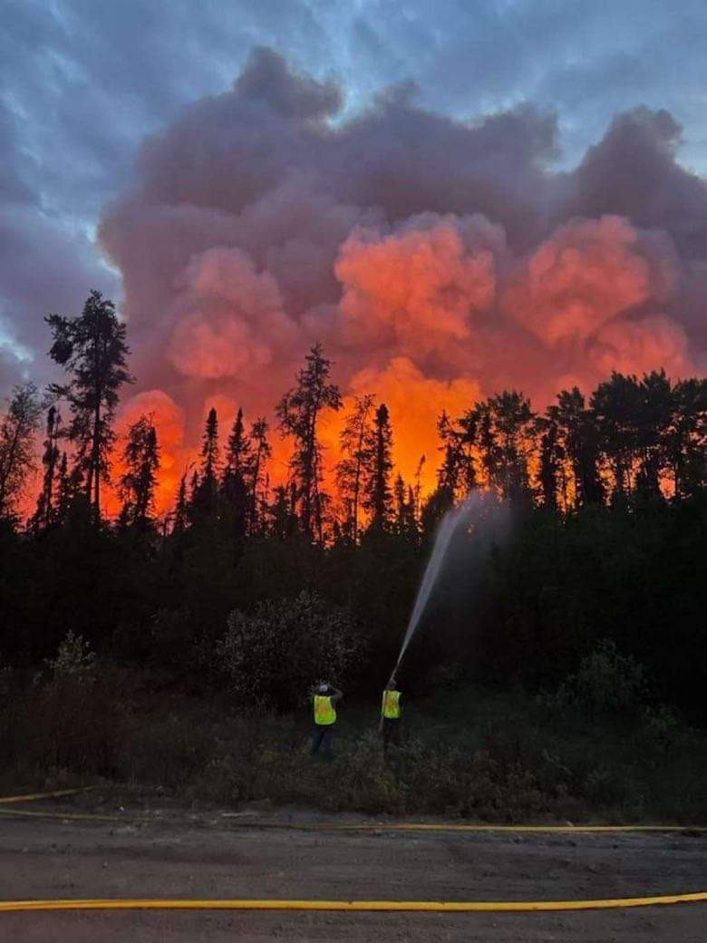
3 SITREP 6PM June 28
The fire is moving rapidly and has spread into a very dry stand of trees. Wind is picking up.
The Province is recommending an Evacuation Order be placed on your community in two days.
5

Slide 13
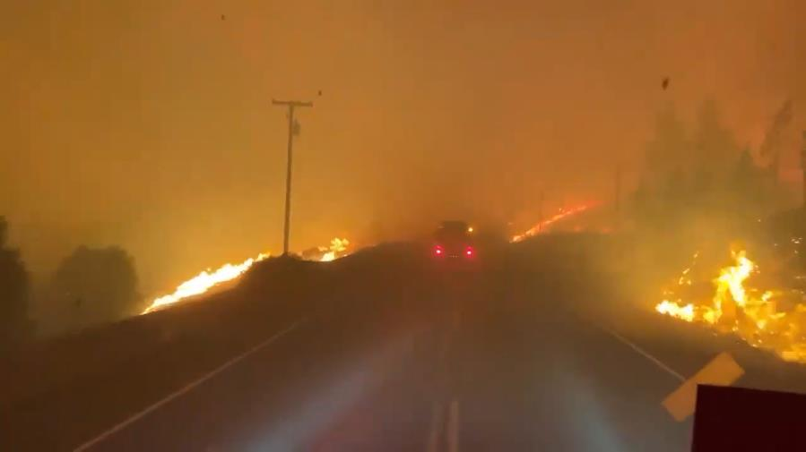
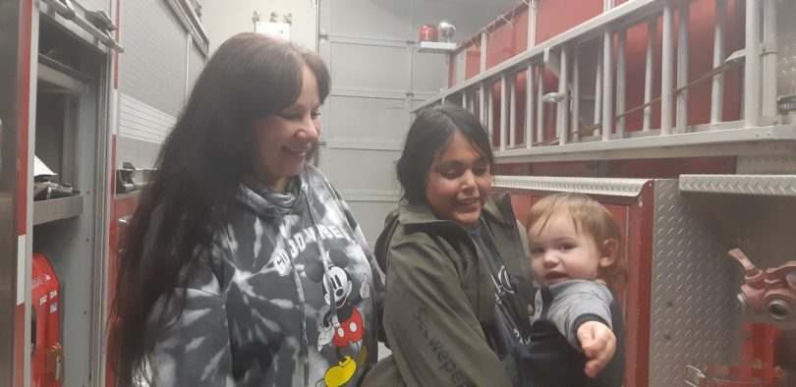
Emergency Preparedness: K-12
Notes:
Sheri

Slide 14
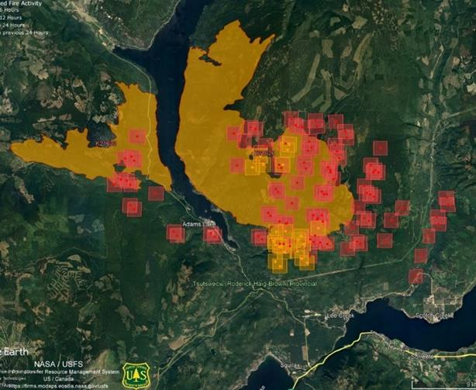
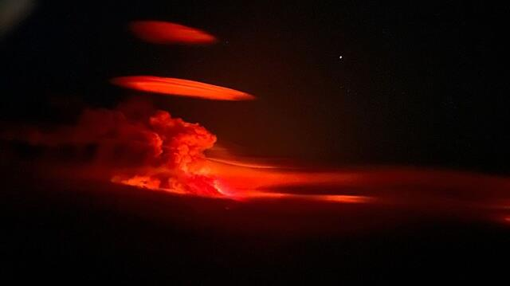
Lower East Adams Lake fire
Lower East Adams Lake fire (smoke column pictured in high-level thermal scan by satellite) at 3 a.m. on Aug. 15th
Photos: BC Wildfire Service
Notes:
Sheri

Slide 15
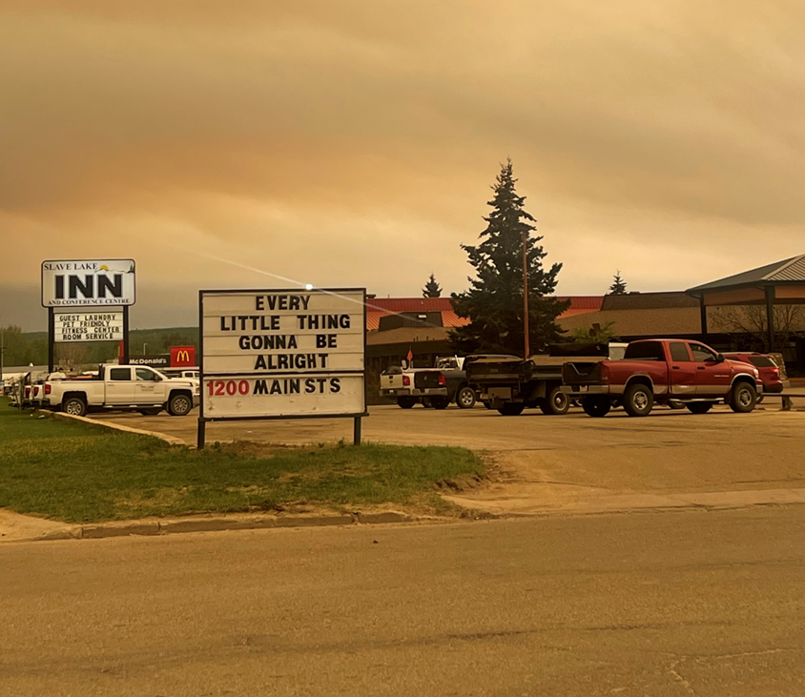
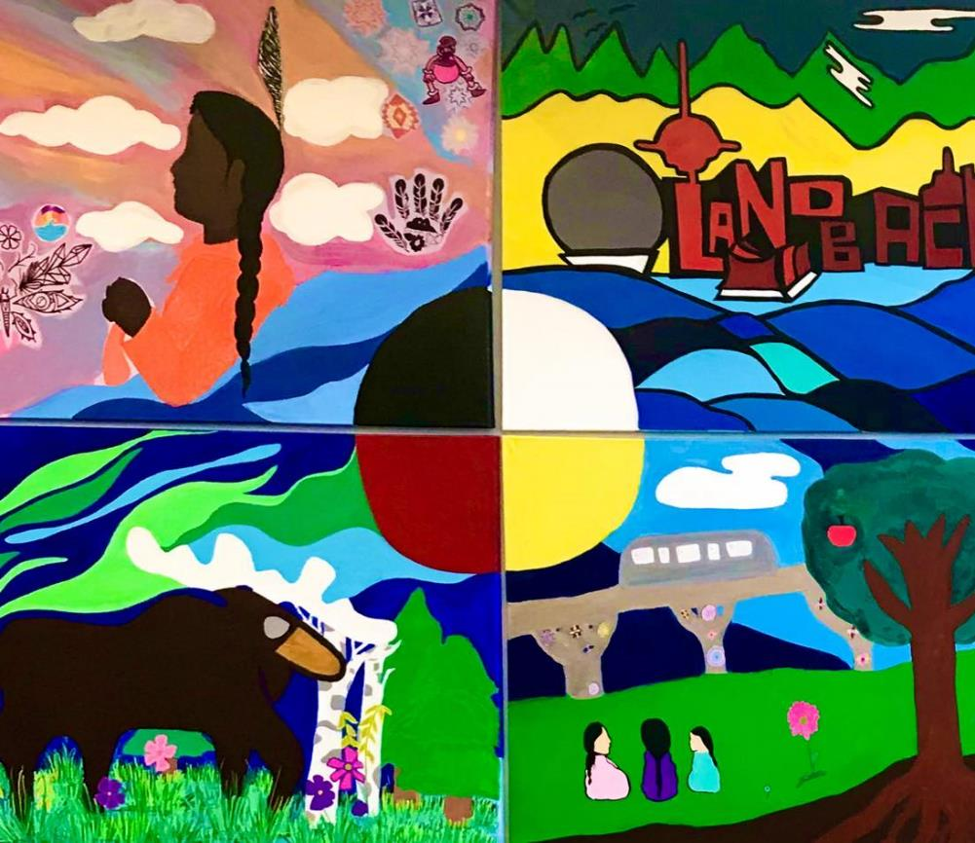
Safe spaces for children in evacuations
Notes:
Aaliyah

Slide 16
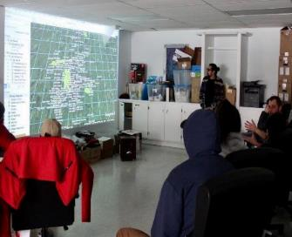
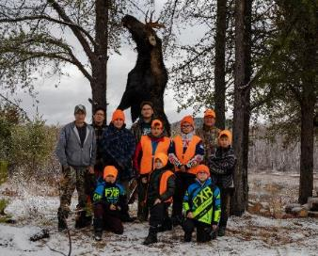
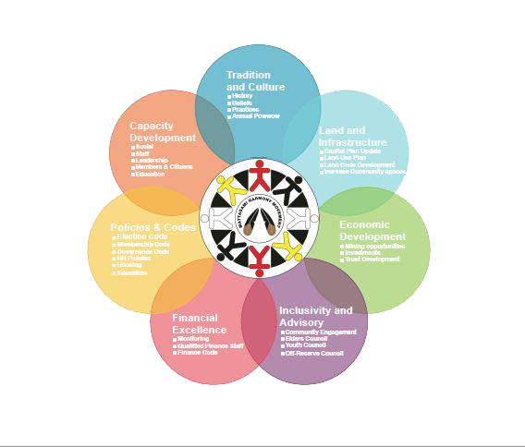
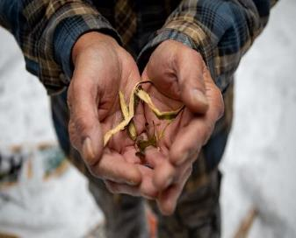
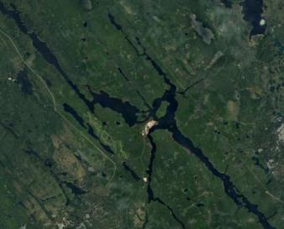
Mattagami First Nation
Credit: Bizhiw nindizhinikaaz Devin Naveau, Mattagami First Nation
20
Notes:
Brent

Slide 17
Mattagami First Nation
Wildland Protection Plan
The community Wild Land Protection Plan delivers a wealth of knowledge to our community members on being better prepared for wildland fires.
Our Project out comes consist of following:
Fuel Management of forest overgrowth removal
Lowered risks of loss or devastation
Protect the public / community homeowners & industry from the risk of wild land fire by fuel reduction
To have a positive impact on the community’s health and well-being by making the community safer. Education and awareness is a necessity for emergency preparedness.
Notes:
Tessa

Slide 18
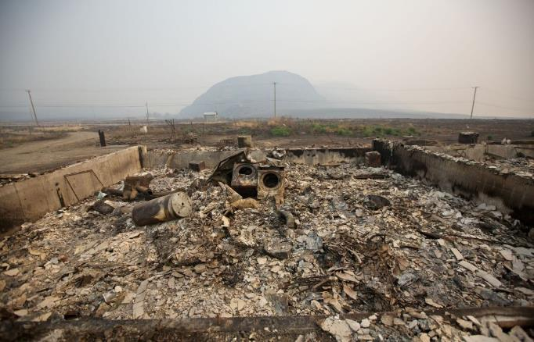
Ashcroft Indian Band – Shalyn Pigeon
July 7, 2017 – Elephant Hill Wildfire
No emergency management plan or capacity
Damages: 12/32 homes burnt, maintenance building, almost all power poles, fences, cemetery, personal property
Notes:
Shalyn

Slide 19
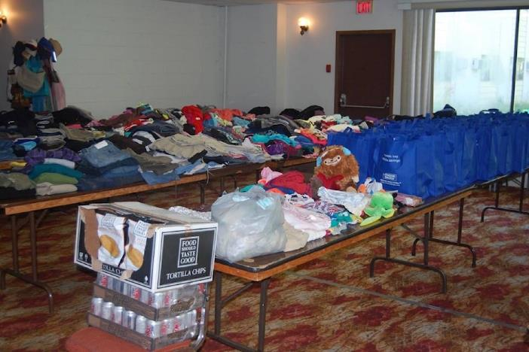
AIB Response
First community to be impacted after bi-lateral agreement – “guinea pigs”
Opened a Band-run EOC and ESS with no prior training
Had to learn “emergency language”
Had to teach cultural safety to partners and advocate for community needs – the “system” did not work for us
Notes:
Shlayn

Slide 20
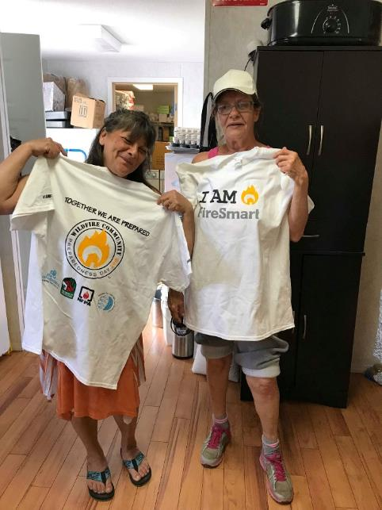
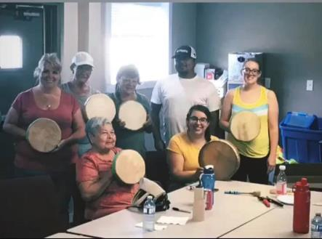
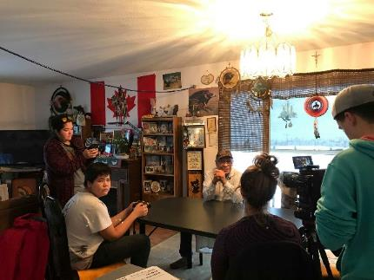
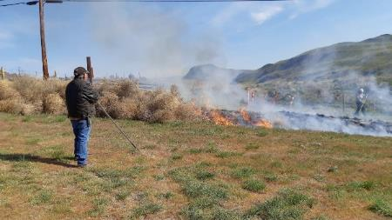
AIB Recovery
“Ugly stepsister to response” with new people & new systems
Two sides – 1. Infrastructure; 2. People
Disaster financial assistance
Community based and community driven healing
Community gatherings, outings, events, culture, food
Community preparedness, firesmarting, controlled burns
Telling our story our way – documentaries (The Fire Within US)
Notes:
Shlayn

Slide 21
Mentorship in Emergency Management
Notes:
Jeremiah

Slide 22
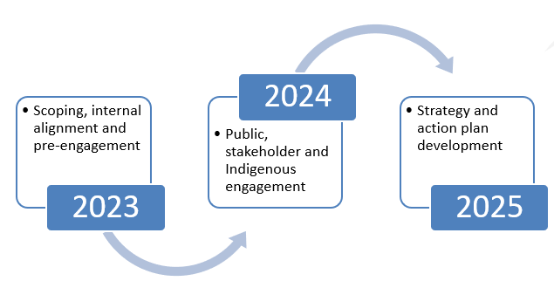
BC Ministry of Agriculture and Food
Food Security in Emergencies – Strategy Development
Premier Eby directed the Ministry to Work with the Minister of Emergency Management and Climate Readiness to support the resilience of B.C.’s food system through an emergency preparedness strategy for food security.
Engagement Characteristics:
Scope: The food supply chain -- foundational ecosystem to individual food access in emergencies
Phases: 2024 Phase 1 (public, ‘listen, learn, and understand’); 2025 Phase 2 (public, strategy development)
4 Themes: Emergency Food Access, Food Production, Food Supply Chain, and First Nations and Indigenous Peoples
Collaboration: The Province wants to share the pen on strategy development with interested First Nations and Indigenous people. Ursus Resilience Strategies is actively working with key community groups to help us determine how to engage with these groups in a meaningful, respectful, and productive way.
Goal: final strategy in late 2025
Notes:
Jeremiah AF is building on proactive actions but a deeper dive into how we future-proof our food system in all phases of emergency events takes time.

Slide 23
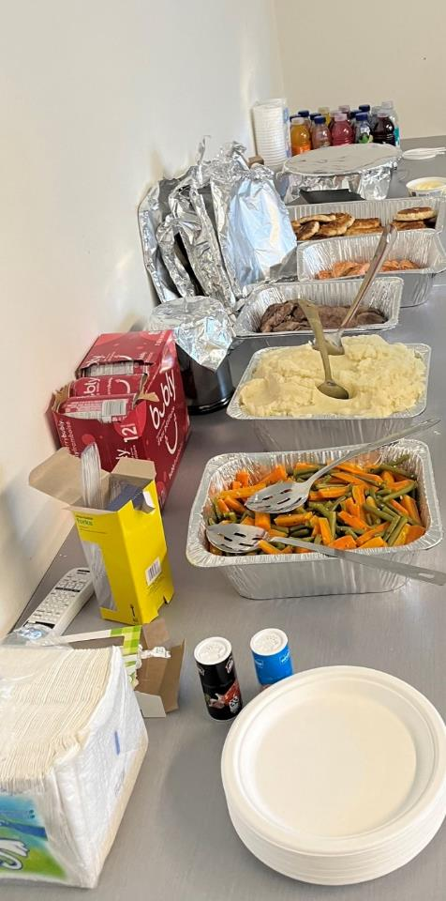
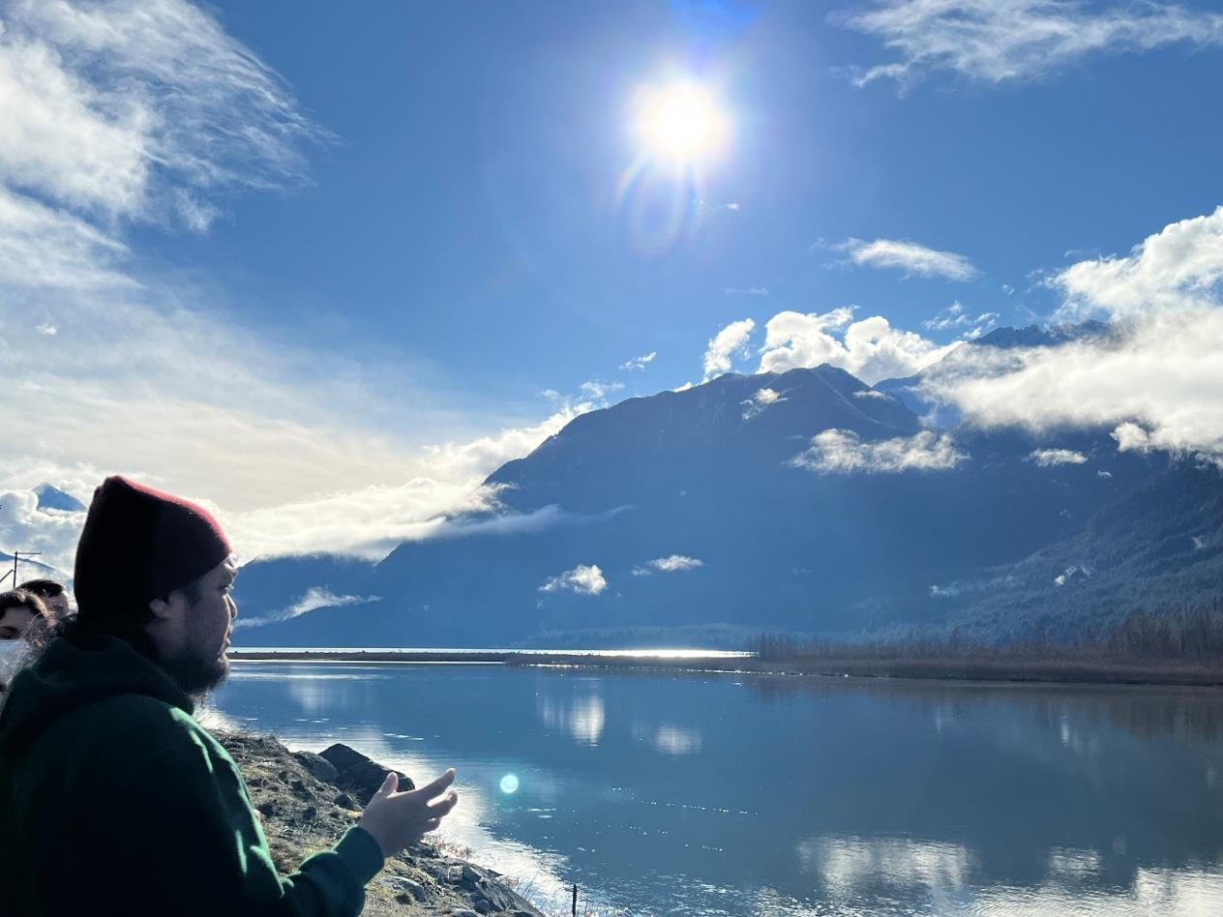
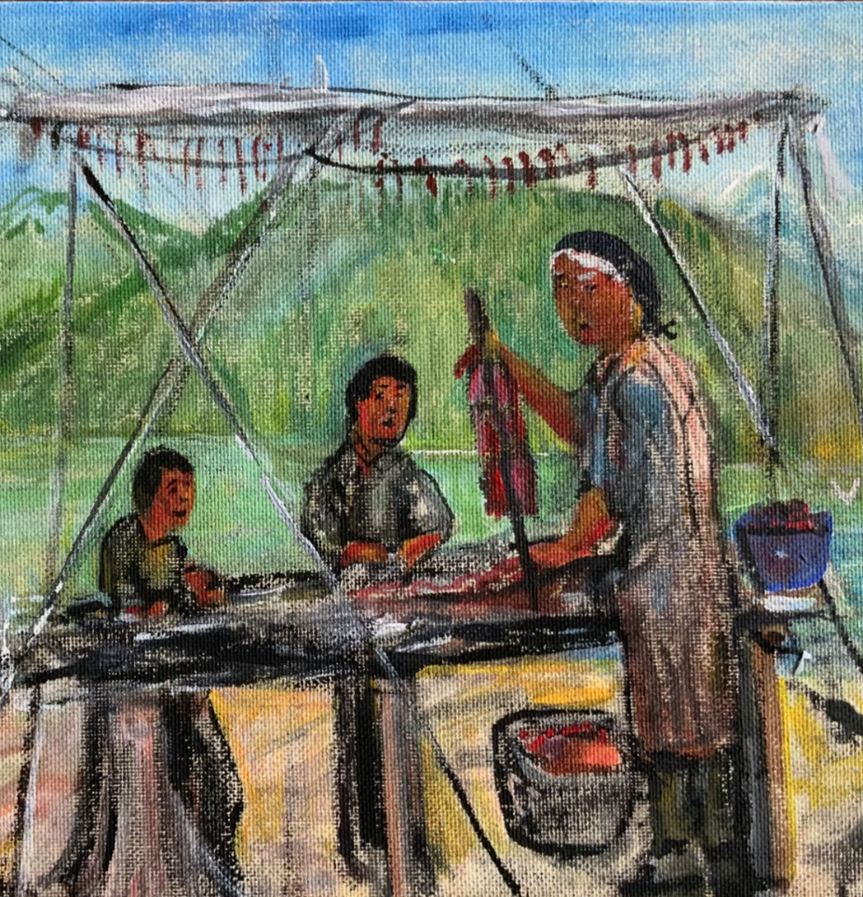
Community workshops, online workshops, community of practice meetings
Photos: Lil’wat Nation Harvesters workshop

Slide 24
Notes:
Sheena

Slide 25
Notes:
Sheena

Slide 26
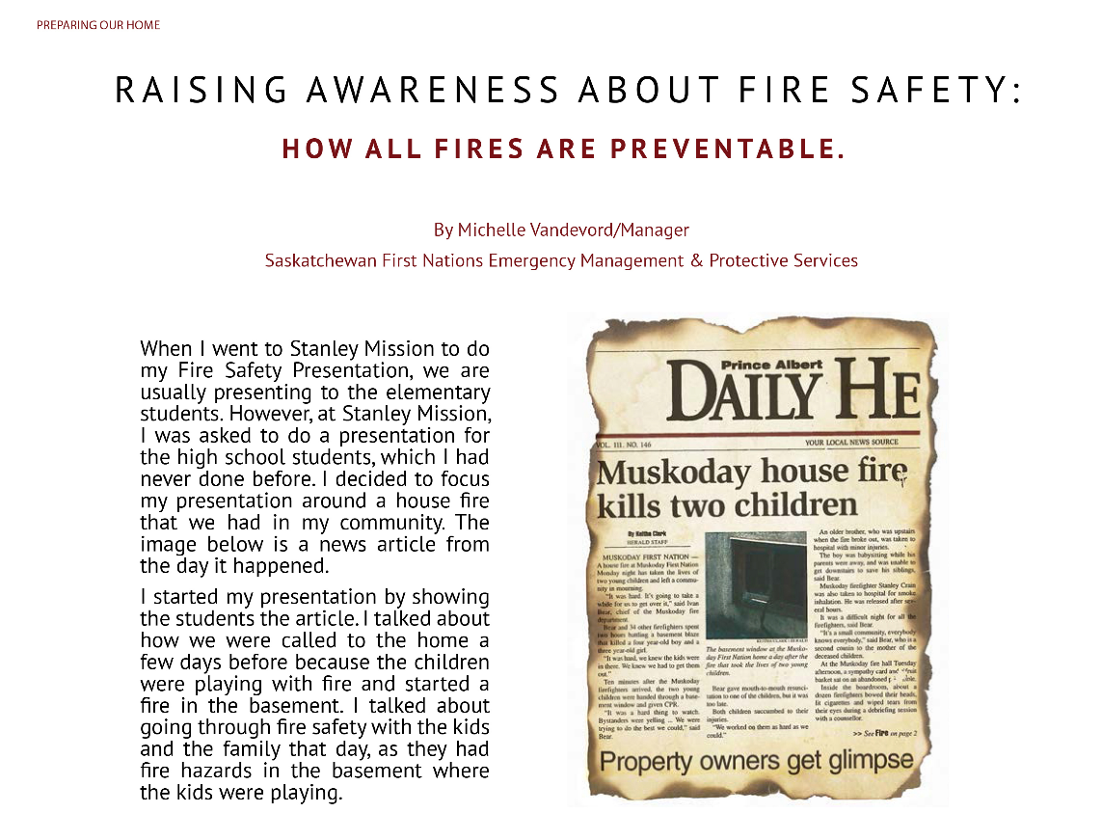
Notes:
Michelle

Slide 27
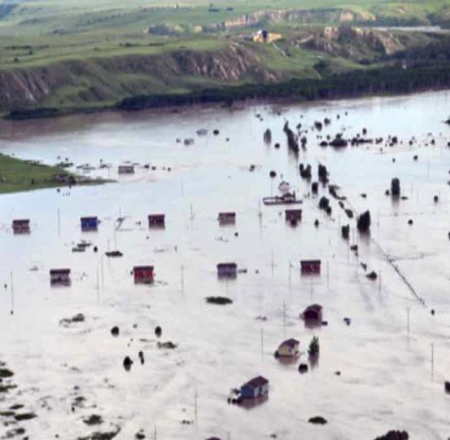
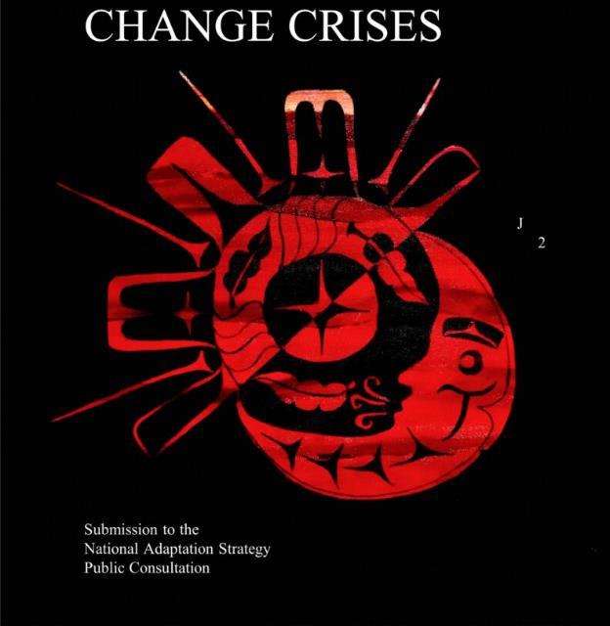
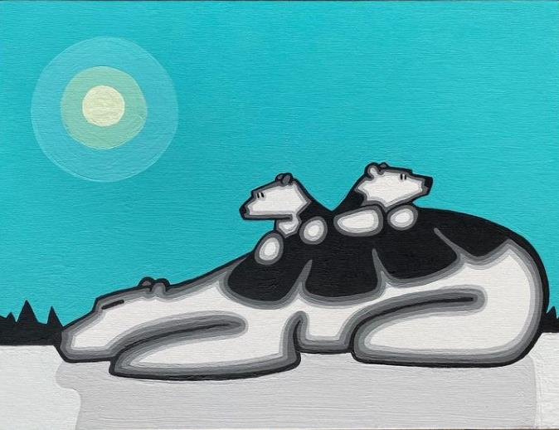
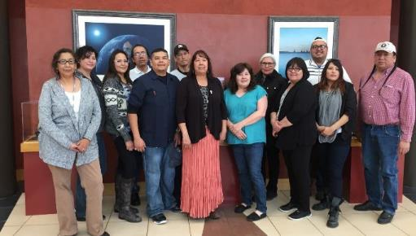
Disasters and Resilience on Turtle Island
Michelle Vandervord, Patrick Michell, Bryan Fayant, Rose Whitehair, Darlene Yellow Old Woman-Munro, Shalyn Pigeon, David Diabo, Santana Dreaver, Simon Lambert, Neebin Prince, and…

Slide 28
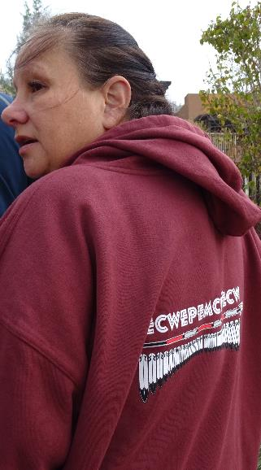
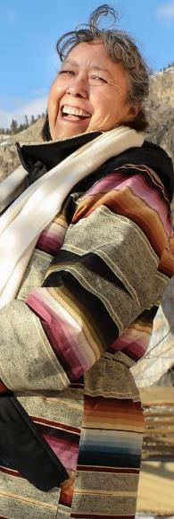
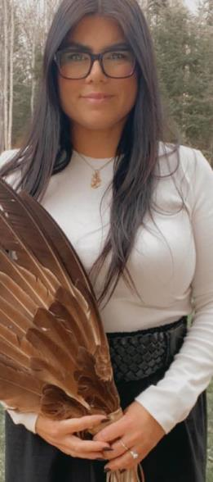
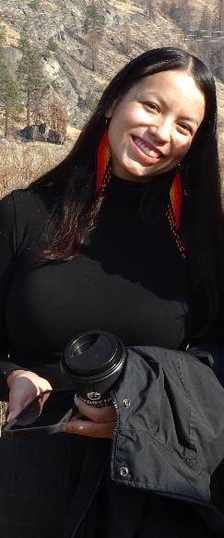
Notes:
Rose

Slide 29
ACTIVE HOPE
Neebin Prince, Mattagami First Nation

