Slide 1
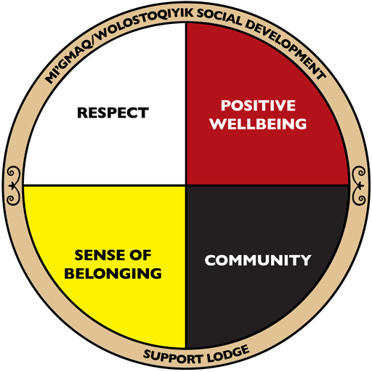
Mi’gmaq / Wolastoqiyik Social development support lodge
The Impact of Funding Agreements on IA Policy Administration
A New Brunswick Perspective
Ruth Levi BSW, MSW
Executive Director

Slide 2

History
2011 Court Case
2015 Liberal Government introduces Social Reform
Social Reform Work

Slide 3
Types of funding for n.B. First nations
Fixed ( annual )
Block Funding ( 5 years )
NFR Funding ( 10 years )

Slide 4
CHALLENGES TO FUNDING
Annual Increases
Reporting requirements
Allocating funds to different programs /services
Who makes the decisions where the funds are redirected to

Slide 5
RECOMMENDATIONS
Stand alone Social / Income Assistance budgets

Slide 6
Thank you
Ruth Levi , BSW, MSW
Executive Director ,
MWSD Support Lodge
New Brunswick
mizlevi@Hotmail.com
506-523-5086

