Slide 1
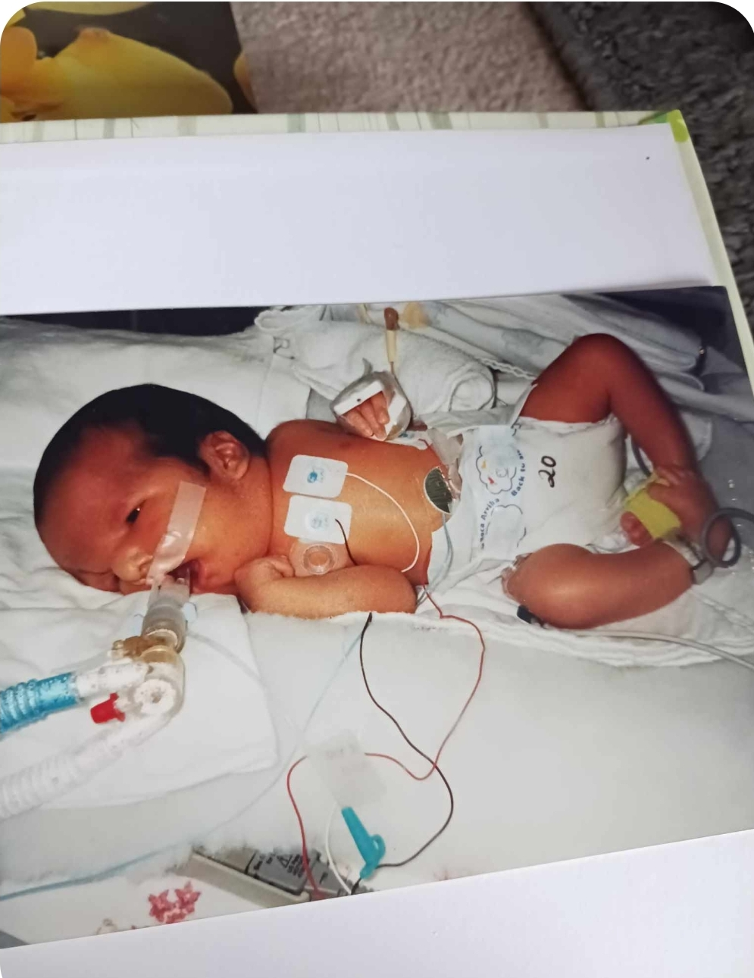
Jordan River Anderson October 22, 1999

Slide 2
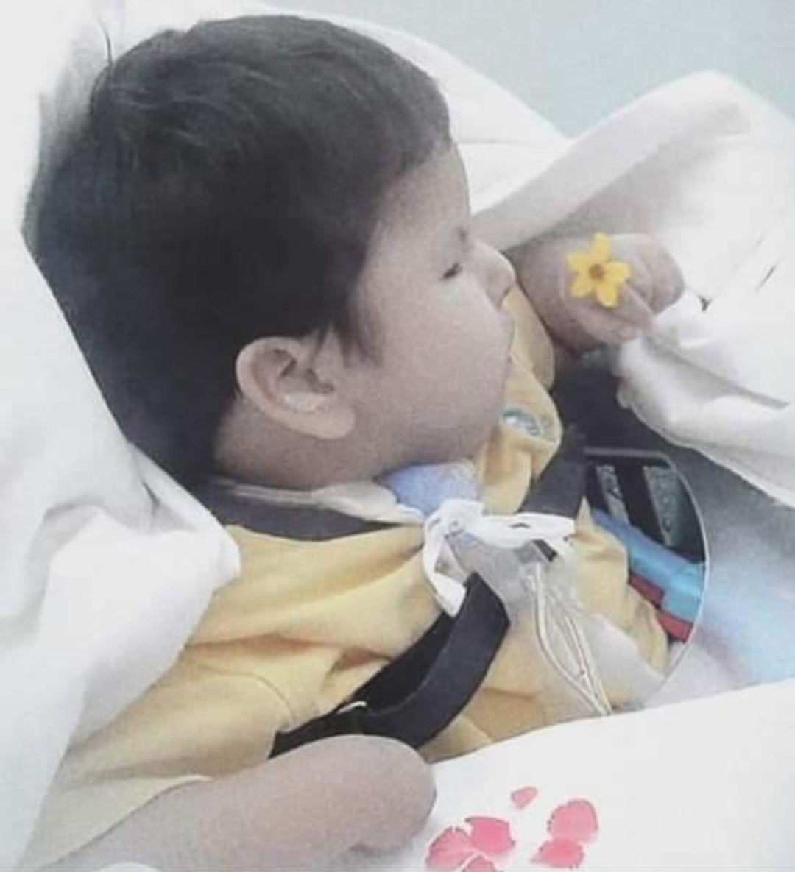

Slide 3
Jordan and Mom 💙

Slide 4
Jordan and family

Slide 5
Jordan and Dad

Slide 6
Jordan’s family

Slide 7
Jordan’s 4th birthday

