Slide 1



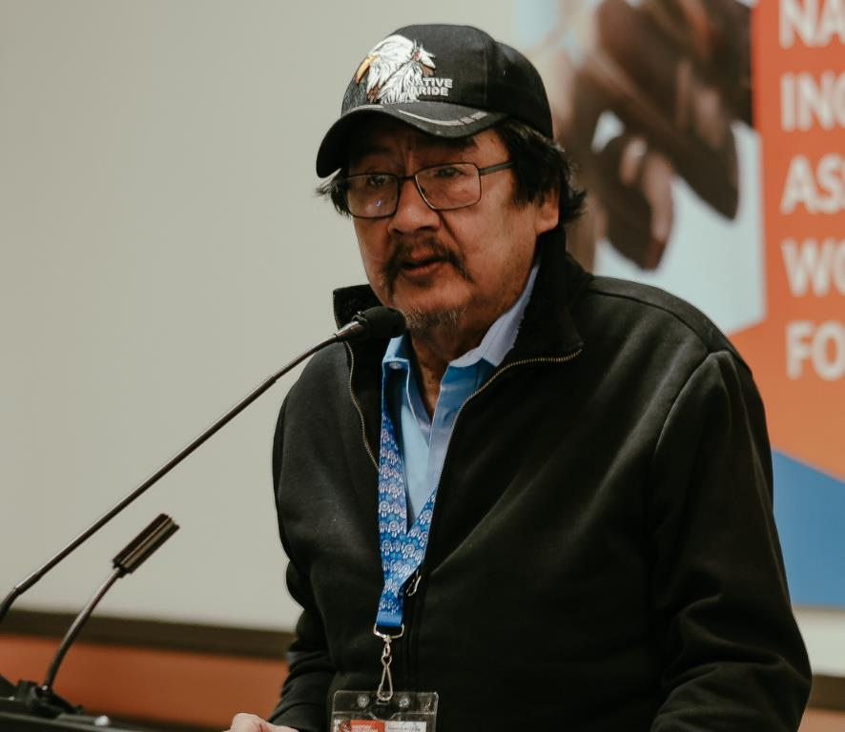

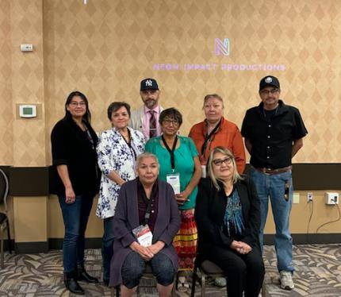



Manitoba First Nations
On-Reserve Income Assistance Program
Presented by:
Amanda Kubrakovich, Social Development Advisor, Southern Co-Chair
Gene Bercier, Social Development Advisor, Northern Co-Chair

Slide 2











Introduction
“The Social Development Advisors Technical Group, (SDATG) , is a Nations–led advisory body focused on the Manitoba First Nations On-Reserve Income Assistance Program.
Our role is to provide strategic advice, technical expertise, and informed recommendations that support the reassertion of the Nations jurisdiction in social development.
We represent Tribal Councils, Independent Nations, leadership organizations, and we work bilaterally with Indigenous Services Canada on policy development and reform.
Importantly, SDATG operates by consensus. This approach reflects our commitment to dialogue, collaboration, and collective decision-making — ensuring policies move forward with shared understanding and regional alignment.”

Slide 3



Manitoba’s First Nation On-Reserve Income Assistance Program Structure & Framework
Nation-Administered: All 63 Nations in Manitoba deliver Income Assistance directly in their Nations, as a “program of last resort” covering basic needs (food, clothing, shelter, utilities) and other benefits.
Policy Alignment: Federal and Provincial Framework
Federal Program Alignment
The On-Reserve Income Assistance Program follows Indigenous Services Canada’s national policy of comparability,
ensuring benefits and eligibility align with provincial standards for individuals in similar circumstances.
Provincial Program Alignment
Manitoba’s On-Reserve Income Assistance Program mirrors the provincial Employment and Income Assistance (EIA)
program for client categories, benefit rates, and rules, including basic needs, shelter, and special needs.
Limited Areas of Misalignment
Minor differences occur where provincial programs are not federally fundable or applicable On-Reserve
(e.g., Rent Assist and related housing benefits).

Slide 4
What Makes Manitoba different from Other Regions
Funding Approach
Administrative Model
Most regions follow annual contribution funding, but Manitoba is among those pioneering the 10-Year Grant funding for social programs as part of a New Fiscal Relationship (NFR) with Nations.
Since 2019, a subset of Manitoba Nations receives IA funding as a long-term block grant – offering flexibility and stable planning. This grants approach is being watched as a potential best practice for empowerment and self-determination, though it comes with accountability requirements.
Manitoba’s On-Reserve Income Assistance program is delivered directly by the Nations (Income Assistance Administrators) under ISC funding agreements, rather than by the provincial government.
Manitoba stands out for its fully First Nation–administered model
(no provincial delivery involvement), requiring strong community capacity and federal oversight collaboration.
Benefit Structure Differences
Delivery & Case Management
Manitoba’s On-Reserve IA includes regional cost-of-living adjustments (distinct rate tables for southern, northern, isolated Nations) to account for remote area expenses.
Indigenous Services Canada-Manitoba Region deemed it necessary to mirror the higher costs in remote First Nations after engagement and consultation with the Nations.
Provincial Offices often have centralized case management systems and larger service delivery infrastructures (multiple case workers, specialized employment counsellors, and modern IT systems).
On-Reserve, each IA administrator typically handles all aspects of the program – doing intake and assessments, ongoing case management, financials & reporting and working with Provincial Companies such Manitoba Hydro.
This difference in scale and infrastructure is a notable contrast between Manitoba and jurisdictions.

Slide 5



Core Challenges facing Manitoba’s First Nation
On-Reserve Income Assistance Program
Cost of Living, Remoteness, and Limited Economic Options
Extreme living costs, geographic isolation, and scarce local employment opportunities—particularly in northern and remote Nations—drive sustained Income Asisstance dependency and limit pathways out of poverty.
Policy Rigidity and Misalignment with On-Reserve Realities
Federal comparability and provincial mirroring requirements constrain flexibility, leaving Income Assistance rates and eligibility rules misaligned with inflation, housing conditions, and northern cost-of-living realities.
Capacity and Workforce Constraints
Chronic understaffing, high turnover, limited training, and compensation gaps place significant strain on IA administrators, impacting program consistency, effectiveness, and client support.
Service Gaps and Intergenerational Impacts
On-reserve clients face limited access to specialized supports and independent appeal mechanisms, while historical and intergenerational factors contribute to long-term reliance on income assistance, requiring culturally grounded, trust-based approaches.

Slide 6
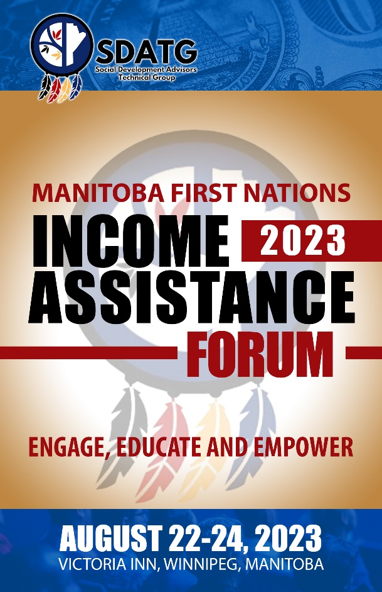
How Manitoba Nations are Responding
Flexible Funding Approaches
Leveraging block and grant funding models to reinvest in Income Assistance enhancements and improve local responsiveness.
Capacity Building for IA Administration
Strengthening administrator capacity through training, onboarding, peer networks, and mentorship.
Policy Advocacy and System Reform
Advancing reforms to better reflect northern and on-reserve realities, including remote allowances, benefit indexing, and recognition of non-traditional employment.
Nation-Led Innovation and Employment
Supporting Nation-driven approaches to employment, social enterprise, and
local economic participation.

Slide 7
What this looks like in Practice in Manitoba
Nation-Led Governance and Coordination
Collaborative table involving IA administrators, leadership, Tribal Councils, and ISC guide policy refinement
and shared problem-solving.
Tribal Council–Based Capacity Support
Hands-on advisory services, training, and peer support ensure smaller and remote Nations can access
technical expertise.
Flexible, Long-Term Funding in Action
Nations operating under New Fiscal Relationships (NFR) can reinvest surpluses, support multi-year planning, and adapt
Income Assistance delivery to local priorities.
Employment and Training Pathways
Income Assistance clients can access Pre-Employment Supports Program (PESP), IAFNYES, local job fairs, life-skills
training, and subsidized placements through Nation- led and employer partnerships.
Standardized Tools Supporting Consistency
Shared policy guides and standardized forms support consistent delivery and onboarding of new administrators.
Nation-Driven Innovations
Food security projects, cultural programming, and youth employment initiatives align Income Assistance delivery
with the Nations values and realities.

Slide 8



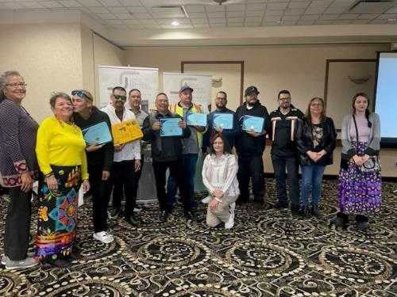
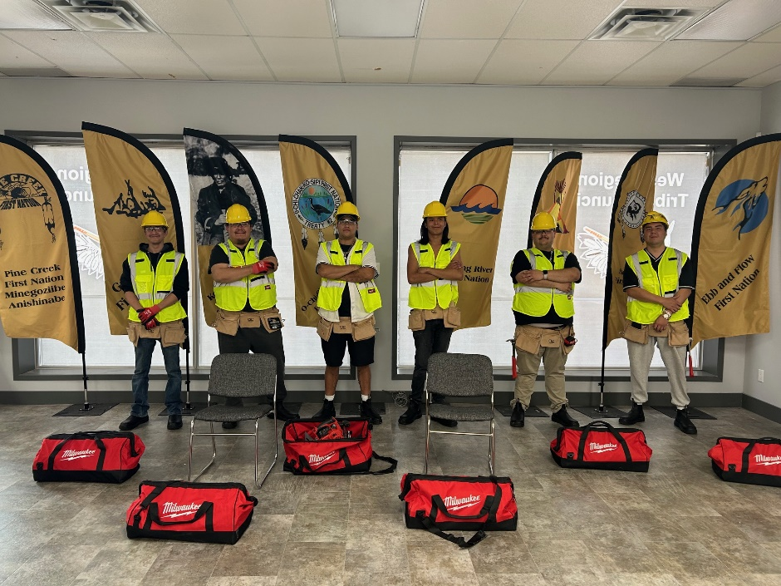

Manitoba’s Key Lessons & Strategic Takeaway
Adapt Programs to People: One size does not fit all. Manitoba’s experience shows the importance of adapting Income Assistance to local context – whether it’s adjusting for remote cost-of-living or integrating cultural practices.
Invest in Youth and Active Measures: Manitoba’s youth-focused pilots (PESP, work mentorship) demonstrate that pro-active investments can pay off. We saw a reduction in IA dependency in the early years of PESP and other employment initiatives. The lesson: by helping clients, especially young people, build skills and find work, the overall demand for income assistance can drop.
Empower Nation Leadership: When Nations have a real say in program design and delivery, programs become more effective and culturally relevant. Manitoba’s model of Nation-delivered IA and ongoing engagement can inspire other jurisdictions. This may lead to more innovative solutions and fosters ownership of outcomes.
Holistic Partnerships Work: Manitoba’s multi-partner approach (federal, provincial, Nation, private) highlights that collaboration boosts success.

Slide 9
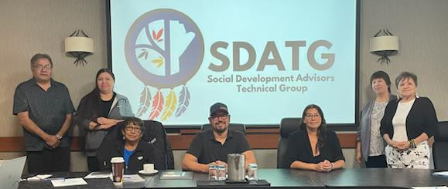





MIIGWETCH/ekosi/ Wopida mahsi cho/THANK YOU
West Region Tribal Council
(WRTC)
Swampy Cree Tribal Council
(SCTC)
Southeast Resource
Development Council
(SERDC)
Interlake Reserves Tribal Council
(IRTC)

