Slide 1
First Nations Health and Emergencies AFN Emergency Management Forum March 5-7, 2024 Gatineau, Quebec
Marlene Larocque
Senior Policy Advisor, Health Sector
Assembly of First Nations

Slide 2
AFN Health Sector
The AFN Health Sector works to advocate for equitable, self-determined health care, and to promote holistic, culturally-based approaches to supporting First Nations wellness.
First Nations Mental Wellness Framework (2015)
Seven Generations Continuum of Care (2021)
First Nations Health Transformation Agenda (2018)
Getting the Relationships Right
Sustainable Investments into Infrastructure
First Nations Capacity First
Notes:
Racism in health is insidious and permeates practice through negative assumptions leading to undignified care and resulting in poor health consequences.
In 2008, Biran Sinclair waited in the ER waiting room in Winnipeg in 2008, he was in wheelchair, diabetic and living in poverty,
Nurses assumed he was inebriated and “let him sleep it off”, he waited 36 hours to be assessed, which was too late
Another example is assuming that First Nations are drug seeking when they go into the ER to manage pain or are inebriated and need a place to sleep it off.
In 2020, we heard of ER health professionals in BC who played a game to guess the blood alcohol level of First Nations patients.
Racism is upheld when there is no accountability from health professionals, regulatory bodies and senior health leadership.

Slide 3
Key File Areas in First Nations Health
Culturally appropriate Care
Mental Health and Wellness
Non-Insured Health Benefits
Accessibility
Indigenous Health Legislation
Seven Generations Continuum of Care
Health Human Resources

Slide 4
First Nations Health Status
Chronic conditions: diabetes, arthritis, circulatory, hypertension, cancers (Comorbidities) / Disabilities-Mobility
Communicable diseases: Tuberculosis, HIV, Hep C, STBBI’s
Addictions and substance misuse: toxic drug crisis
Ongoing intergenerational trauma from unaddressed colonial policies
Gaps in the social determinants of health

Slide 5
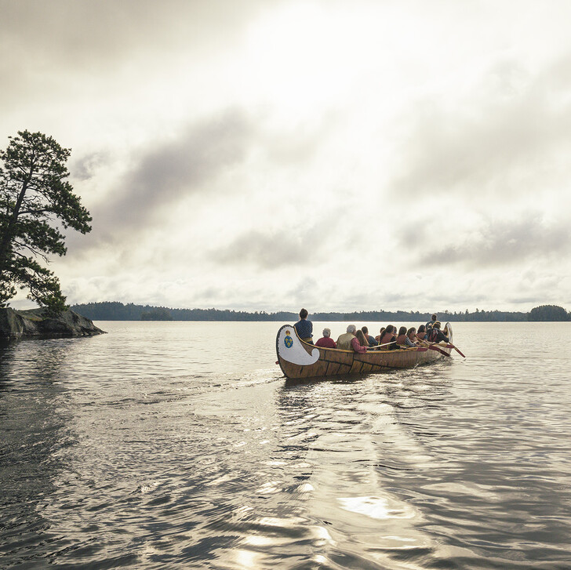
Protective Factors
Ancestral knowledge on foods, lands, waters
Kinship Models and Community Governance
Culture as Foundation
Good Medicines/ Natural Helpers

Slide 6
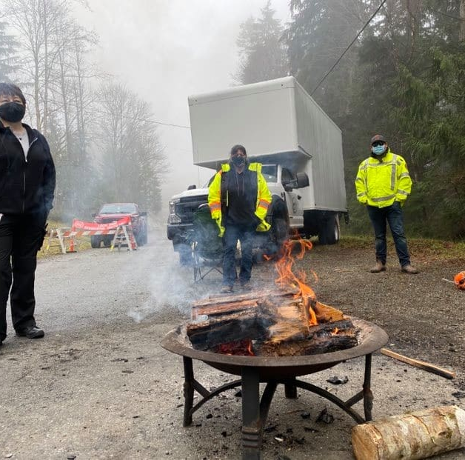
EM is an essential public health function in Canada, defined as the planning for natural or human-made disasters to minimize serious illness and death, and responding to emergencies while minimizing societal disruption.
Emergency Management Continuum
Prevention/mitigation
Preparedness
Response
Recovery

Slide 7
Between 2009-2022, First Nations Communities experienced 1,352 Emergencies
130,000 individuals affected
Source:
https://www.oag-bvg.gc.ca/internet/English/parl_oag_202211_08_e_44154.html#IG

Slide 8
Source: https://www.oag-bvg.gc.ca/internet/English/parl_oag_202211_08_e_44154.html Office of the Auditor General of Canada Emergency Management in First Nations Communities (2022)

Slide 9
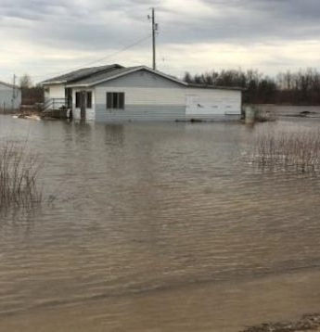
Health Considerations in EM Planning and Implementation
Accessibility: wheelchairs, hearing/vision impaired, language
NIHB: medications, prescriptions, treatments, appointments
Mental Health: substance mis-use, stress, spiritual care
Access to traditional/nutritious foods
Mobility: on/off reserve, children in care

Slide 10
Facilitators of Good EM Practice
Relationships
Administrative
Communications

Slide 11
Social Considerations
Racism
Sexual Exploitation
Predatory Behavior
Financial Burden

Slide 12
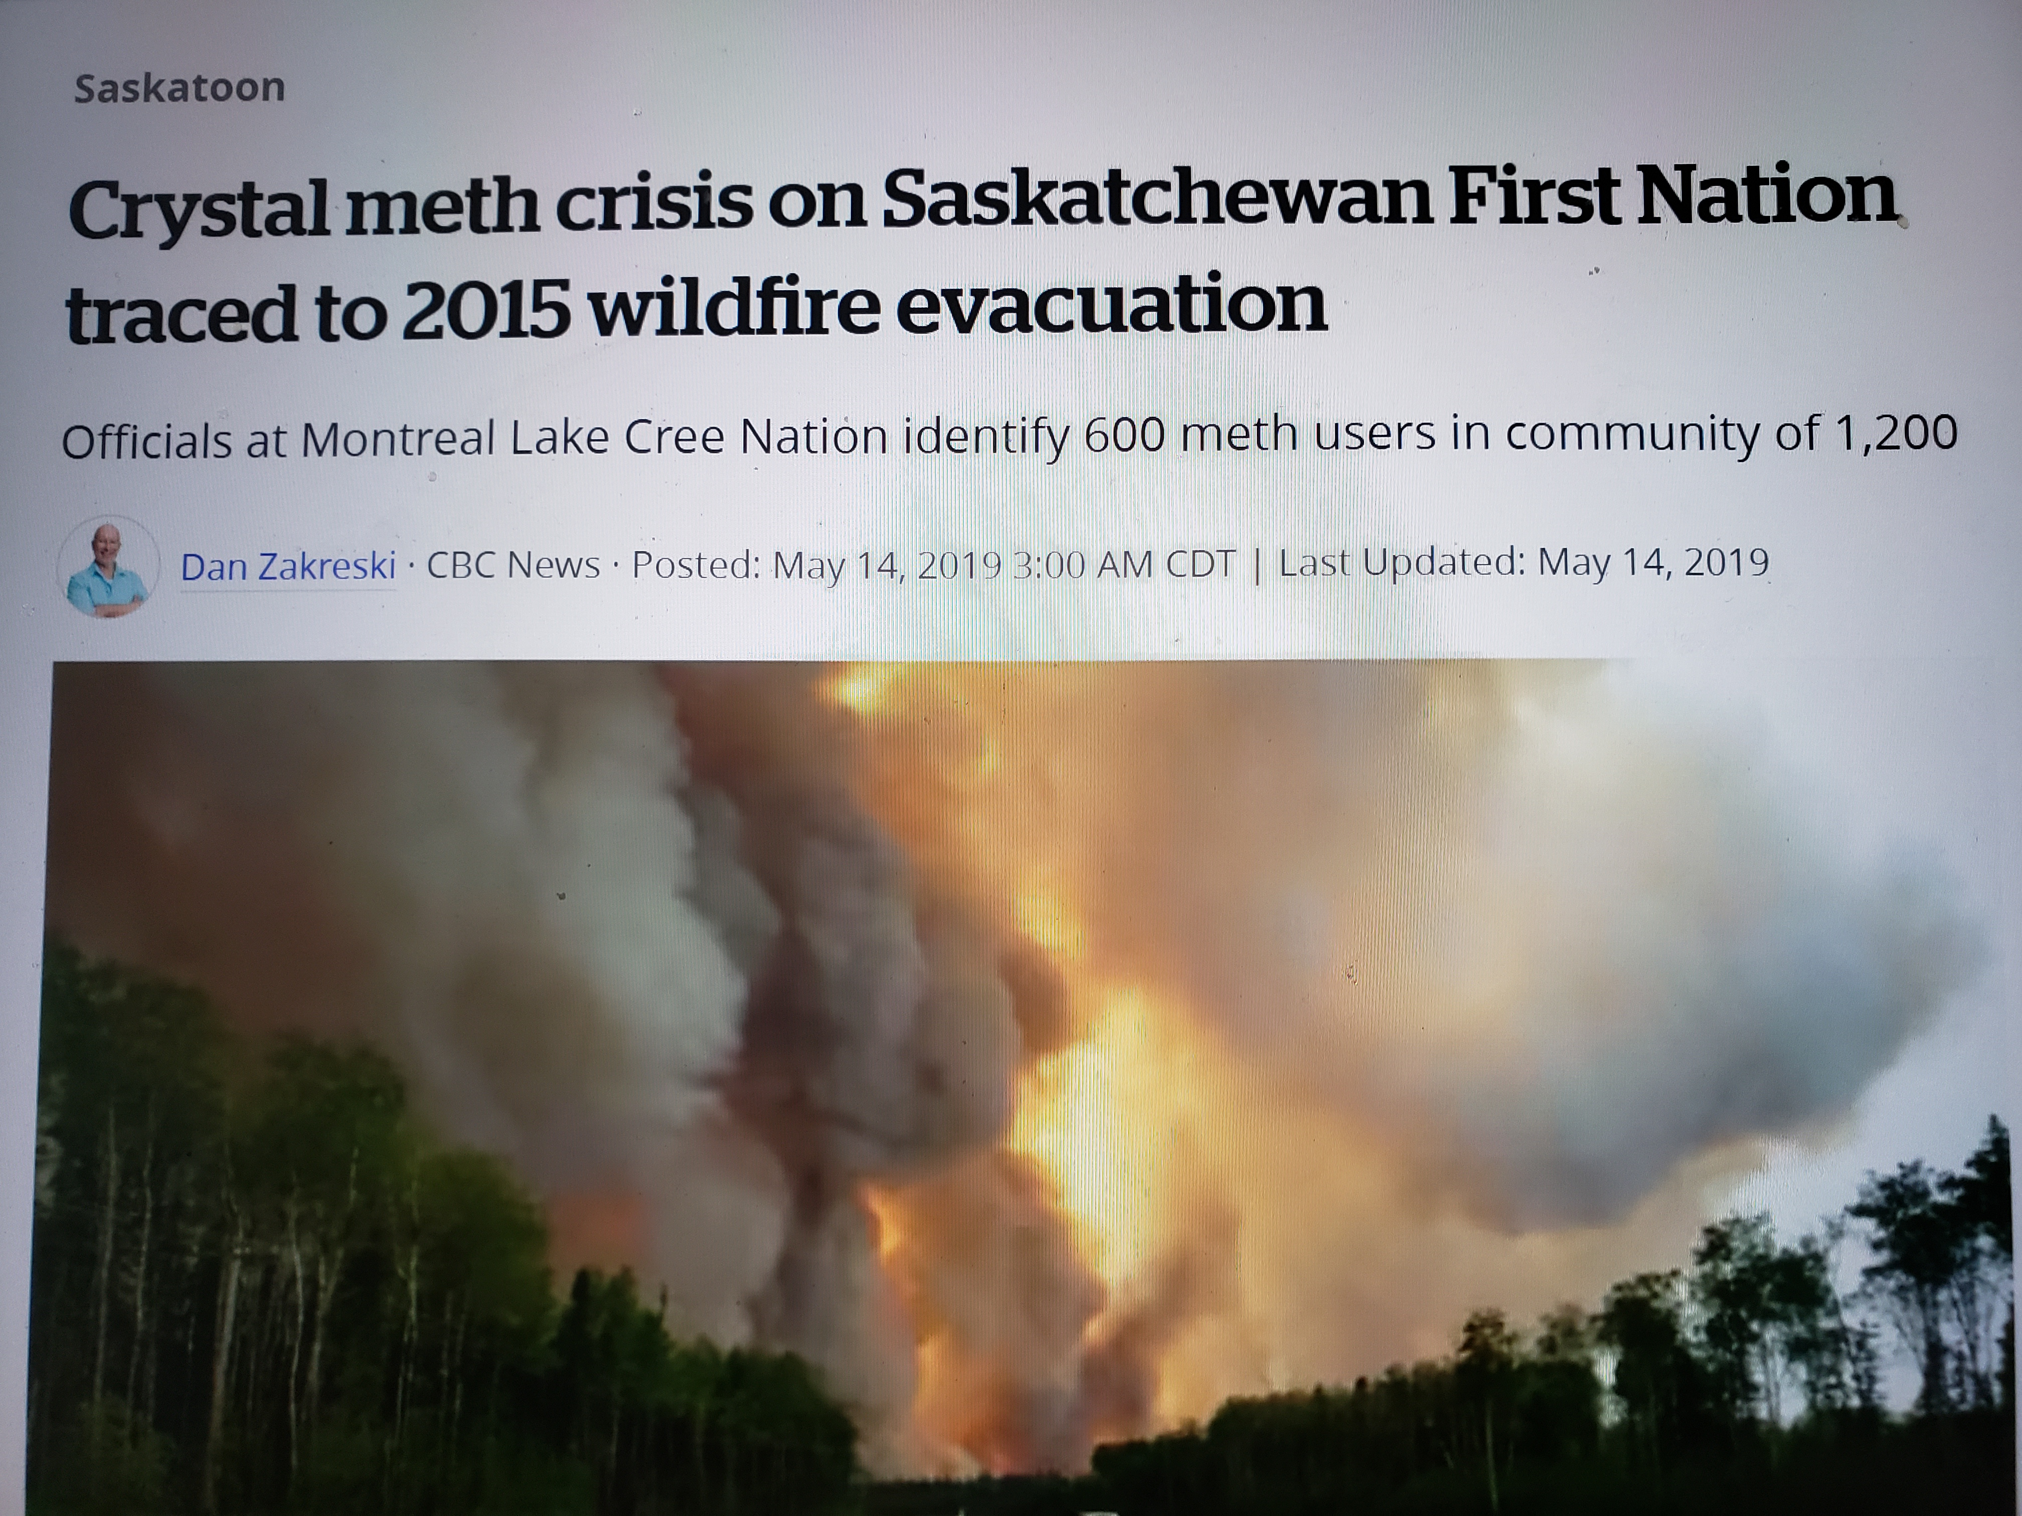
Unintended Consequences
Long-Term Evacuations
Hotel as home
Mental Health of the Workforce
Predatory/Opportunistic threats
Development and Implementation of Community and Personal Safety Plans

Slide 13
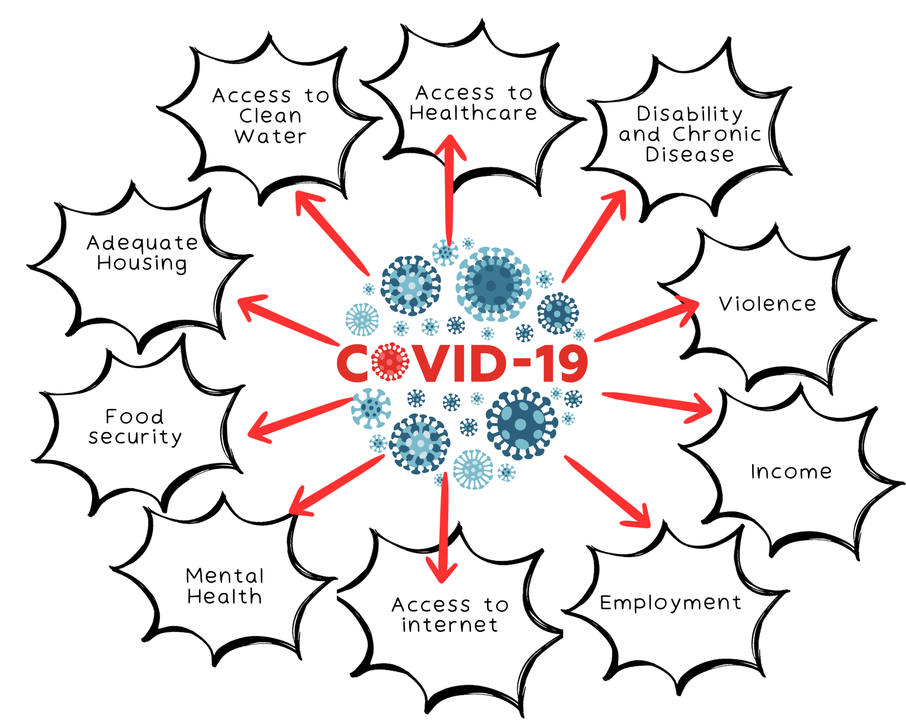
COVID-19 Pandemic
Pandemic Preparedness was tested in real life
Gaps in the Social Determinants of Health= Vulnerability
First Nations jurisdiction
Proposal based funding and reporting burden
Land-based healing/education
Traditional knowledge

Slide 14
Future Considerations
Digital Health Tools
Electronic Medical Records
Technology needs and competencies
Inter-Operability
Health Human Resource Capacity
Surveillance and Data Sovereignty
Reactive > Proactive
Health Impacts of Climate Change
Evaluation and Lessons Learned

Slide 15
Wel’lalin, Meegwich, Mahsi Cho
Marlene Larocque
Senior Policy Advisor, Health Sector
Assembly of First Nations
marlenel@afn.ca

