Slide 1






Honoring the Work,
Modernizing the Tools
Strengthening Income Assistance Delivery
2026 Annual Income Assistance Conference
Assembly of First Nations
Presenter:
Nordeen El Bakkouri
360 Nation Administration Solutions
mynation.app

Slide 2

Land Acknowledgement
We respectfully acknowledge that we are gathered on the traditional and unceded territories of the Musqueam and Tsawwassen First Nations.
We honor the ancestors, Elders, and Knowledge Keepers of this land, and we recognize the ongoing responsibilities to care for the land and to support one another in the work we do today.

Slide 3











The Case Manager at the Center
The Role That Holds the Program Together
01
First point of contact for members
Supports individuals, families, and households
03
02
Balances policy, paperwork, and people
Works across crisis response, transitions, and long-term planning
04

Slide 4






A Program Designed to Mirror the Provinces
How Income Assistance Is Structured
First Nation Income Assistance was designed to mirror provincial programs
Rates, eligibility rules, and policy interpretations align with provinces
Intended to support consistency between on- and off-reserve delivery
Delivery contexts differ, even when policy is shared
Effective delivery requires tools that reflect on-reserve realities

Slide 5


The Size of the Job
On-Reserve (First Nation)
On reserve, Income Assistance is often delivered by one case manager. This role commonly includes intake, eligibility assessment, policy interpretation, decision-making, file management, client follow-up, reporting and statistics, and liaison with leadership and external programs.
Off-Reserve (Provincial Systems)
Off reserve, the same program rules are supported by multiple dedicated roles, including case managers, policy analysts, supervisors, and administrative staff. Responsibilities are distributed across people and systems rather than concentrated in a single role.
Note: This comparison focuses on scope of responsibility and structure — not pay scales.

Slide 6



  Data Management Tools
On-Reserve (First Nation Offices)
  On reserve, data is often managed with limited or fragmented tools. Case managers may rely on spreadsheets, paper files, or basic databases, resulting in manual reporting, duplicate data entry, and increased administrative workload.
Off-Reserve (Provincial Systems)
Off reserve, Income Assistance delivery is supported by centralized, integrated case management platforms. These systems support reporting and audits, reduce manual handling, and are maintained by dedicated IT teams.

Slide 7





Members and Case Managers Come First
Why Data Matters — In Service of People
  The well-being of members and case managers is the priority
  Trust, understanding, and meaningful interaction come first
  Data supports — but does not replace — human relationships
  When data is captured once and used well, it:
    Reduces administrative burden
    Improves consistency and clarity
    Supports timely decisions and follow-up
Strong data practices exist to support people — not the other way around

Slide 8


INTRODUCING 360 NATION ADMINISTRATION SOLUTIONS

Slide 9

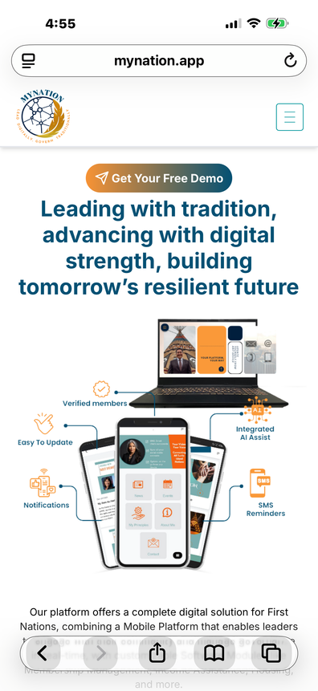

Technology to Empower Your Team
  Built specifically for on-reserve program realities
  Developed with ongoing input from day-to-day users
  Designed to support:
    Income Assistance
    Case management
    Reporting and compliance
    Leadership decision-making
  First Nations–focused administrative and data solutions
Mynation.app

Slide 10




  Refocusing Time Where It Matters
Our Design
Focus
What This
Enables
Our Design Focus
Our Design Focus
  Reduce routine and repetitive administrative tasks
  Minimize manual calculations and duplicate entry
  Automate reporting and statistics
  Use guided processes to support policy compliance
  More time spent with clients
  Better understanding of individual circumstances
  Stronger case planning and follow-up
  Technology supports the case worker — not the other way around

Slide 11





FROM APPLICATION TO REPORTING
WHAT CASE MANAGERS DO
WHAT 360 DOES
  Meet with clients and review applications
  Assess and reassess eligibility
  Make benefit decisions
  Apply policy and professional judgment
  Support clients as circumstances change
  Guides workflows to align with policy requirements
  Handles calculations and validations in the background
  Generates DCI and statistical reports automatically
  Reduces duplicate data entry
  Supports consistency and compliance

Slide 12
Adding the Missing Pieces
  Moves beyond eligibility toward understanding the person
  Introduces a social factors assessment
  Uses AI-assisted case planning to support:
    Individualized pathways
    Training and employment readiness
    Referrals to appropriate supports
  Strengthens continuity and follow-up
  Complements Income Assistance delivery without changing policy rules
A Client-Centered Approach to Income Assistance Delivery

Slide 13


Asking Questions in Plain Language
Ask questions using natural language
Receive immediate answers from program data
No report building or spreadsheet exports required
Supports day-to-day operations and leadership questions
Turns data into usable information
Data remains First Nation–controlled

Slide 14

Thank you.
MYNATION.APP

