Slide 1
Developing an Emergency Program Coordinator
Marc D'Aquino
Emergency Management Educator and Response Specialist/President
Cell# 604.816.1994
Office Main# 778.225.0500
marc@holisticepr.com
Holistic Emergency
Preparedness & Response
Notes:
Open with:
See challenges – Are these positions successful in communities?
The information that we are sharing with you today is from the perspective of “trainers” on the ground developing programs in communities.
Growth not occurring in your EM program?
Can't keep the position filled??
The information we will share today will help your program succeed.

Slide 2
EPC vs ERC
Emergency Program Coordinator(EPC) vs Emergency Response Coordinator(ERC)
Emergency Program Coordinator Includes 4 Pillars;
Mitigation, Preparedness, Response & Recovery
Notes:
Creates Challenges as community position focuses on too much on response.
50% Should be spent on Mitigation and Preparedness and 40% on recovery, response really should be the smallest portion.

Slide 3
Community/Leadership Involvement
- Creating buy-in among community and leadership
- Big picture understanding
- Community and staff support
Holistic Emergency
Preparedness & Response
Notes:
- Getting community leadership on board
- ensuring they understand the big endeavour ahead
- To be successful in creating this role there needs to be support for community and staff

Slide 4
Emergency Program Coordinator (EPC) Within the Organizational Structure
- Develop a fit within your organizational chart that supports the role
- Create a space that encourages the EPC to step into a leadership role
- Foster a position that earns respect and commitment from other departments
- Establish who the EPC will report to
Holistic Emergency
Preparedness & Response
Notes:
-Develop the fit within your organization structure
-Position cannot be under a manager, they must be the same level as a manager (provide sample org charts/structures) - think fire chief
-ensures better commitment from other departments
-needs to be position that gets respect
-who do they report to?

Slide 5
Administrator/Chief Administration Officer(CAO)
Lands
Manager
Housing
Manager
Capital and Public Work Manager
Finance
Manager
Health
Manager
Fire
Chief
Emergency Program Coordinator(EPC)
Notes:
This Org chart sample does not promote success, EPC’s must be at management table, involved in community planning, strategic planning and program development.
Needs to a culture around emergency management that all things and new endeavours bring a level of risk.

Slide 6
Administrator/Chief Administration Officer(CAO)
Lands
Manager
Housing
Manager
Capital and Public Work Manager
Fire
Chief
Emergency Program Coordinator(EPC)
Finance
Manager
Health
Manager
Notes:
Provide Handout # 1
All At the same level promotes a stronger relationship between EPC and Managers and will have better commitment from departments.
Explain training and staff requirements t be included in everyone's job descriptions.

Slide 7
Creating a Job Description
- Identify roles and responsibilities
- Inclusive of the 4 pillars of Emergency Management
Mitigation, Preparedness, Response & Recovery
- Outline education/training requirements
- Performance review including clearly defined indicators of success
4 Pillars of EM
Mitigation
Preparedness
Response
Recovery
Holistic Emergency
Preparedness & Response
Notes:
See Student handout # 2
-development of the job description - roles and responsibilities - Implement activities/exercises in community
- Create/Develop EM committee or team
- develop programs
-needs to be inclusive of all aspects of EM (4 pillars)
-needs to include education from community level and household level all the way up to staff minimum training requirements
-clearly defined performance indicators
-review process (3 month, 6 month, 1 year)
-incorporate process to evaluate the success (may need to be separate slide)

Slide 8
Hiring Committee/Interview Panel
- Develop key questions that highlight community values
- Refer to subject matter experts, agencies and community members to create interview questions
- Create a panel of personnel that balances community needs/focus
- Utilize a scoring system for interviewing
Holistic Emergency
Preparedness & Response
Notes:
Reference Handout #4
-Develop a hiring committee/interview panel, utilize professionals from field.
-as part of this process Develop a scoring system for interviews – Transparent especially when hiring local
-Develop a series of interview questions (utilize other agencies and subject matter experts to help develop key questions that factor in the values of your community)
- The more time you spend on this process the better candidate you will get!!

Slide 9
Building the Role
- Determine the needs of the role
- Internal vs external hire
- Skilled vs unskilled
- Community member vs non community member
Are we building from the ground up?
Holistic Emergency
Preparedness & Response
Notes:
- determine if you're hiring internal or external and whether they are skilled or unskilled, highly qualified or in need of immediate training.
- Are building from ground up?
This is important as budgets are not endless and we need to be aware of limitations and insure if the candidate doesn’t have the skills that we provide the training

Slide 10
EPC Training Plan
- Develop a long term and short-term training plan
- Requires a certificate or diploma program to be completed over two years
- Professional development plan should include, but not limited to:
Emergency Management
Organizational leadership
Public Speaking
Program Management Training
Holistic Emergency
Preparedness & Response
Notes:
-developing internal position long term/ short term training plan
-needs to include a certificate or diploma program to be completed over two years
-should include leadership, public speaking, program management training

Slide 11
New Emergency Program Coordinator - Education Courses - Year 1
Self-Study | Hours | Credits | Approx Study time | Cost
Justice Institute of BC (JIBC) Intro to EM in Canada | 7 | 0.5 | 2 | 59.00
JIBC ICS 100 | 7 | 0.5 | 2 | 59.00
JIBC Intro to EOC | 7 | 0.5 | 2 | 59.00
Totals | 21 |  | 6 | 177.00
Certificate in EM (JIBC)
HRVA | 14 | 1 | 3 | 390.00
Dev. Em Program | 7 | 0.5 | 2 | 260.00
Community Recovery | 14 | 1 | 3 | 440.00
Community Evac | 7 | 0.5 | 2 | 260.00
Develop EM Plans | 14 | 1 | 3 | 450.00
Psychosocial in Disasters | 7 | 0.5 | 2 | 260.00
Into to Ex Design | 14 | 1 | 3 | 445.00
Intro to BC | 14 | 1 | 3 | 390.00
EOC Essentials | 14 | 1 | 3 | 445.00
Info Officer | 14 | 1 | 3 | 475.00
3x Electives | 28 | 3 | 6 | 1,686.00
EM Final Capstone | 28 | 2 | 6 | 400.00
Certificate in EM Totals | 175 | 15 | 39 | 5,901.00
JIBC-all foundational, 12 core credits, 3 elective credits
Extra | Hours | Credits | Approx Study time | Cost
First Aid and CPR C | 14 | 0 | 5 | 250.00
Computer(Word/excel/PP etc.) | 22 | 3 | 8 | 1,285.00
HazMat Awareness | 7 | 0 | 2 | 60.00
Swiftwater Awareness | 7 | 0 | 2 | 100.00
S100 | 7 | 0 | 2 | 100.00
Pleasure Craft Operator | 6 | 0 | 1 | 50.00
Mastering Public Speaking | 24 | 0 | 8 | 150.00
Totals | 87 | 3 | 28 | 1,995.00
On-The-Job (OJT) - Job Shadowing or Coach
Radio | 4 | 0 | 2 | 216.00
Survival | 8 | 0 | 2 | 360.00
COVID | 1 | 0 | 1 | 72.00
inReach/Satphone | 8 | 0 | 1 | 324.00
EOC Kits | 4 | 0 | 2 | 144.00
Policies (WS/Unsafe work/alone/Pri etc. | 4 | 0 | 2 | 144.00
Vehicle (safety/tire change/tire type) | 4 | 0 | 4 | 144.00
Travel to Communities - Response Support Apprentiship Portion | 96 | 0 | 6 | 3,672.00
Totals | 129 |  |  | 5,076.00
 | Hours | Credits | Approx Study time | Cost
Course Cost - Total |  | 18 | 73 | $8,073
Labour Cost - Total | 412 |  |  | $14,832.00
1 Year EPC Training Total Cost |  |  |  | $22,905.00

Slide 12
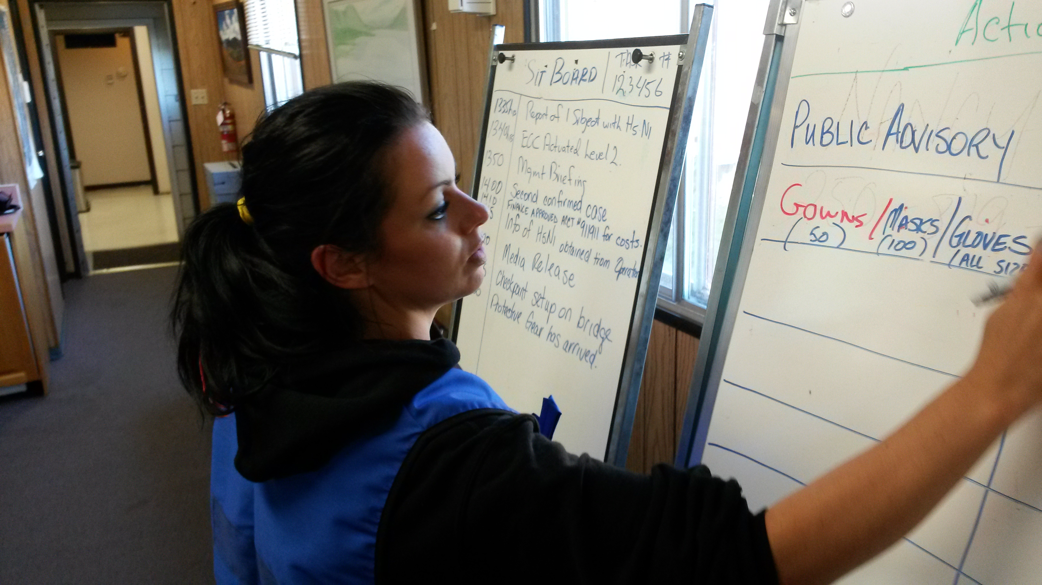
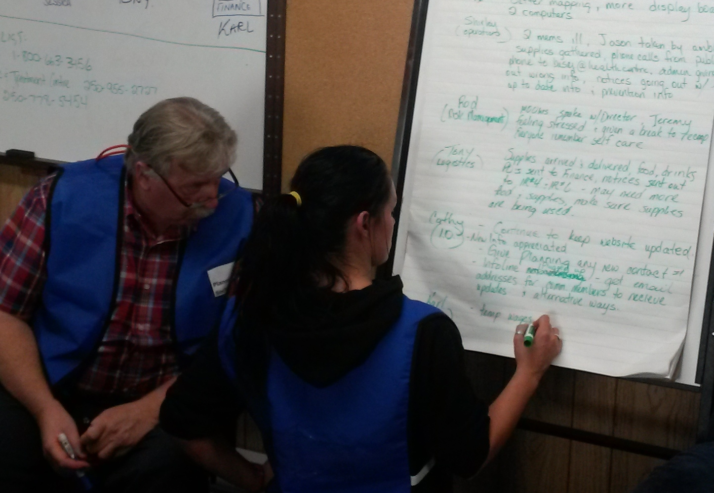
Support Professional Growth Through Experience
How do we get new coordinators to gain hands on experience?
- Practical experience goes hand in hand with training
- Uphold to similar standards of apprenticing professional trades
- Train locally and out of region with coaches/mentors
- Job shadowing and on the job training
- Apprentice through other emergency management organizations
- Attend all regional training exercises with neighboring communities and agencies
This is where partnerships become key
Holistic Emergency
Preparedness & Response
Notes:
-got the training now need the experience
-needs to include practical experience
-should be looked upon as similar trades like electrician or plumber to apprentice
-local and out of region deployments with a coach or mentor
-where partnerships become key
-how do we get new coordinator to gain hands on experience? (Work share or job shadowing at response agency)
-partnership with a sister community out of region that has successful development program
-no classroom skills are good without being able to apply (they will be lost)
-attending any and all regional exercises with neighbour's and agencies

Slide 13
Conclusion
Need to set the position up to succeed;
Must have community leadership commitment and support!
Development of position must not be taken lightly!
Select the best candidate that fits your communities needs!
Development of community emergency program will depend greatly on the success of this position!
Holistic Emergency
Preparedness & Response

Slide 14
Questions?
Marc D'Aquino
Emergency Management Educator and Response Specialist/President
Cell# 604.816.1994
Office Main# 778.225.0500
marc@holisticepr.com

